Slide 1

Assembly Audit Training
Former Master Francesco Iannaggi

Slide 2

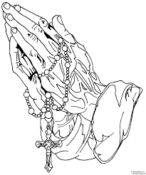


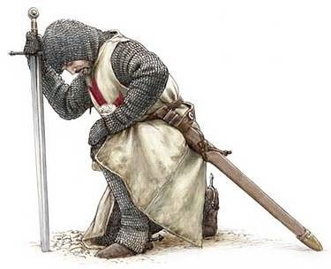
Opening Prayer

Slide 3

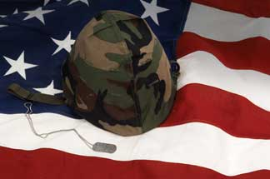


Pledge of Allegiance

Slide 4


The Assembly Audit
Be Not
Afraid

Slide 5
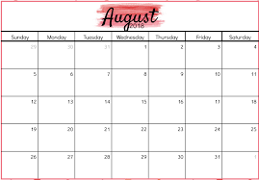
The Assembly Audit
Due Annually ( yes, just once every year)
Due to the Supreme Office on or before 1 August each year
Covers Fraternal Year (July 1, XXXX to June 30, (XXXX+1))
Must be signed in person – no electronic signatures

Slide 6
The Assembly Audit
Who does the annual Audit of the Assembly books?
The Purser? He pays the bills…
The Comptroller? He controls the incoming and outgoing funds…
The Navigator? He runs the show overseeing everything…
NOPE! All Three? NOPE! Then WHO???
Let’s check with Supreme…

Slide 7
The Assembly Audit
ARTICLE VIII ASSEMBLY OFFICERS AND DUTIES
Section 23.
Officers of the Assembly.
Board of Trustees:
The Board of Trustees shall consist of the Faithful Navigator and three members to be elected by the assembly. The Faithful Navigator shall be its Chairman. At the first election of a new assembly three Trustees shall be elected; one to hold office for one year or until the second next regular election, one for two years or until the second next regular election; and the other for three years or until the third next regular election; as determined by lot among themselves. Thereafter, at each succeeding election one Trustee shall be chosen for a term of three years.

Slide 8
The Assembly Audit
The Trustees shall have supervision of all the financial business of the assembly and their approval shall be necessary for the payment of all moneys, except demands of the Supreme Council, initiation fees due the District Master, regular and usual payments of the assembly, and payments authorized by the assembly after resolution and vote in accordance with Section 24(k). They shall audit the accounts of the Comptroller and Purser annually as of June 30 and report thereon to their assembly, the Supreme Secretary, Supreme Master, Vice Supreme Master, and Master upon blanks approved by the Board of Directors and furnished by the Supreme Assembly. They shall see that the Faithful Comptroller and Faithful Purser give proper bonds running to the Knights of Columbus in trust for their particular assembly and in amounts fixed by said Trustees, and they shall be the custodians of such bonds. But incase the Board of Directors shall bond such officers, the Trustees shall be charged only with fixing the amount of such bonds in excess of the amount provided for by said Board of Directors and in such case they shall have evidence that said officers shall have been bonded in such excess amount. They shall perform such other duties as their assembly or the District Master or Vice Supreme Master or the officers of the Order may direct.

Slide 9

The Assembly Audit
So the Board of Trustees completes the annual Assembly Audit
How???

Slide 10
The Assembly Audit
From the Faithful Comptroller the Board of Trustees receives during the first week of July:
  The membership transactions for the previous Fraternal Year
  The Vouchers for all Financial Transactions of the previous Fraternal Year
  A list of Brothers who owe dues and the amount owed
  A copy of any documentation concerning outstanding obligations
  A copy of any investments owned by the Assembly

Slide 11
The Assembly Audit
From the Faithful Purser the Board of Trustees receives during the first week of July:
  The Vouchers for all Financial Transactions by the Assembly
  A copy of all Bank Statements for the previous year
  The Check Register for the Assembly
  A statement showing any and all cash on hand
  A copy of all receipts for expenditures (especially if Assembly uses a bank card)
  A statement of any “special funds/accounts”

Slide 12
The Assembly Audit
From the Faithful Scribe the Board of Trustees receives during the first week of July:
  The Official Minutes of the Assembly for the previous year
From the Faithful Navigator the Board of Trustees receives during the first week of July:
  A statement showing the number of members for whom he has waved dues and the amount waved

Slide 13
The Assembly Audit
Step 1 – Reconciliation & Justification
Trustees verify each transaction insuring for every deposit and withdrawal there is a voucher
Trustees verify for each dispersement of Assembly funds and that said expenditure was approved and recorded in the Assembly minutes
Trustees reconcile each bank statement with Assembly checkbook

Slide 14
The Assembly Audit
Step 2 - Organize and consolidate – preparing for Schedule A, B, and C
  Gather membership information in two Groups Additions and Deductions
  Group all income together and all disbursements together
  Classify within the two groups
  List all Assets
  List all liabilities

Slide 15

The Assembly Audit
Putting it all together:

Slide 16
The Assembly Audit
The Header:
Enter your Assembly Number
Enter the “Official” City of the Assembly
Enter the Assembly’s State of Record

Slide 17
The Assembly Audit
Schedule A – Membership
Additions:
1. Show the Assembly Official Membership as of July 1 of the Audit year
2. List the number of new Sir Knights exemplified during the Audit year
3. List the number of Sir Knights restored during the Audit year
4. List the number of transfers in
5. List all others additions (Typically zero )

Slide 18
The Assembly Audit
Schedule A – Membership
Deductions:
Show the number of Suspensions
Show the number of Withdrawals
List the number of Deaths
List the number of Transfers out

Slide 19
The Assembly Audit
Schedule A – Membership
Completing Section A:
Add the number of Additions and to the total; number of members at the start of the Audit year and enter
Add the number of Deductions and enter in both columns
Subtract the Deductions from the total Additions and members at start of the period
OR if the Assembly uses Member Management --- Just check the box

Slide 20
The Assembly Audit
Schedule B: - Cash Transactions (a misnomer actually ALL financial transactions)

Slide 21
The Assembly Audit
Schedule B: Faithful Comptroller
From the data collected above enter income under the Faithful Comptroller
(Cash on Hand should always be $0.00)
Total cash/checks received and amount transferred to the Purser should be the same

Slide 22
The Assembly Audit
Schedule B: - Faithful Purser
From the data above complete Cash on Hand (this is the starting balance in the Checkbook) enter banking Transfers and interest and investment income. Then add to obtain the total Income (receipts)

Slide 23
The Assembly Audit
Schedule B: - Disbursements:
Expenses of Delegates should be $0.00
From the data gathered above enter the disbursements and transfers to investment accounts
Miscellaneous should be $0.00
Total the disbursements and record
Subtract the Disbursements from the Total Receipts to obtain the net balance on hand

Slide 24
The Assembly Audit
Schedule C - Assets and Liabilities

Slide 25
The Assembly Audit
Schedule C - Assets and Liabilities

Slide 26
The Assembly Audit
Schedule C - Assets
Cash: Undeposited Funds should be $0.00
List amounts in Bank accounts
Show amount of Dues owed from the number of members owing dues
Add the assets:
Leave Liabilities blank for now
Show values of any owned furniture, stocks, bonds and other investments

Slide 27
The Assembly Audit
Schedule C - Liabilities
List moneys due to Supreme for Supplies and other items
List monies due to the Master for the District
List any Advanced Dues paid
And any other liabilities
Add the total Liabilities

Slide 28
The Assembly Audit
Schedule C - Assets and Liabilities
Insert the total amount of Liabilities under total current assets and then subtract

Slide 29
The Assembly Audit
Schedule C - Assets and Liabilities
Add Net Current Assets to Net Investment Assets to obtain the total Assets

Slide 30
The Assembly Audit
Schedule C – Signing the Audit
Date and sign the Audit
The Faithful Navigator MUST sign the Audit as well as at least two of the Three Trustees

Slide 31
The Assembly Audit
Make three copies the completed Audit
  Send the Original Audit to the Supreme Master
  Send the first copy to the Vice Supreme Master
  Send the second copy to the Master for the District
  Retain the third copy for the Assembly Files

Slide 32
Learn how to do a proper audit and then do it correctly
Don’t be a
Post Turtle

Slide 33
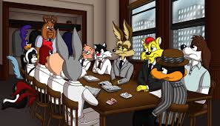
?Questions?

