Slide 1

Assembly Member Billing for
Faithful comptrollers
Session 3

Slide 2
Assessing
Membership Dues
You can not access membership dues until 60 days before the beginning of the next year
For Fraternal Year Jul 1 to June 30 - May 1st is the earliest you can assess dues.
For Annual Year Jan 1 to Dec 31 – Nov 1st is the earliest you can asses dues

Slide 3
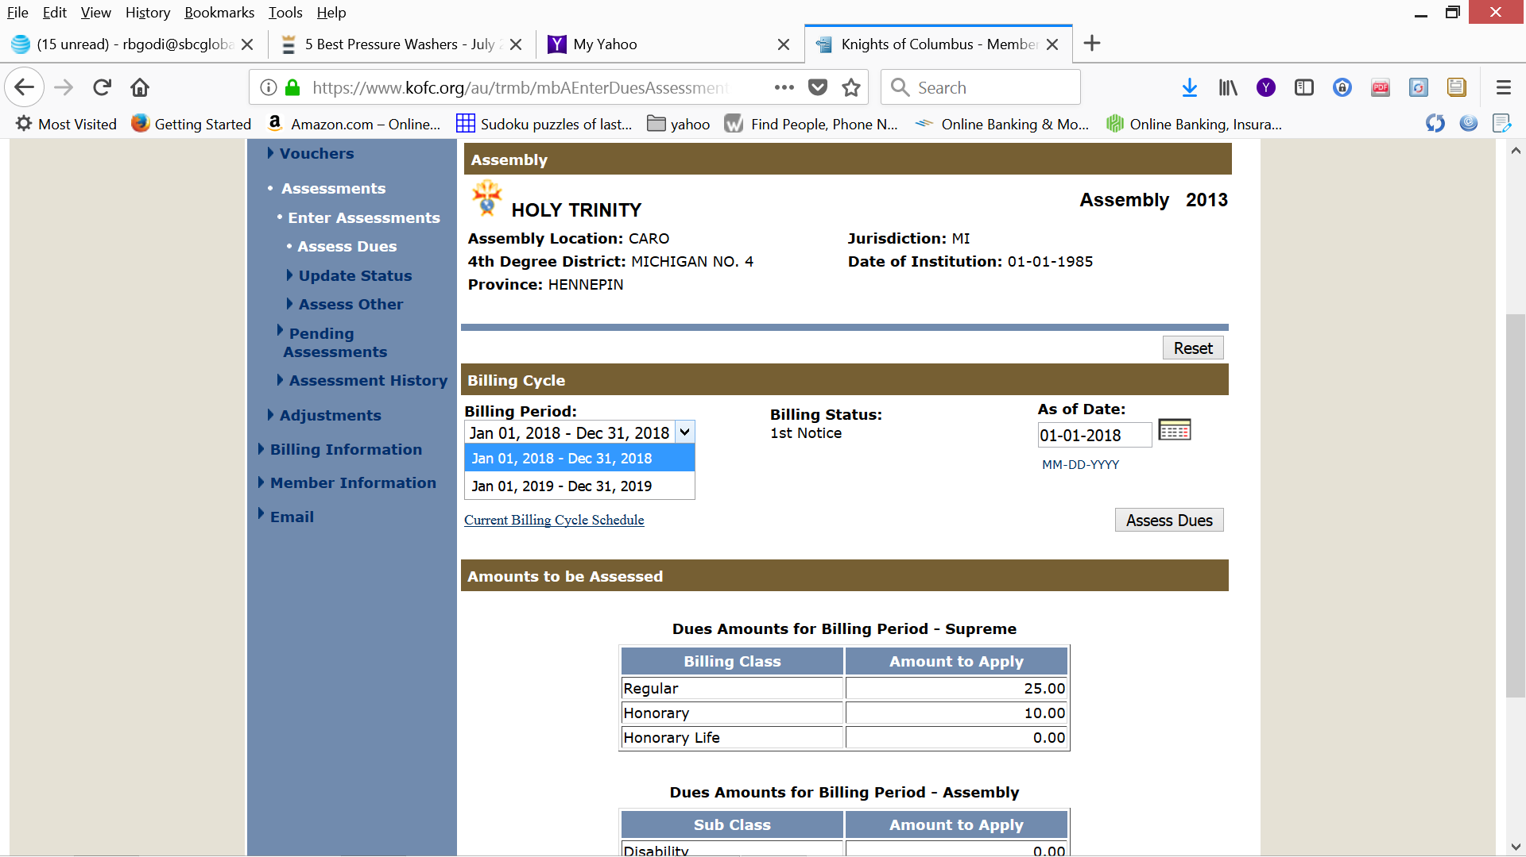
From the drop down menu select Jan 01,2019 – Dec 31, 2019

Slide 4
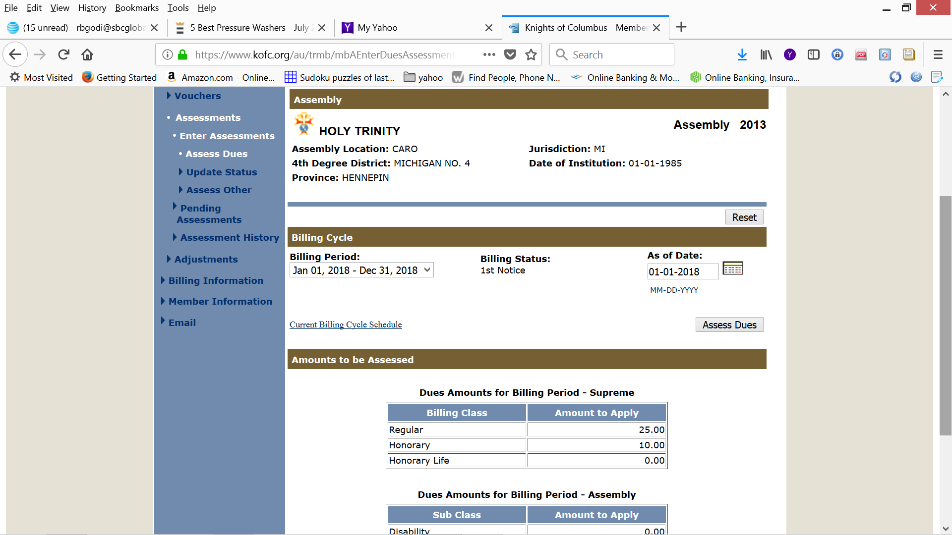
Be Sure that the “As of Date” matches “Billing Period”
When you Assess Dues they will be posted to Pending Assessments

Slide 5
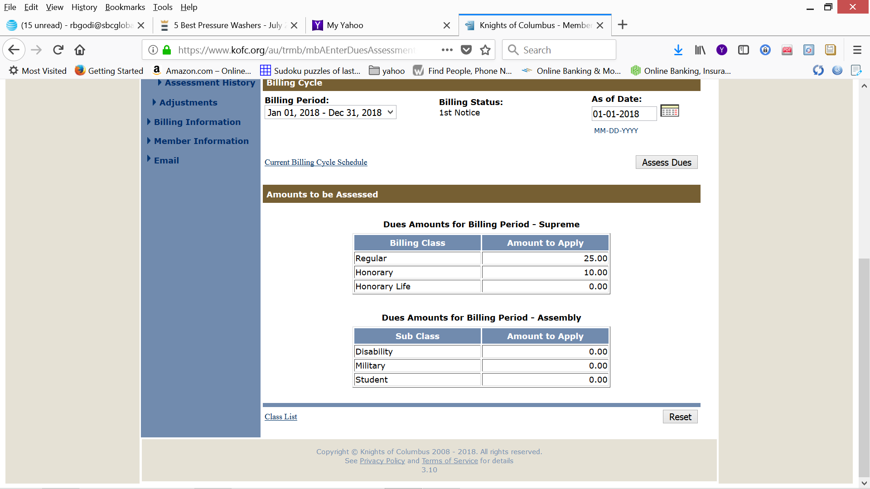
Lower half of “Enter Dues Assessment” page

Slide 6
Assess Other
There two types of Assessments
Mandatory – Can not be Forgiven
Voluntary – Can be Forgiven
Holy Cross Children’s Services
Or another charity your assembly supports

Slide 7
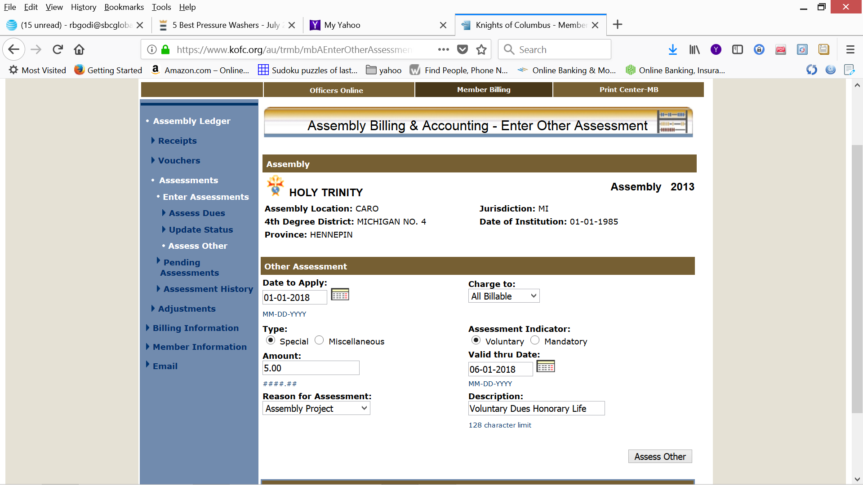
We have filled in Date to Apply, Charge to, Type & Assessment Indicator, Amount, Valid thru Date, Reason for Assessment and Description. When we “Assess Other” it will be posted to “Pending Assessments”

Slide 8
After we have added all our “Assess Other” accounts.
We will open “Pending Assessments” just as we did with “Pending Receipts” & “Pending Voucher”. We will then “Process” the “Pending Assessments”.
After “Pending Assessment” have been posted. We will go to the “Print Center” to generate our Member Statements.
Remember to Process the “Pending Assessments” can only be done November 1 thru December 31 for ANNUAL YEAR DUES and May 1 thru June 30 for FRATERNAL YEAR DUES.

Slide 9
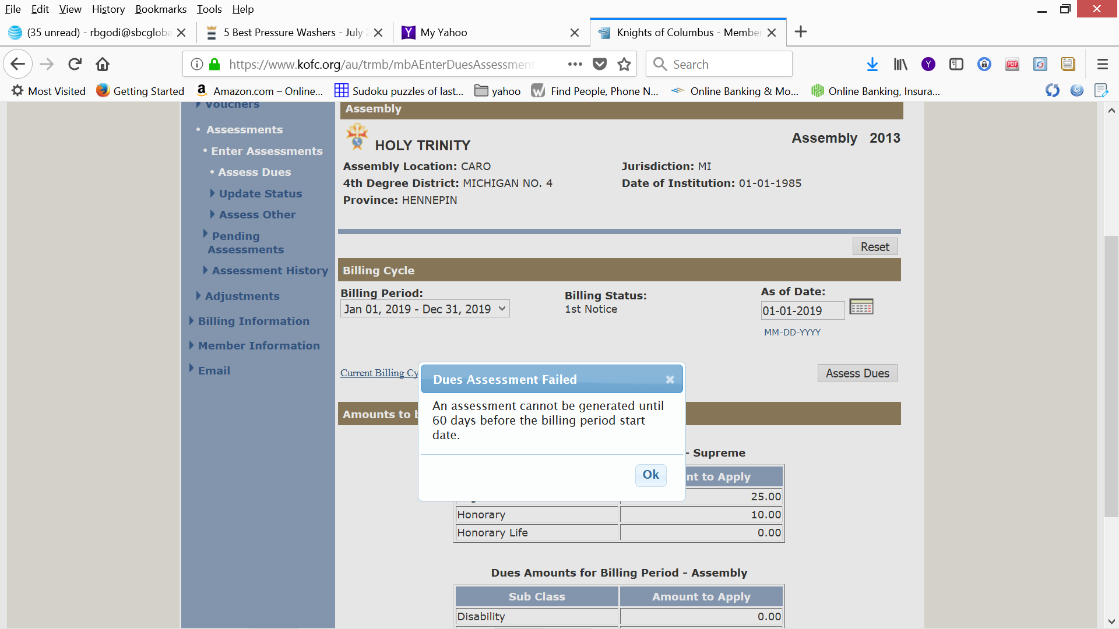
If you are trying to assess “Dues” before November 1 for the next years dues you will get a flag.

Slide 10
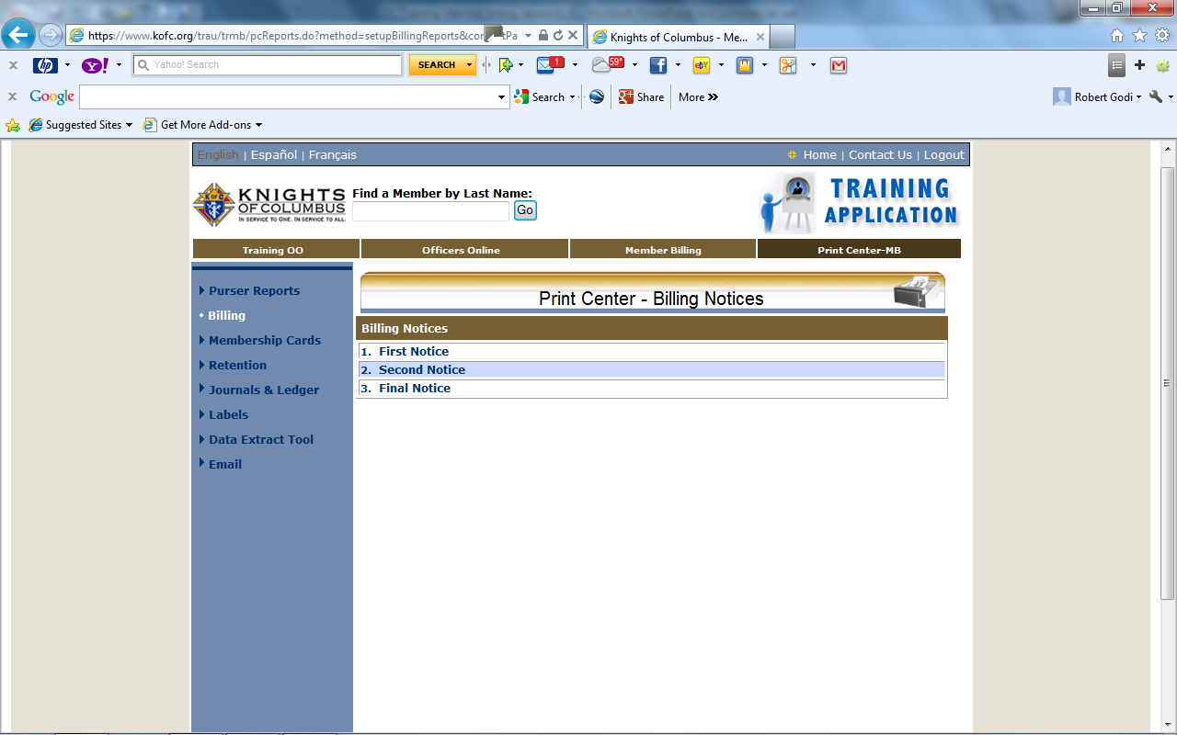
We have Clicked the “Billing” link
the “First & Second Notice” may be Emailed
“Final Notice” must be Mailed

Slide 11
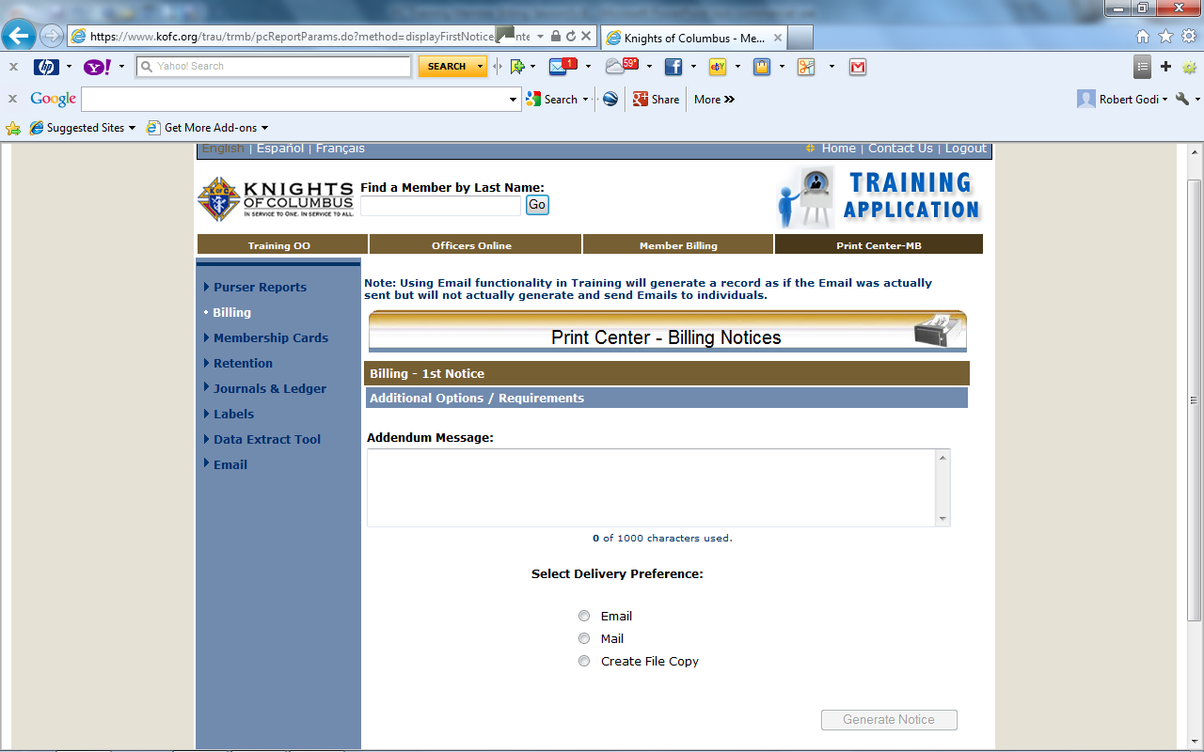
Within this area we can add additional messages to the Statement. These messages will be added to all Statements
Member Delivery Preference :
  + Email – notice will go as Email only
  + Mail – notice will be generated in PDF to be mailed
  + Both – will generate an Email (when sent) and will generate a PDF for mail option to be mailed
You may need to Generate “Email” & “Mail” Notices. Always “Create File Copy”

Slide 12
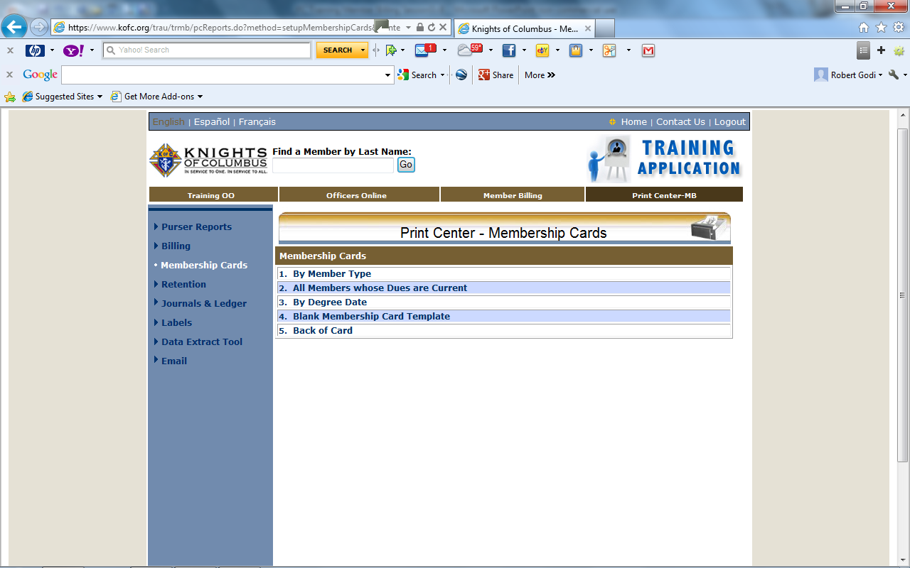
Choose how you want to print “Membership Cards”
I prefer to Print “By Member Type”
Do you print the back of the Membership Card?

Slide 13
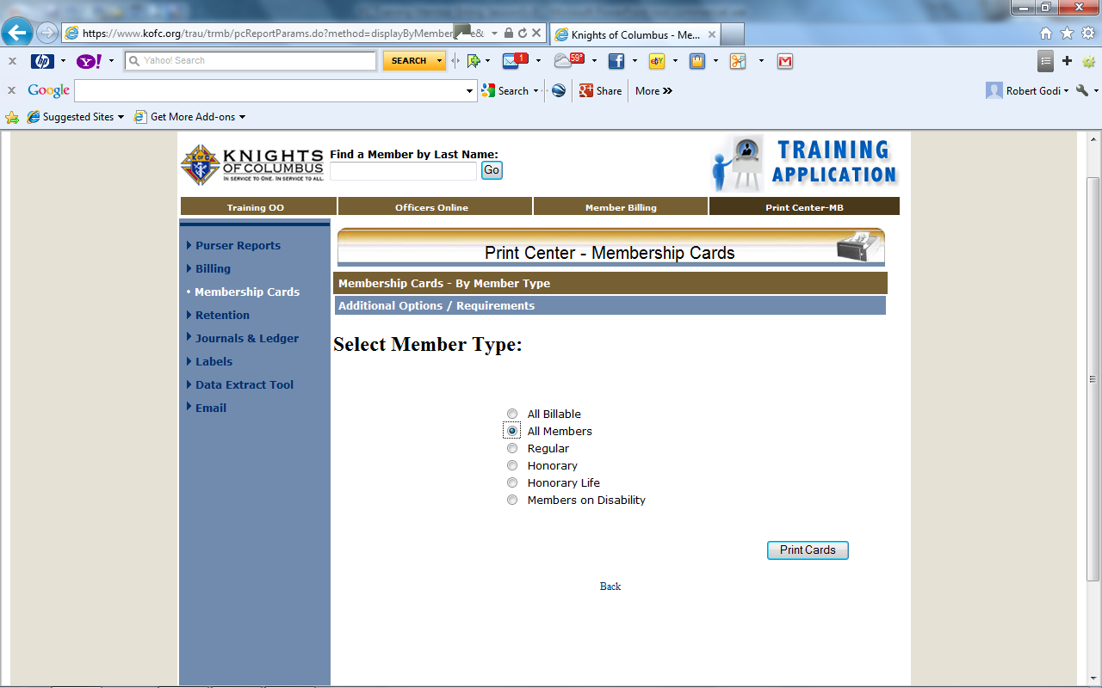
You can try different formats with the “Training Data Base” until you find the format that will work best for you and your assembly.
I prefer to Print “All Members”
When you select “Print Cards” a PDF file will be Generated.

Slide 14
Membership Cards
Please Note:
The “Dues Paid To” date that is displayed when generating Membership Cards will change to December 31, 2019 when a Dues Assessment is generated and processed through the Assessment section of Member Billing.
Membership Cards:
To print Membership Cards properly on the respective Membership Card paper (Council - #4817; Assembly #4818):
Generate the Adobe file (clicking on the label name will do this).
Click on the print icon within the Adobe window.
When the Print window “Dialog Box” opens, the “Page Scaling" reference in this window should be set to ‘None.’
Print the cards (click on “OK”).

Slide 15

  We will need to Return to the Billing Print Center.
    About January 15th to Generate the “Second Notice”
    About February 15th to Generate the “Final Notice” Letter
    About March 15th to Generate the Notice of “Intent to Suspend”
  We will need to return to “Assessment” page.
    About March 1st
      We will need to open “Assessment History” link.
      Fill in the date Range and open “Assessment History.
      We will now be able to “Forgive” the “Voluntary Assessments”
  We must forgive these assessments before we send the “Intent to Suspend” letter as they are not “Dues” (Reason for Suspension).

Slide 16
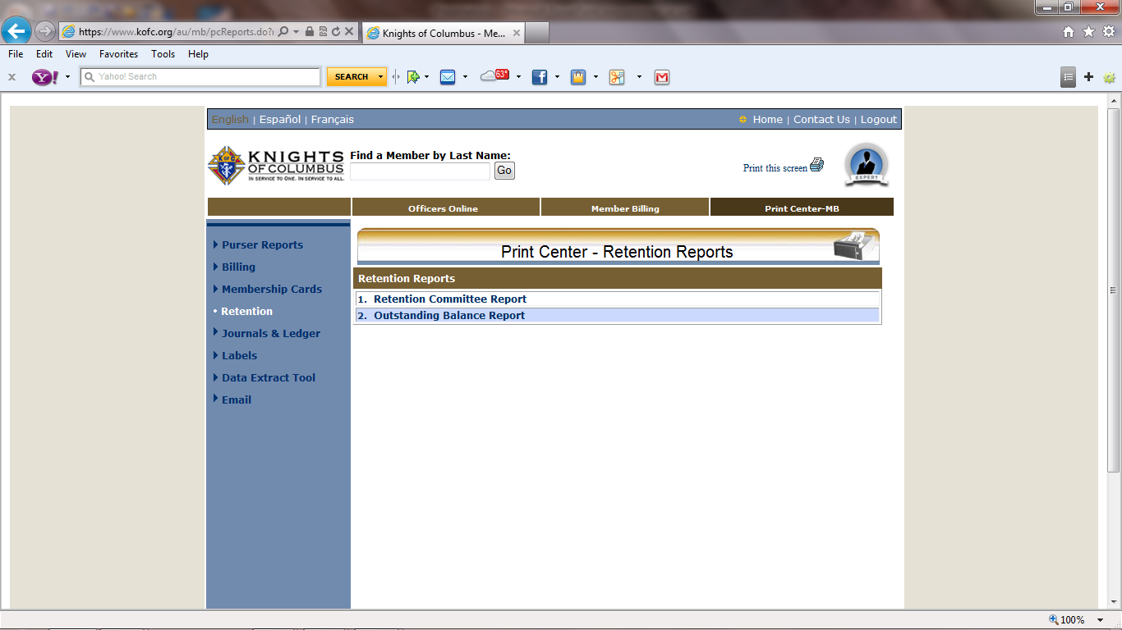
Select “Outstanding Balance Report”

Slide 17
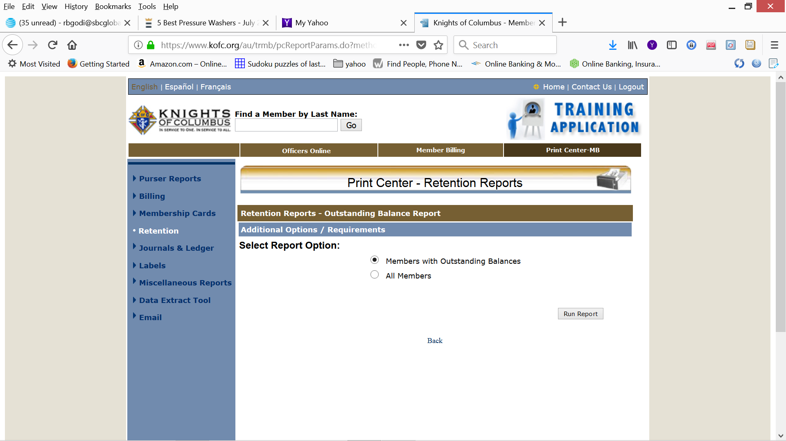

Slide 18
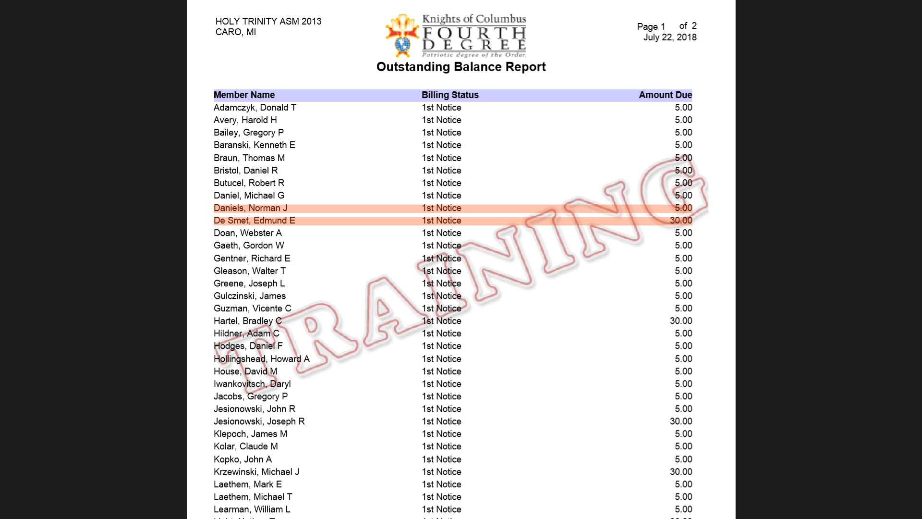
Dues Paying Tool
Print out this report and as members pay their dues you can highlight their names and after rectifying them in ”Dues Paying Tool” you can print the report again with the remaining members that still need to pay.

Slide 19
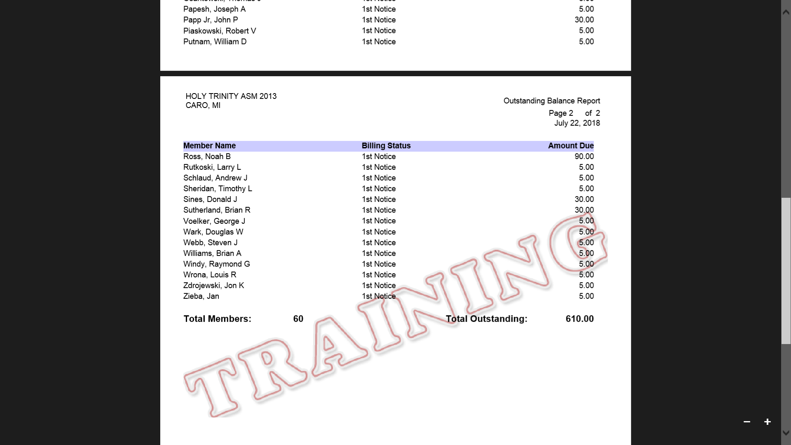

Slide 20

This has been an overview of assembly Member billing
Take the time while you are using the “Training Center” to Explore all the things this Great Tool of Member Management Can do for you and your Assembly.

Slide 21



Slide 22

Thank you for your kind attention. I hope this training session was helpful to you.
God bless you and God bless the Knights of Columbus.
Bob Godi, FM
Training Instructor

Slide 23
You can reach me at r.godi@mikofc.org or 989-737-1731
Bob Godi, FM

