Slide 1

Welcome to Provincial Training for Assembly Officers
2019

Slide 2

Welcome Faithful Comptrollers to
Member Management
Robert J. “Bob” Godi, FM, FDD
Provincial Training Instructor

Slide 3

Member Management for
Faithful Comptrollers
SESSION ONE of THREE

Slide 4
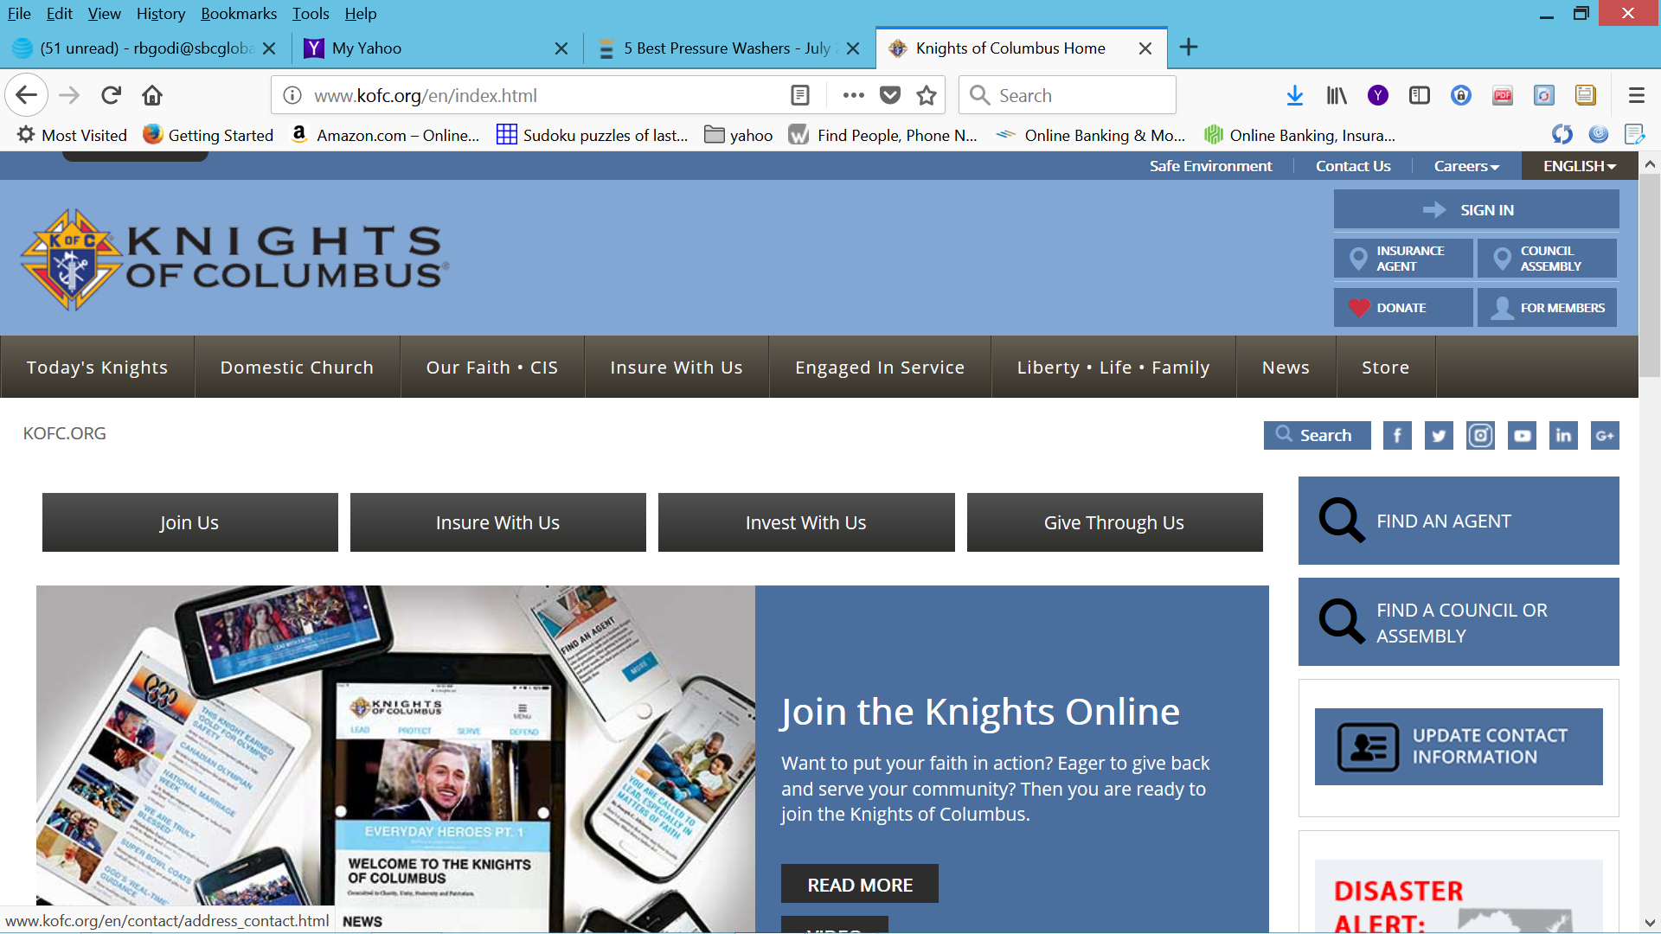
If you do not have a username & password:
Please Contact:
(203) 752- 4210 Select Option 1
or
E-mail: Membership@kofc.org.

Slide 5
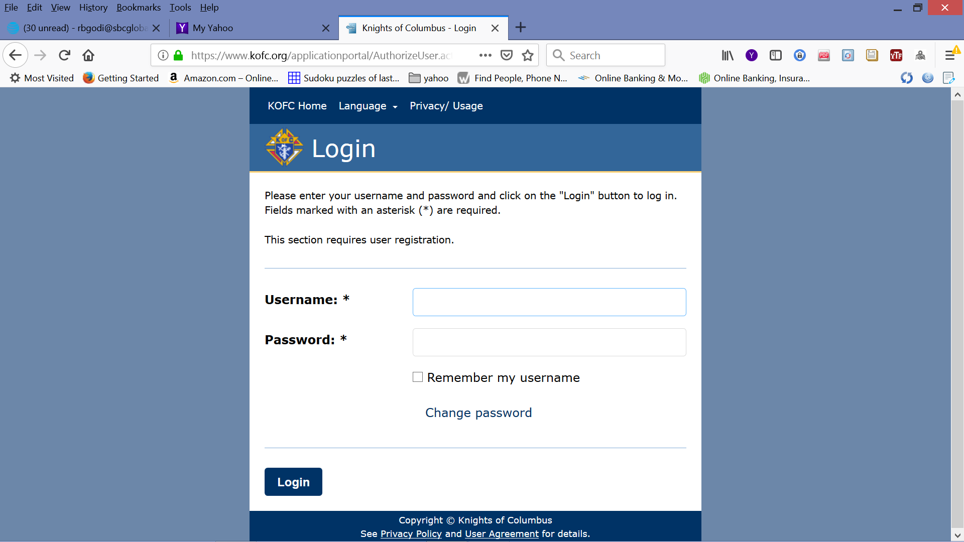
Put in your Username and Password.
You can check box if your want the system to remember your Username

Slide 6
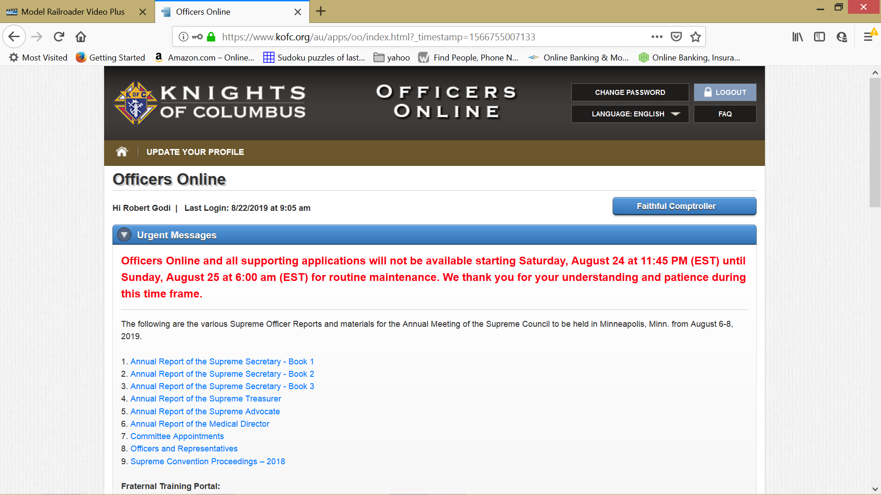

Slide 7
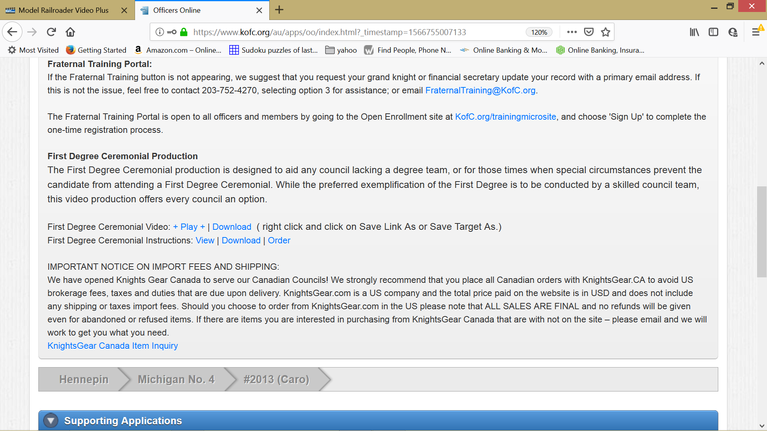

Slide 8
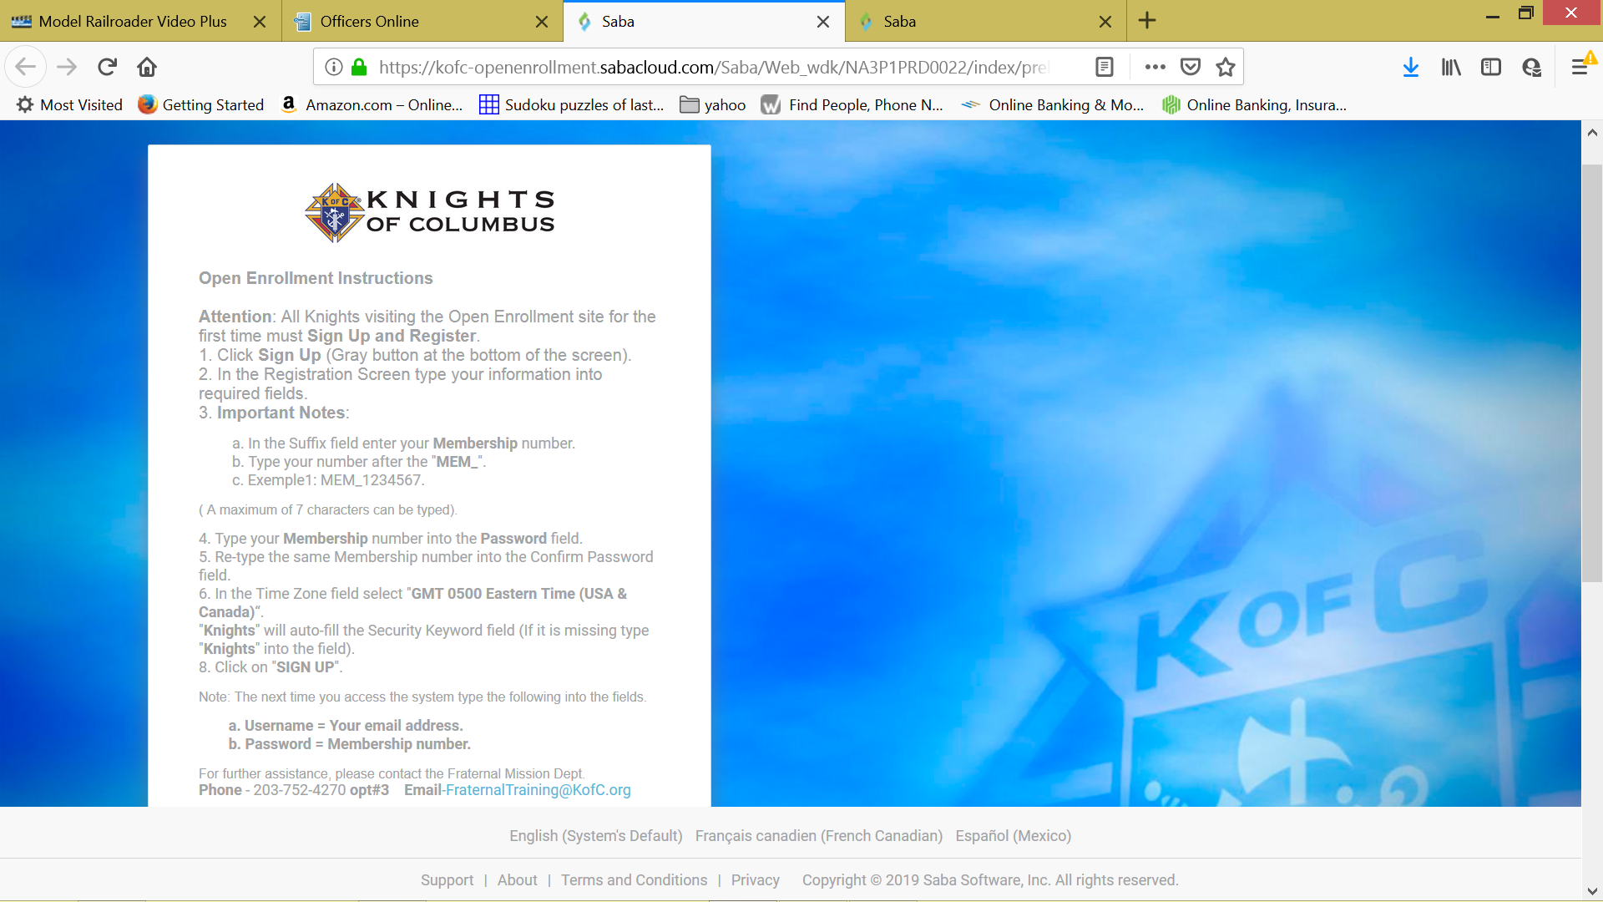
OPEN ENROLLMENT INSTRUCTIONS

Slide 9
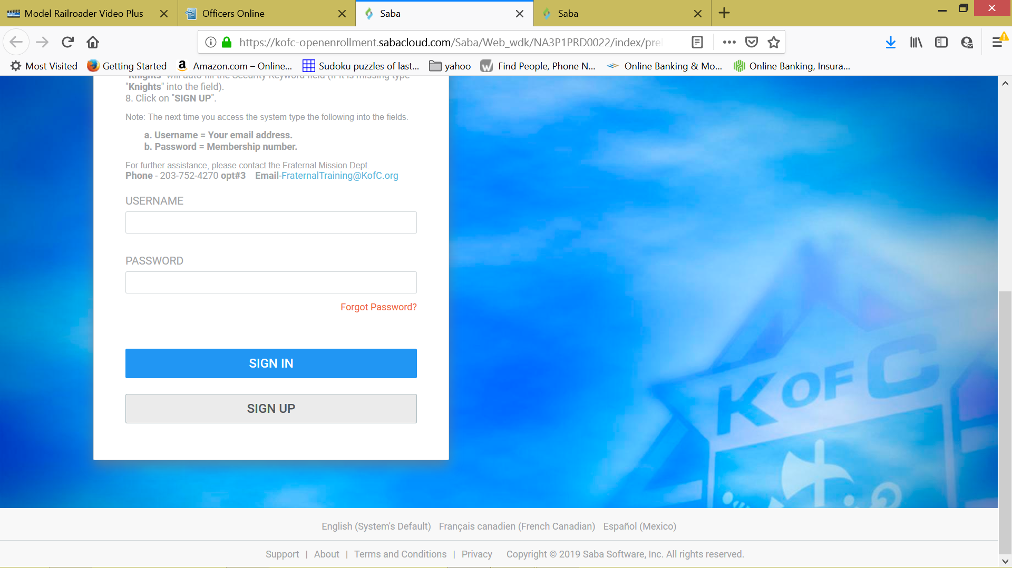
SIGN IN
OR
SIGN UP

Slide 11
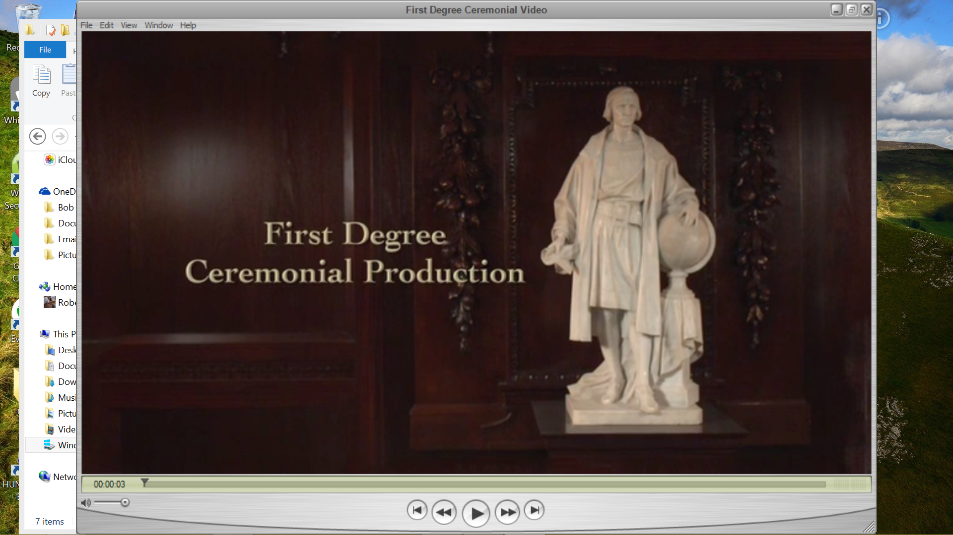

Slide 12
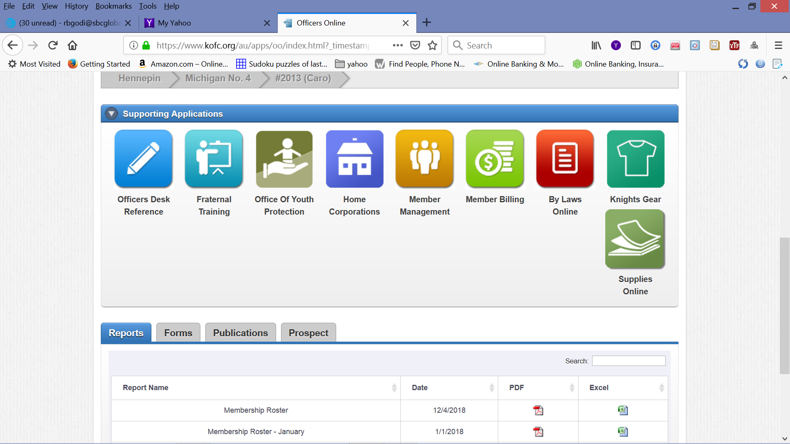

Slide 13
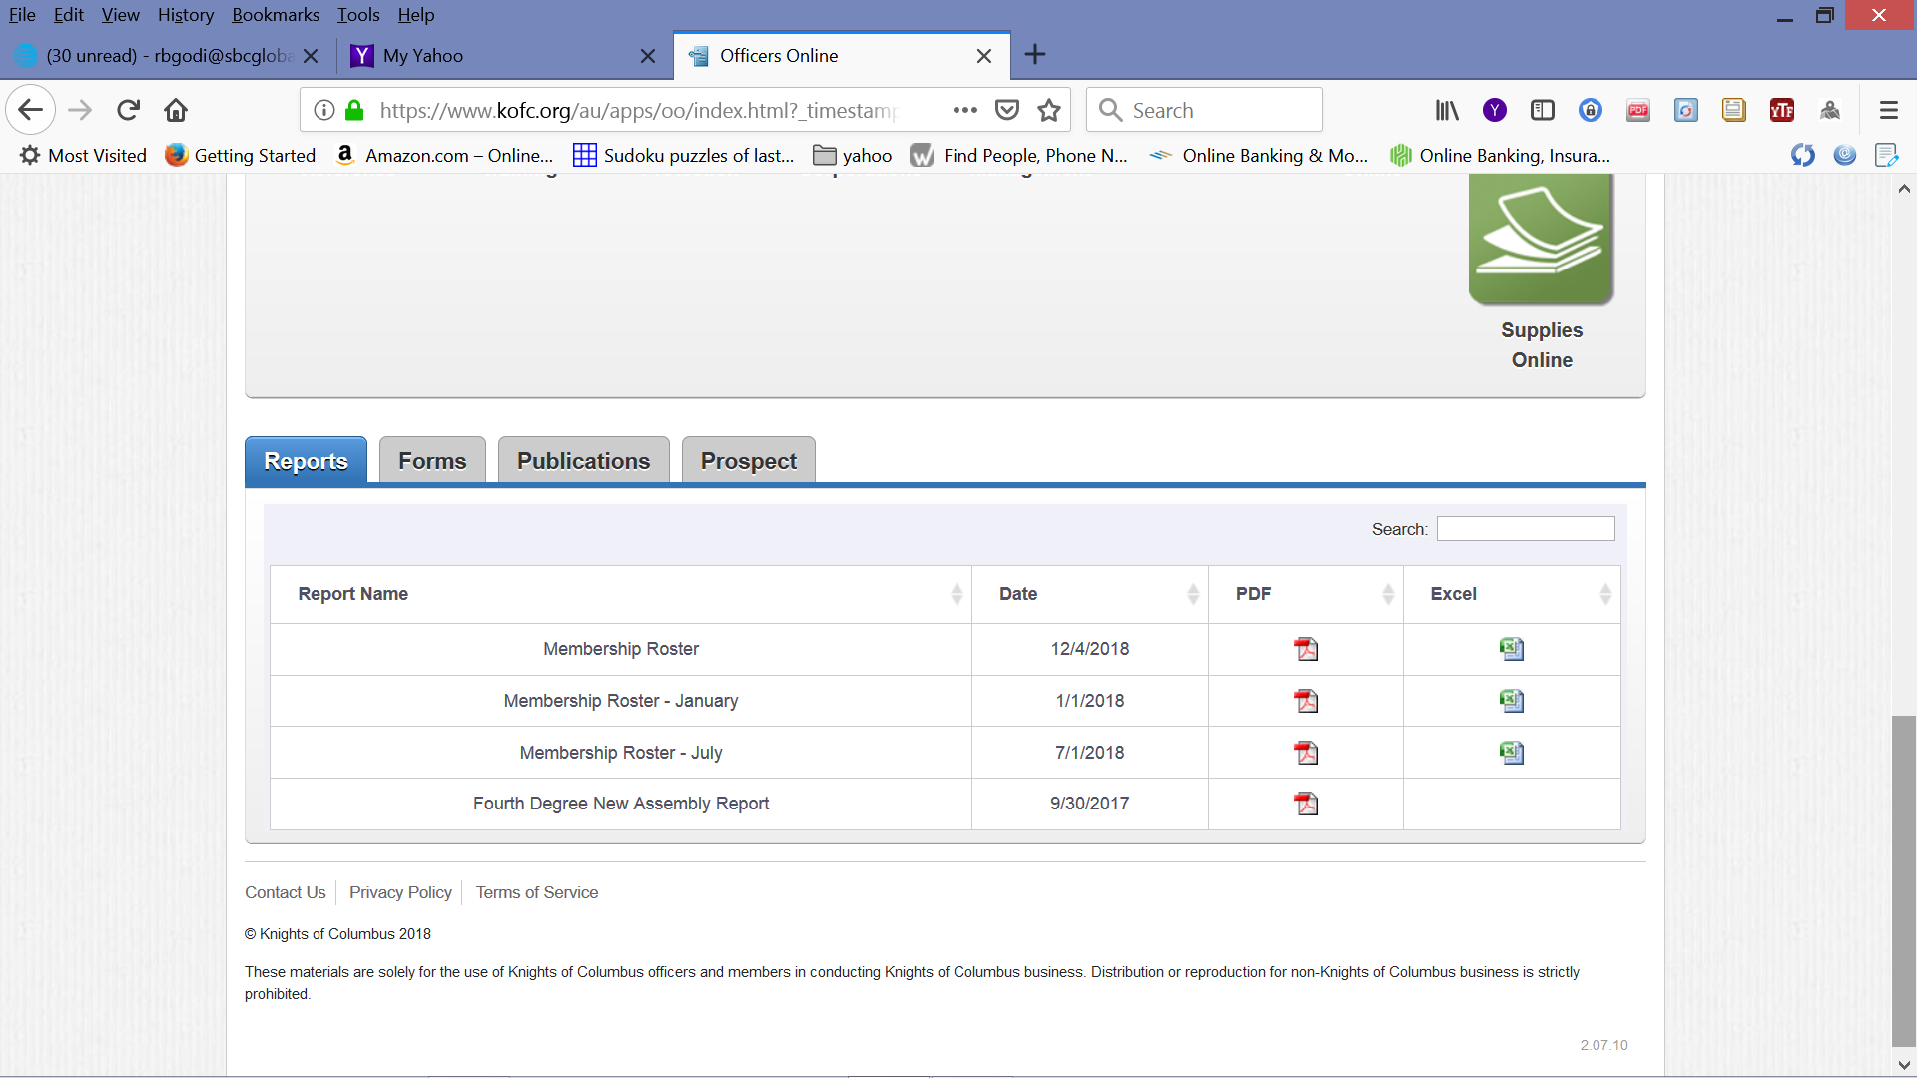

Slide 14
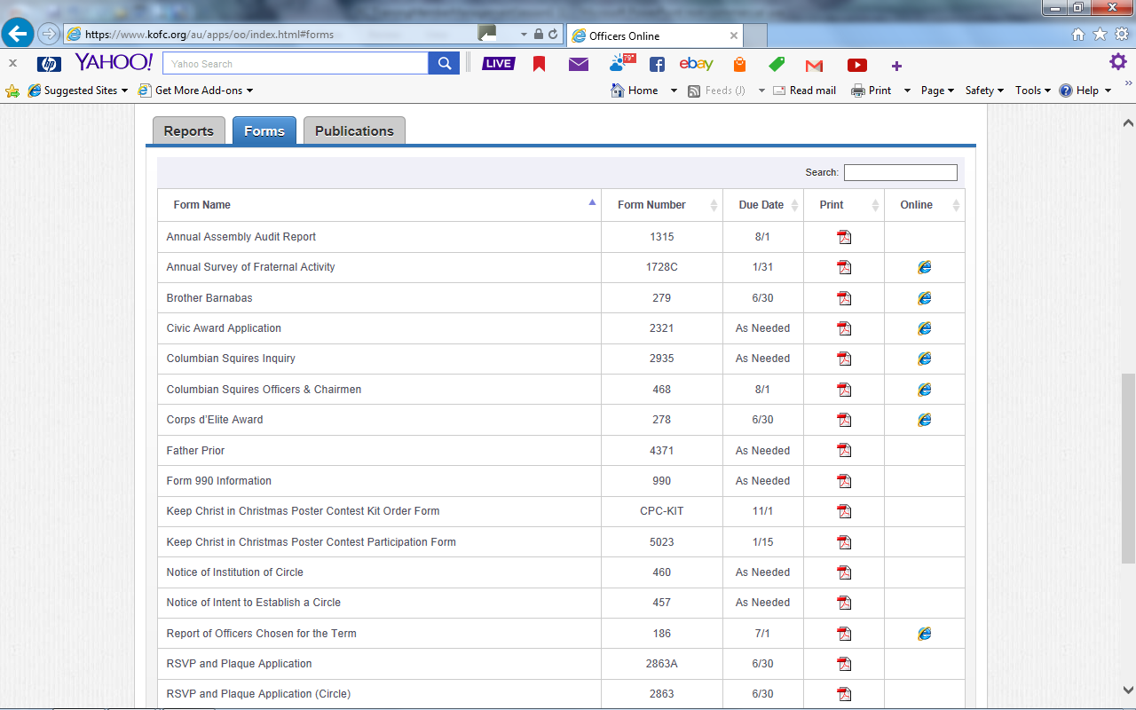

Slide 15
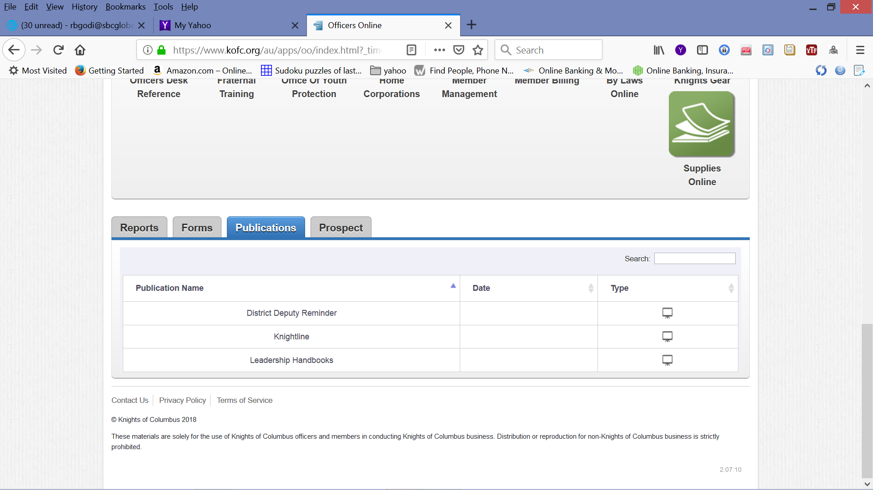

Slide 16
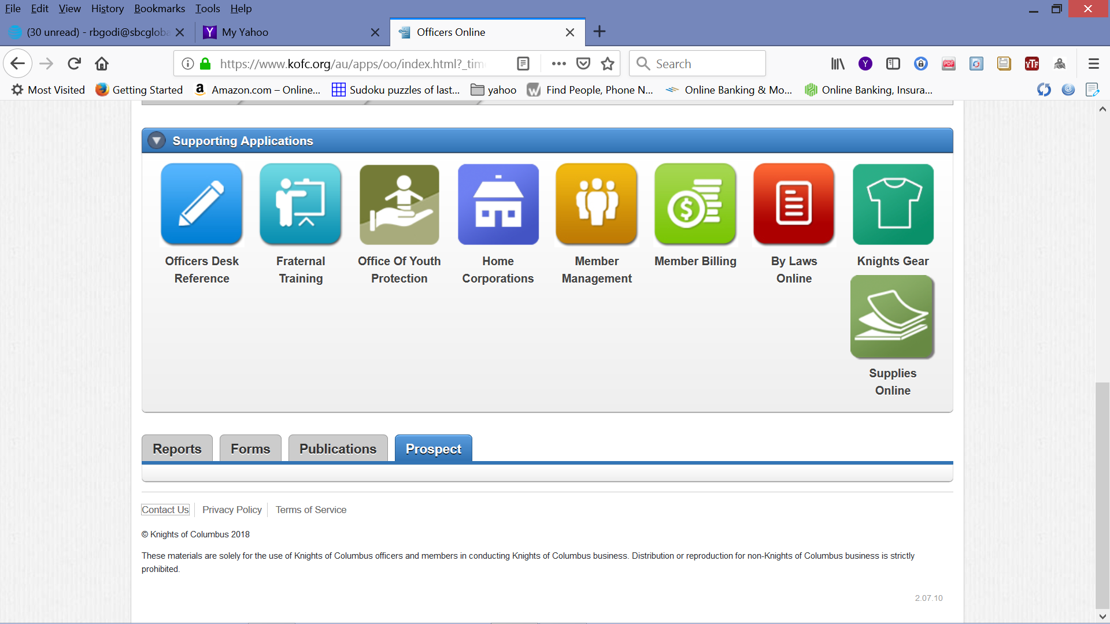

Slide 17
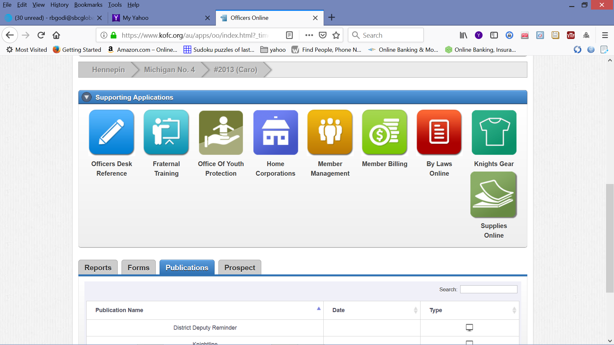

Slide 18
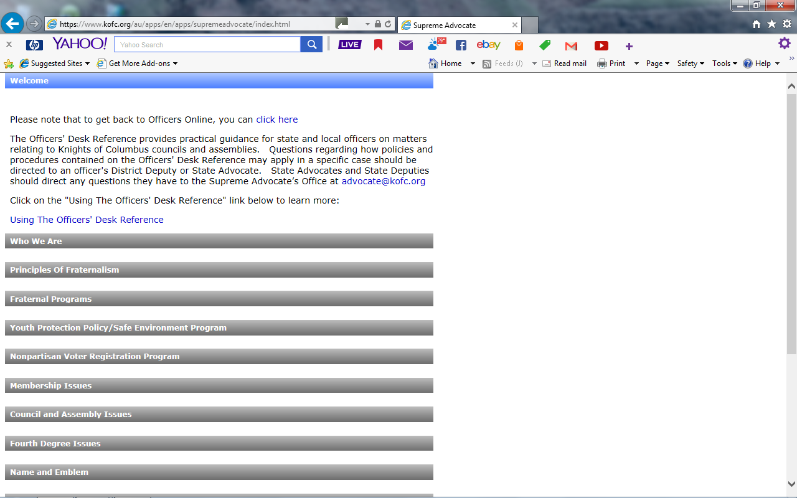

Slide 19
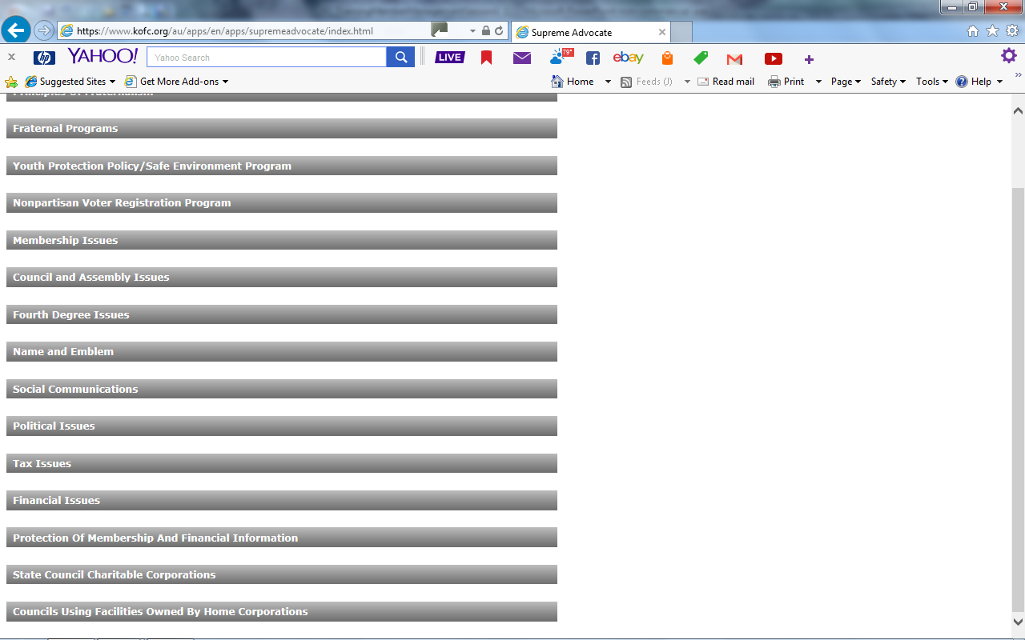

Slide 20
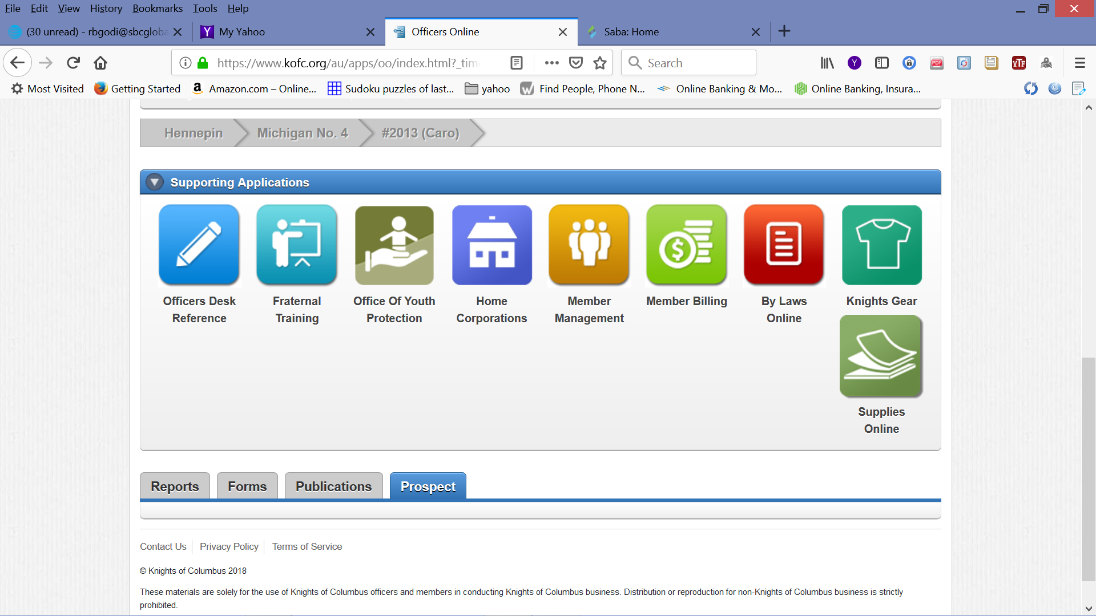

Slide 21
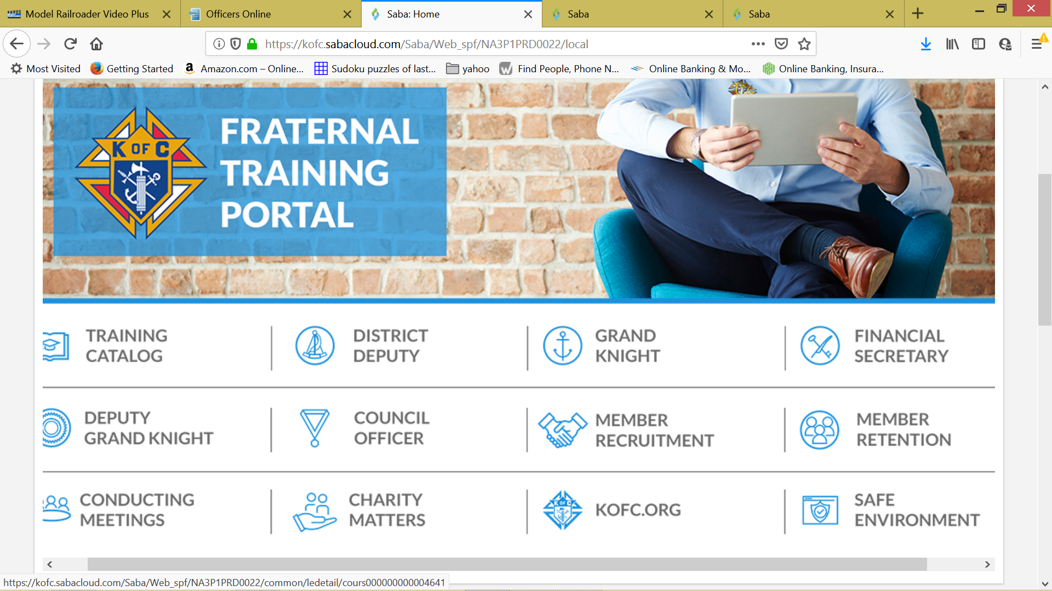

Slide 22
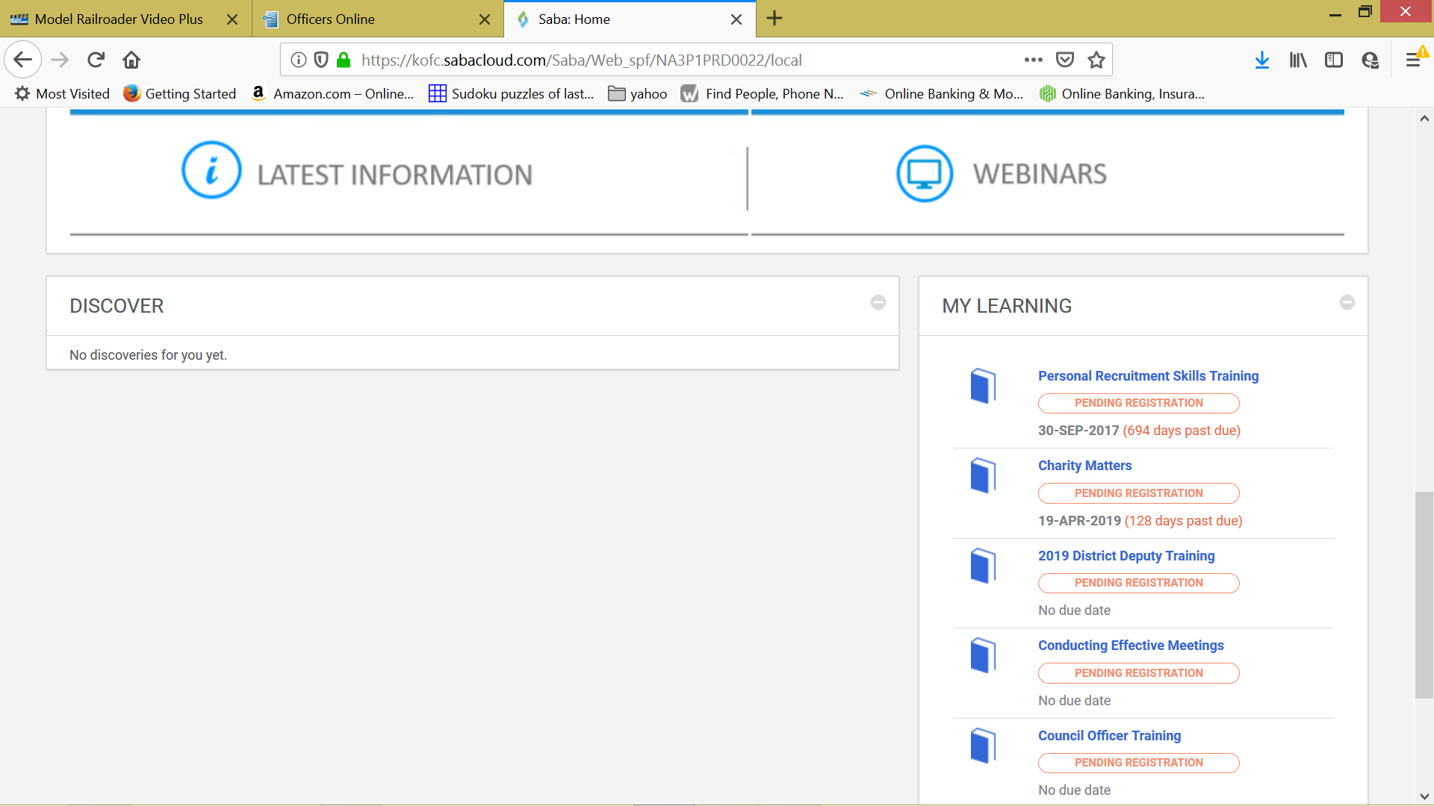

Slide 24
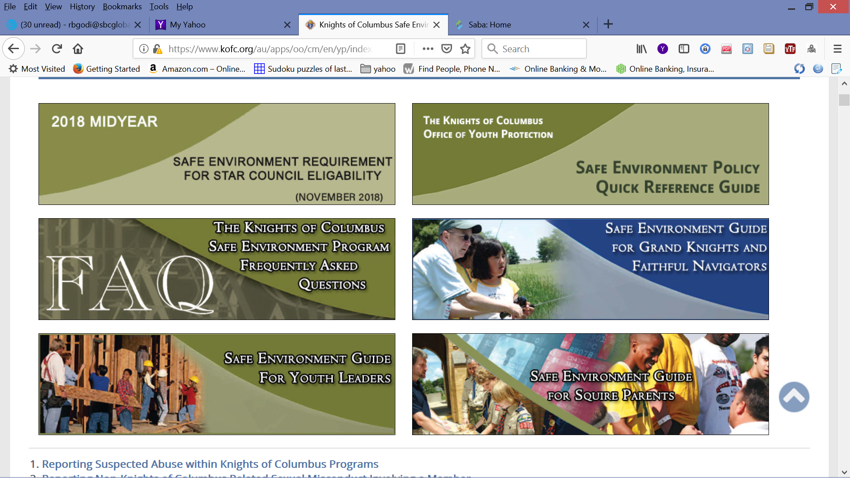

Slide 25
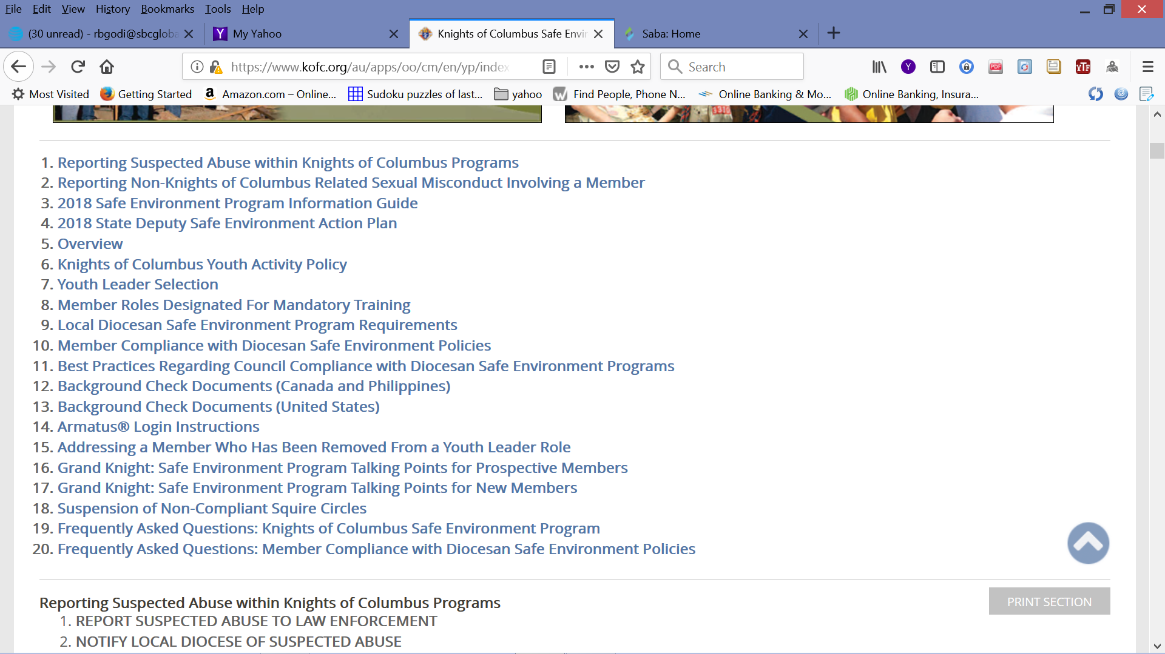

Slide 27
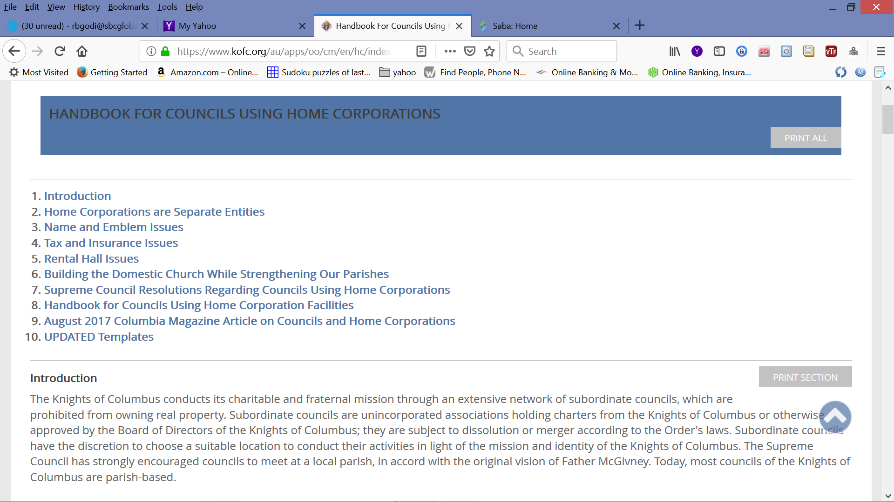

Slide 29
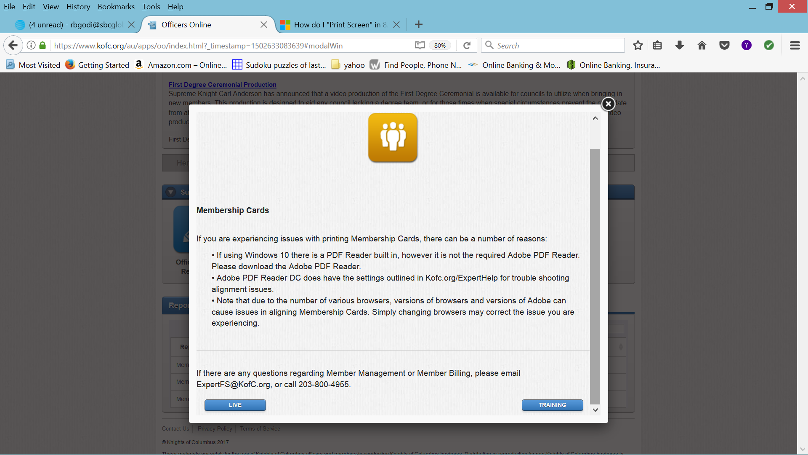

Slide 30
We will choose the “TRAINING” button.

Slide 31
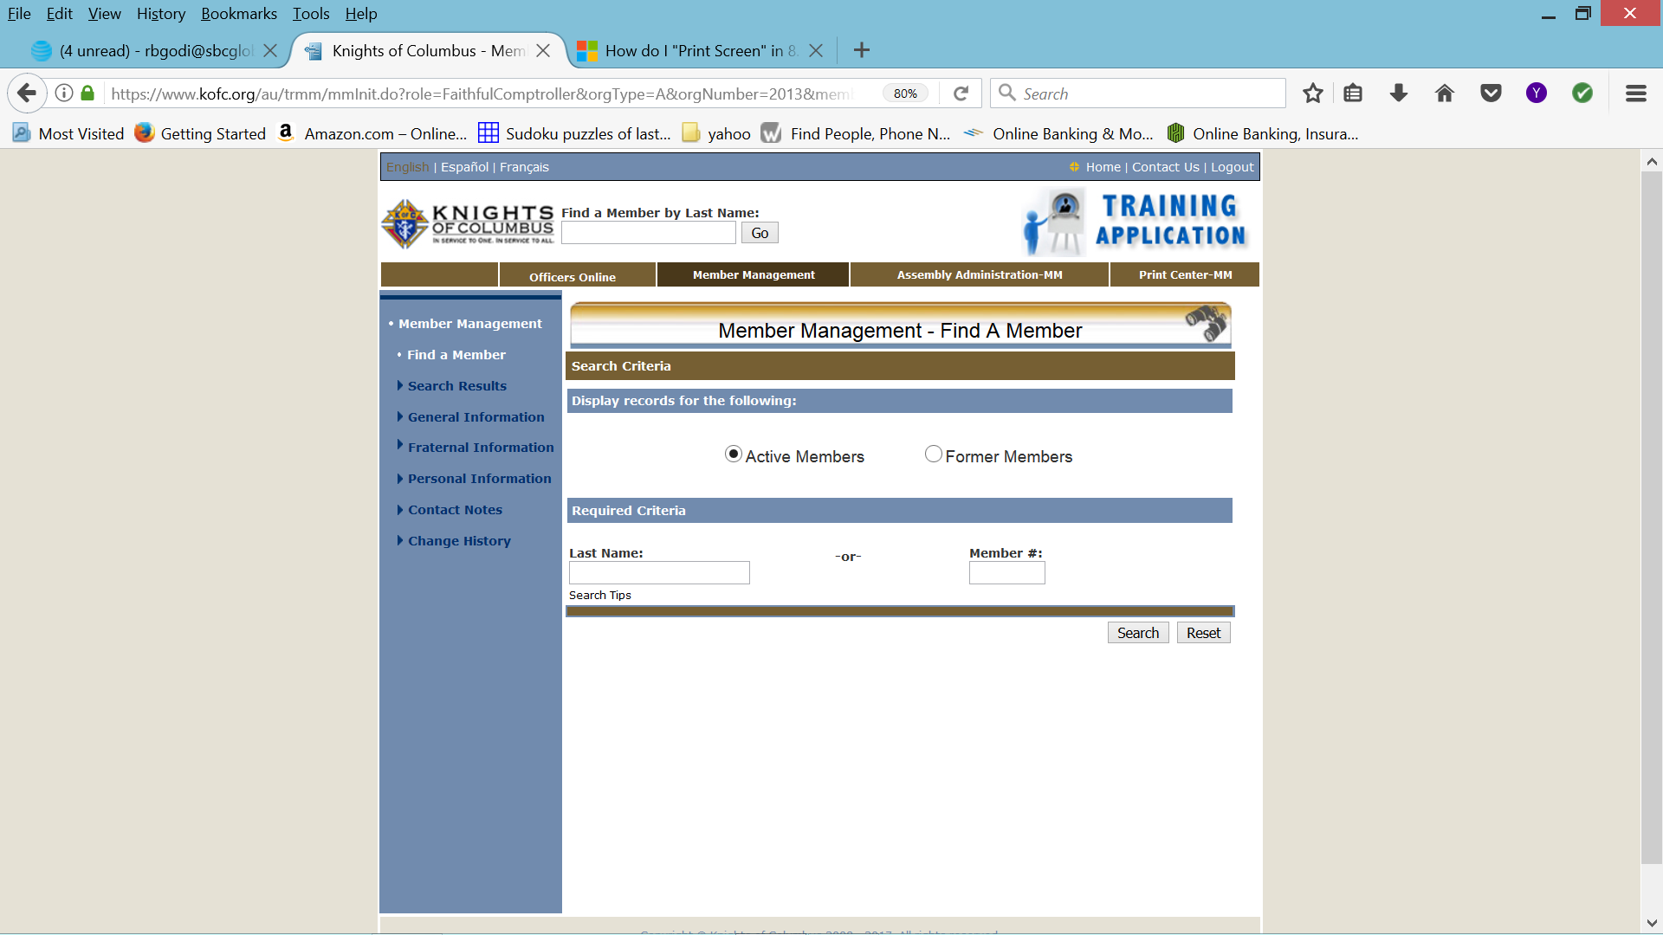
This one button push now takes us to the “TRAINING APPLICATION”.

Slide 32
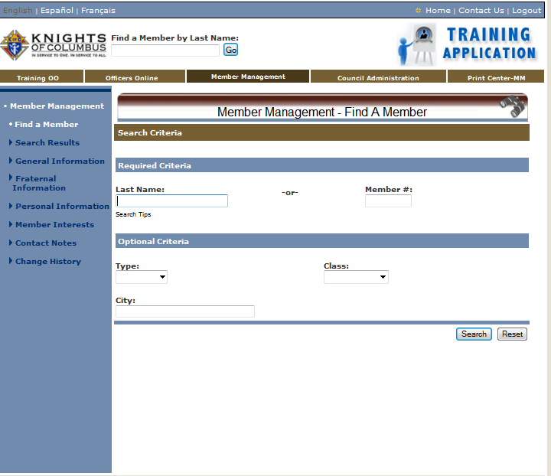
On this page will search for a member of the assembly. There are two ways to find a member’s record.
1 - type in the “Last Name” box the member’s last
name or the first letter of the last name (G).
2 – type in the member’s membership number.

Slide 33

We are looking for a member whose last name begins with a “G”. Enter the Letter G then click the search button or “enter” from the key board.

Slide 34
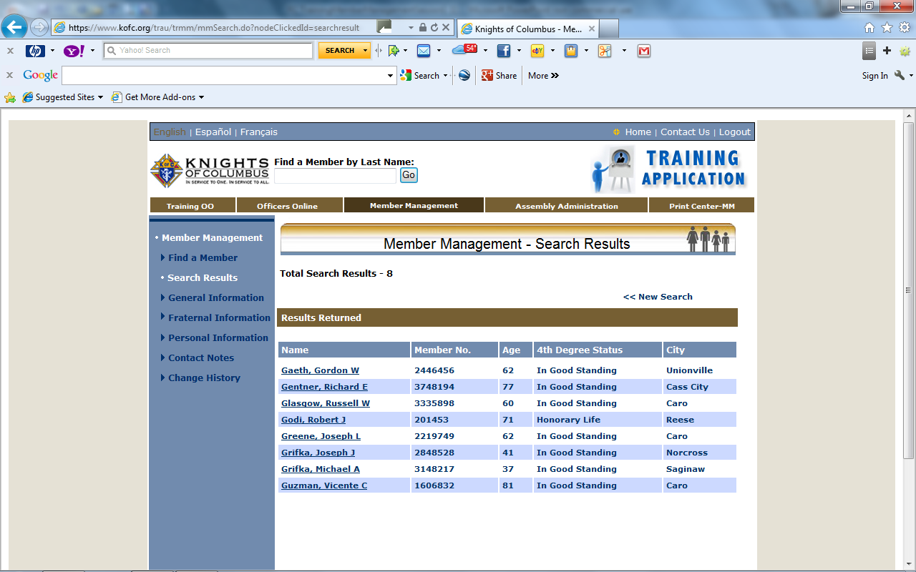
We will now click on Godi, Robert J.

Slide 35
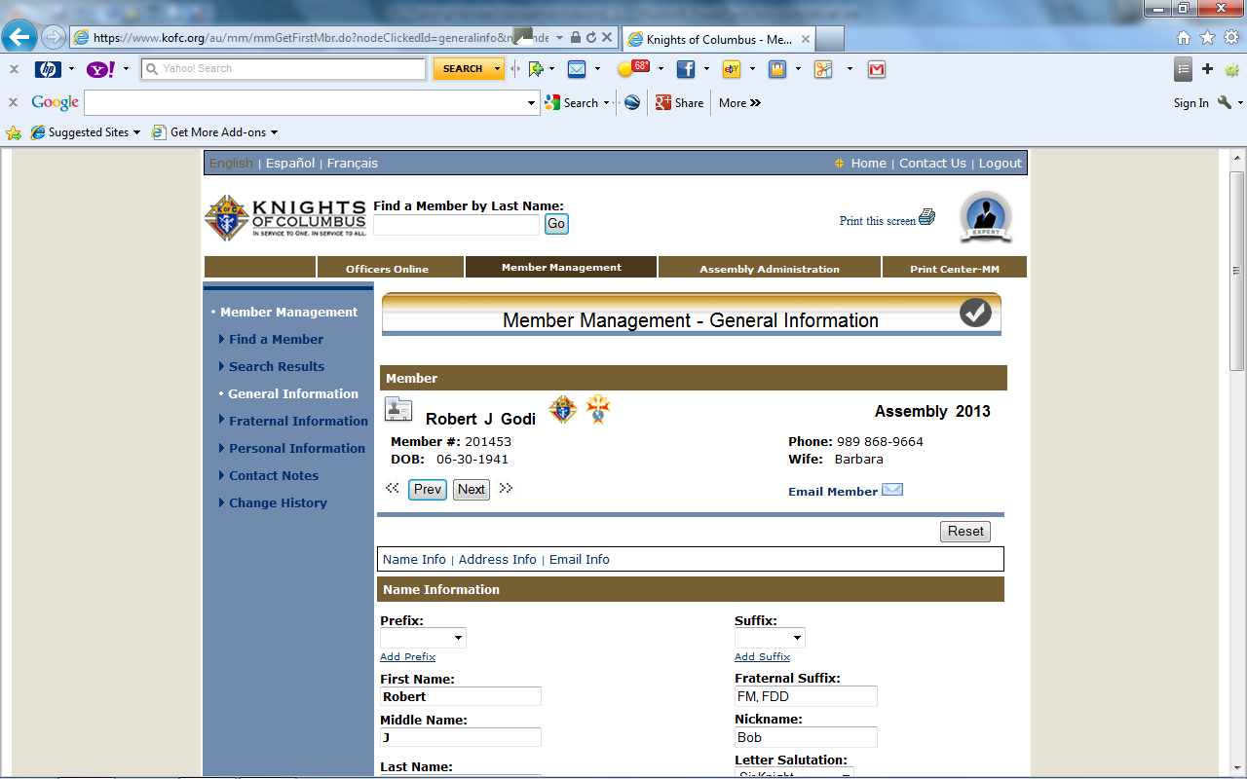
The Third Degree Emblem show us that he is an active member of the council. If there is no emblem he maybe inactive, suspended or deceased. If he is a Fourth Degree Member both emblems will appear.
Use these Links to scroll between sections
This slide and the next are all on one screen in the program. We will now fill in all missing information we have available.

Slide 36
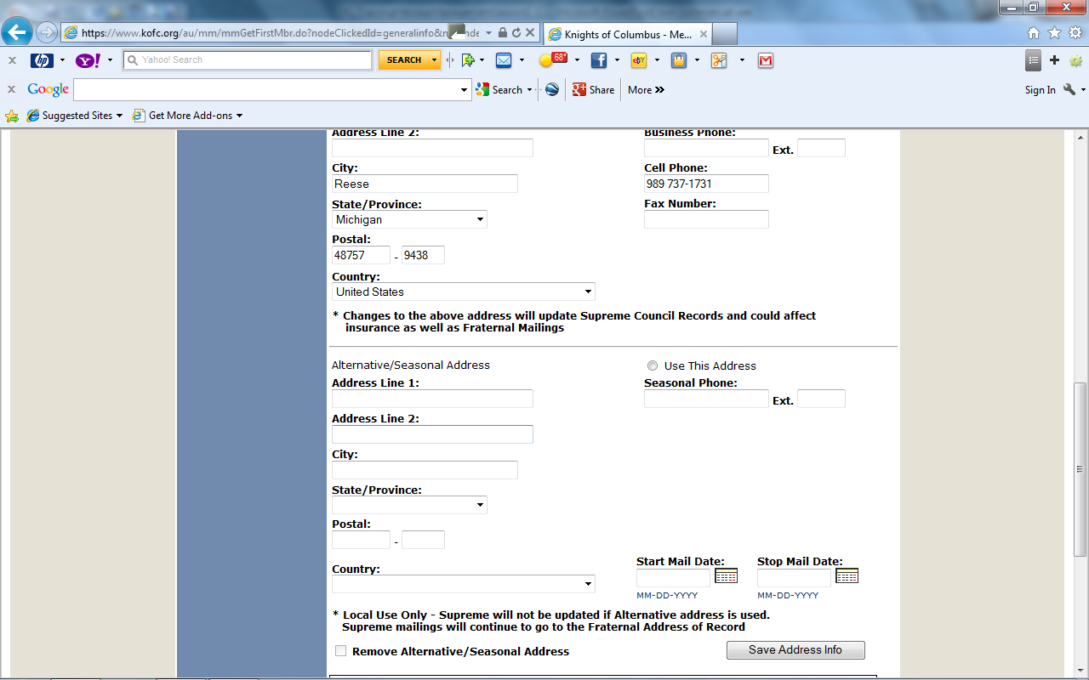
We will add his phone numbers and then we will click on the “Save Address Info” Button.

Slide 37
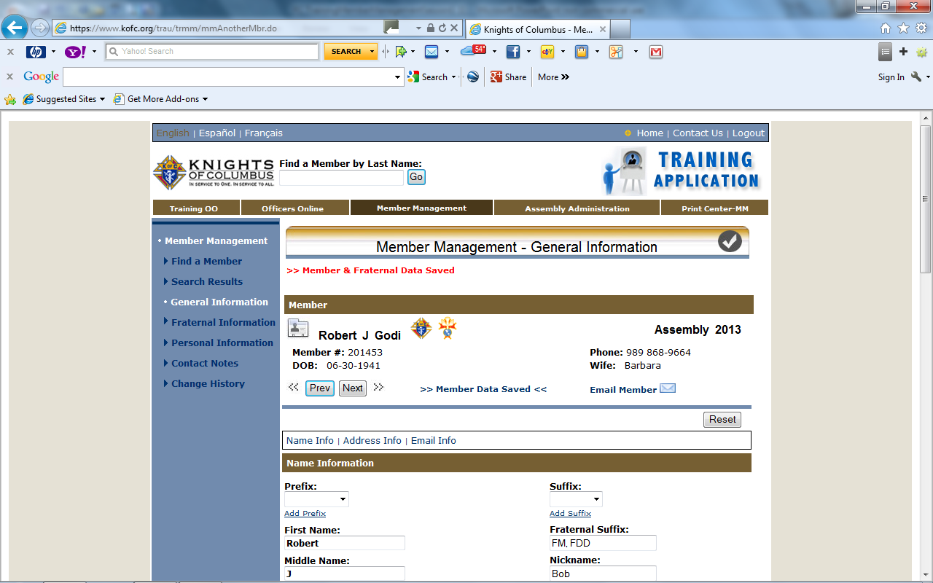
Please note confirmation of data saved

Slide 38
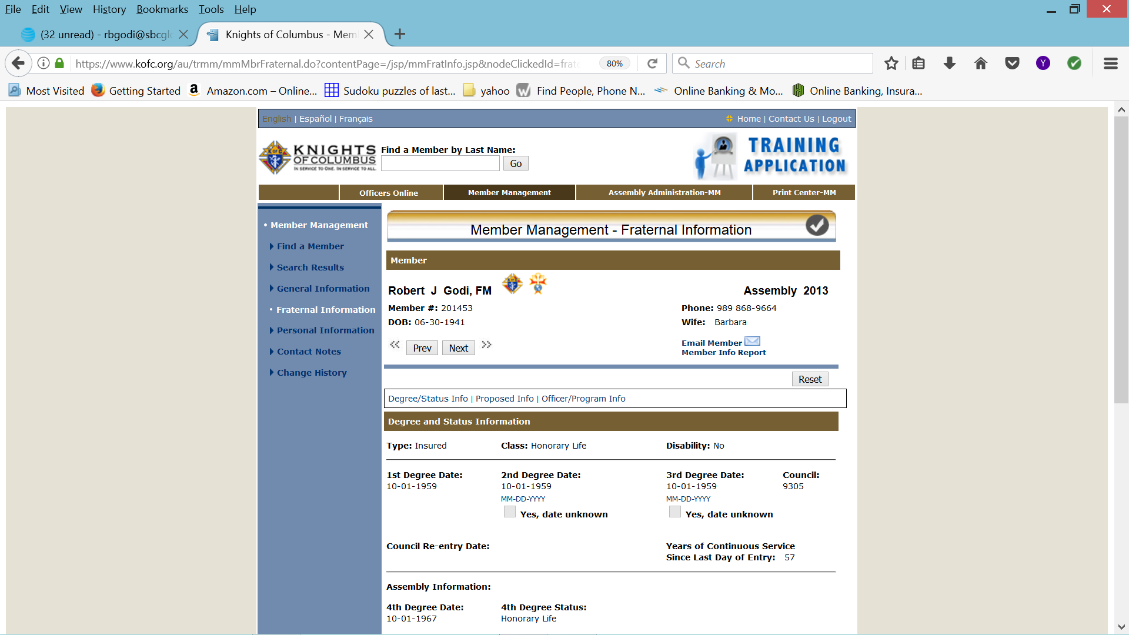

Slide 39
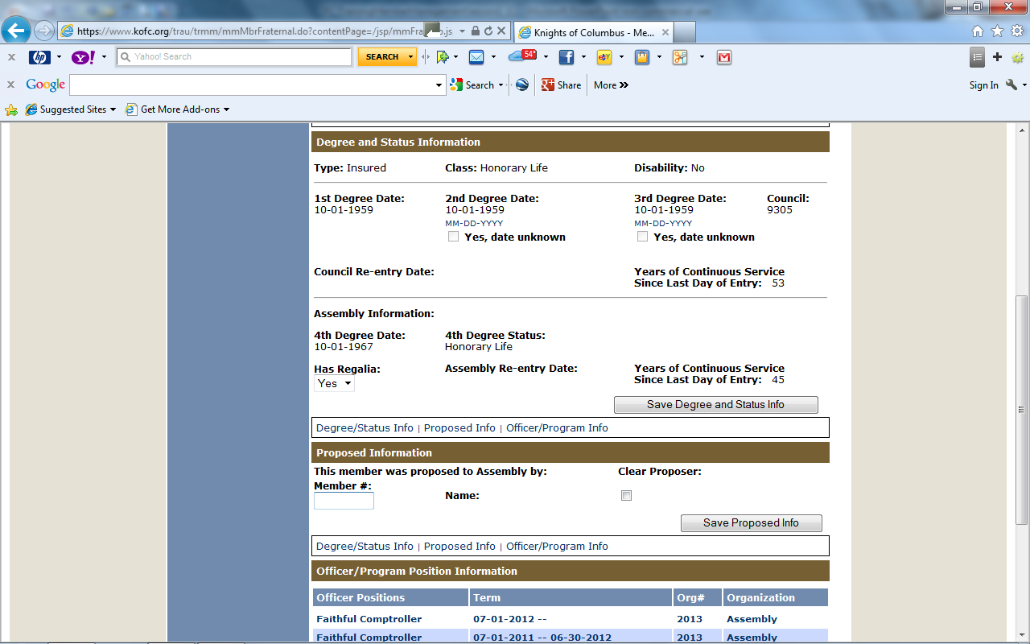
Check the data boxes and enter any missing information you have.
Enter “YES” if member has “Regalia”
DO NOT forget to SAVE in each section

Slide 40
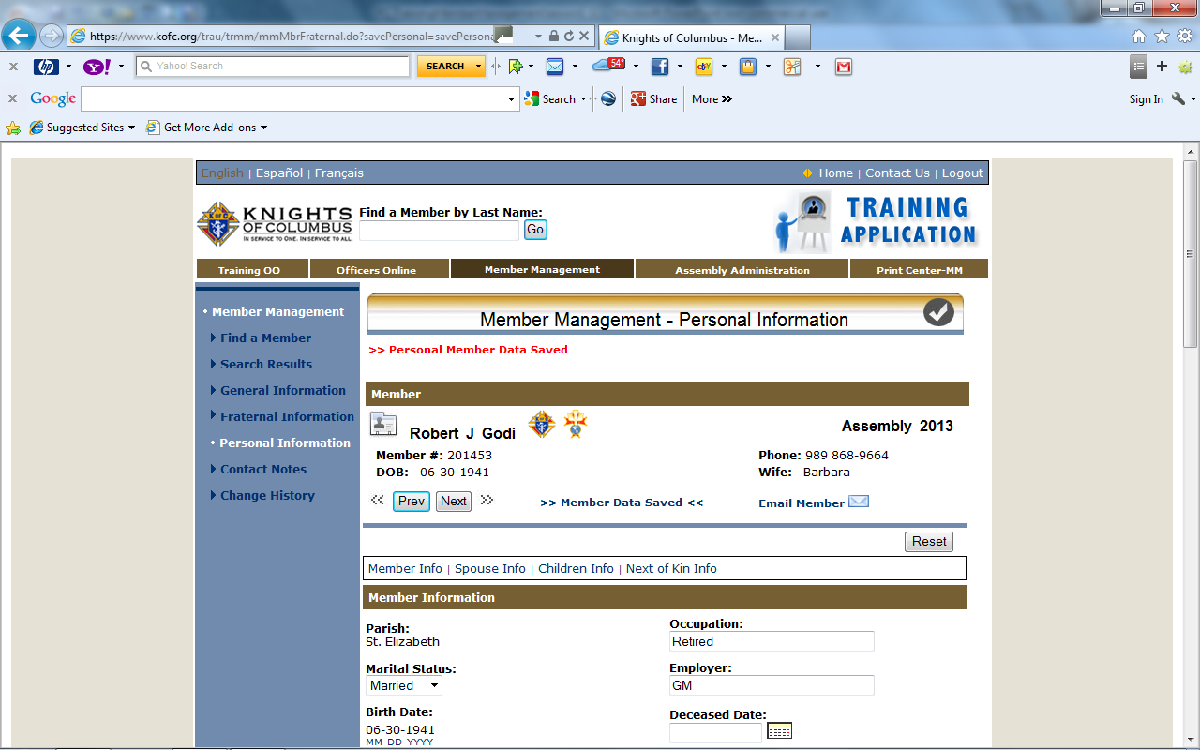
Personal Member Data Saved

Slide 41
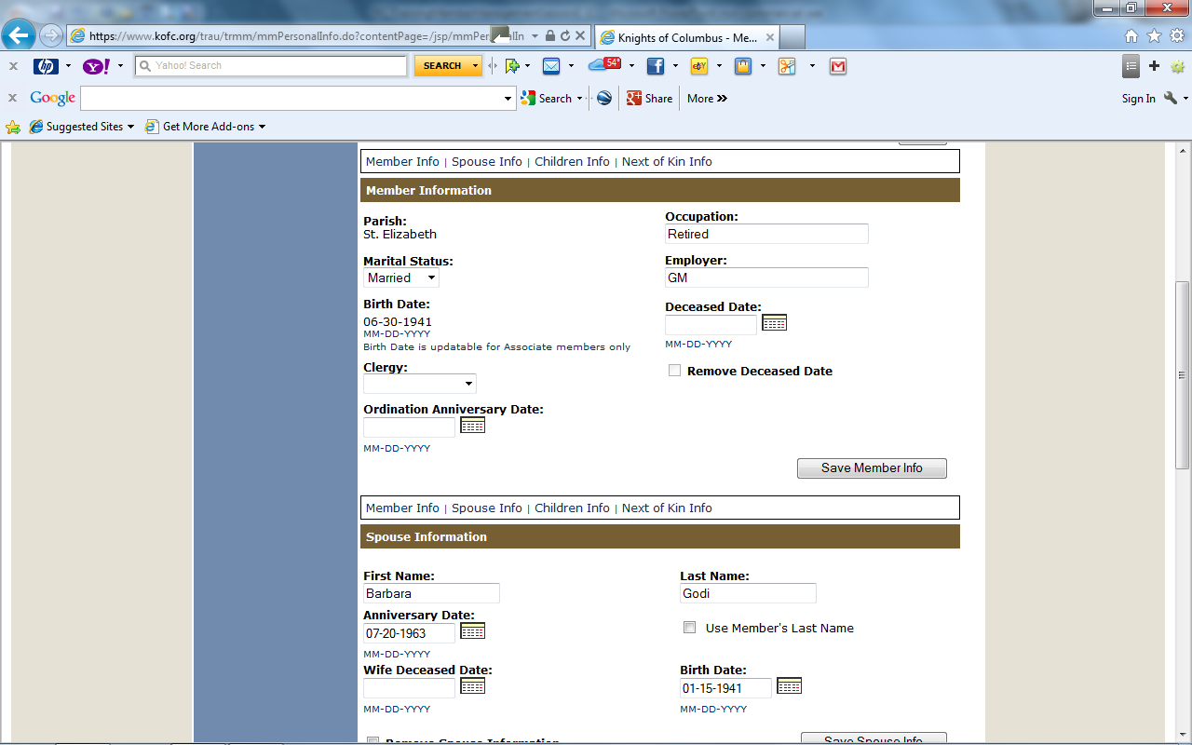
We will now work on Bob’s Personal Information:
1 His Parish
2 Occupation
3 Marital Status
4 Employer
Most of this information will be entered by his council. Information that is incomplete and you have in your records, please fill in.
Be Sure you Save

Slide 42
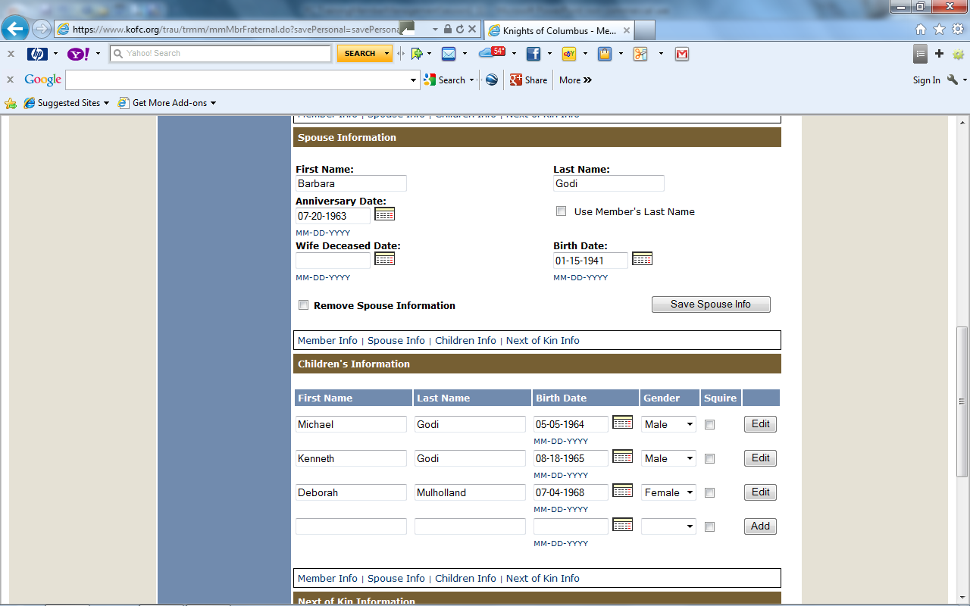
We have filled in all the spouse Data and we will now save the Spouse Information. When the screen refreshes we will work on next of kin.
You can enter the last name by checking box; “Use Member’s Last Name”
Again, much of this data will be filled in by his council, but enter whatever you have.

Slide 43
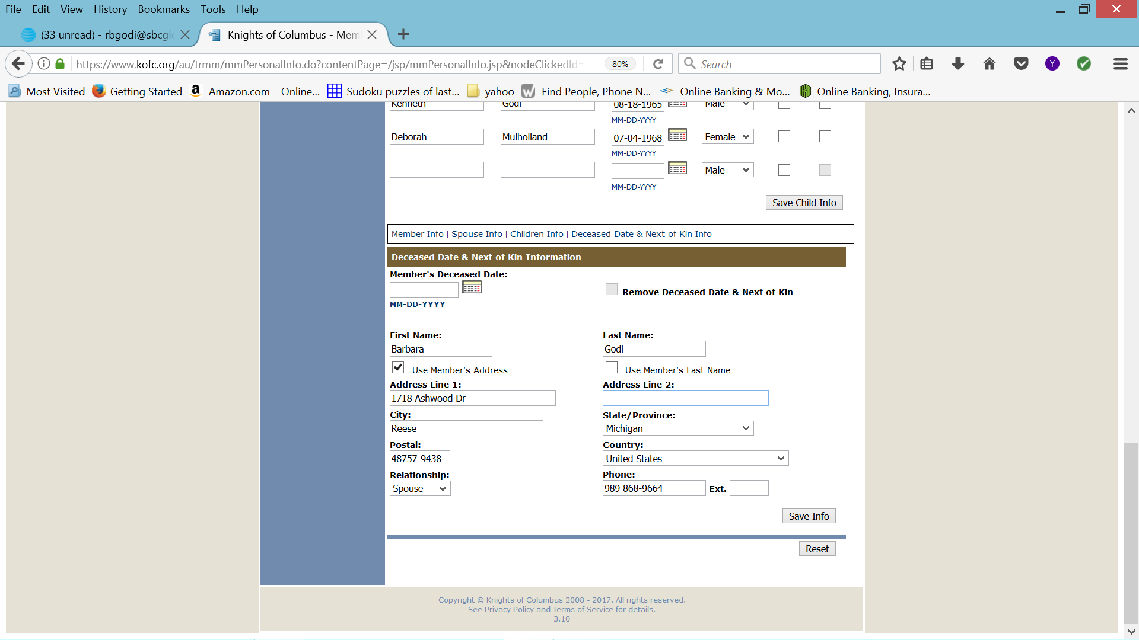

Slide 44
Personal Member Data Saved
Personal Member Data Saved

Slide 45
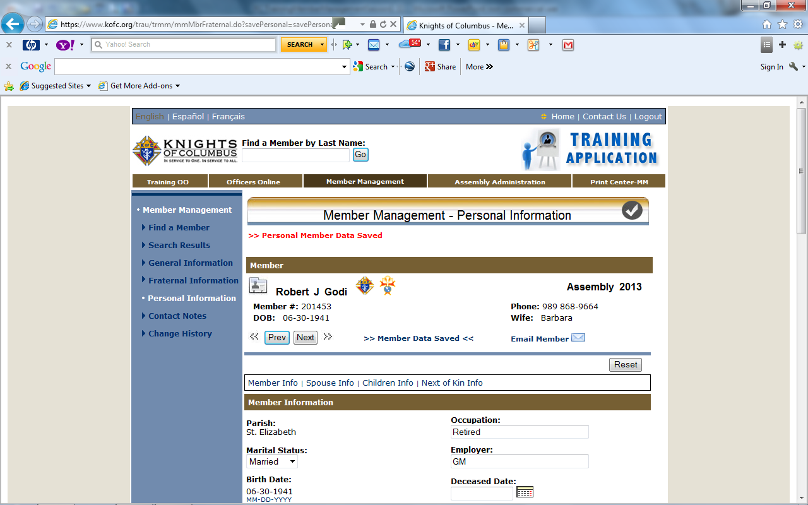
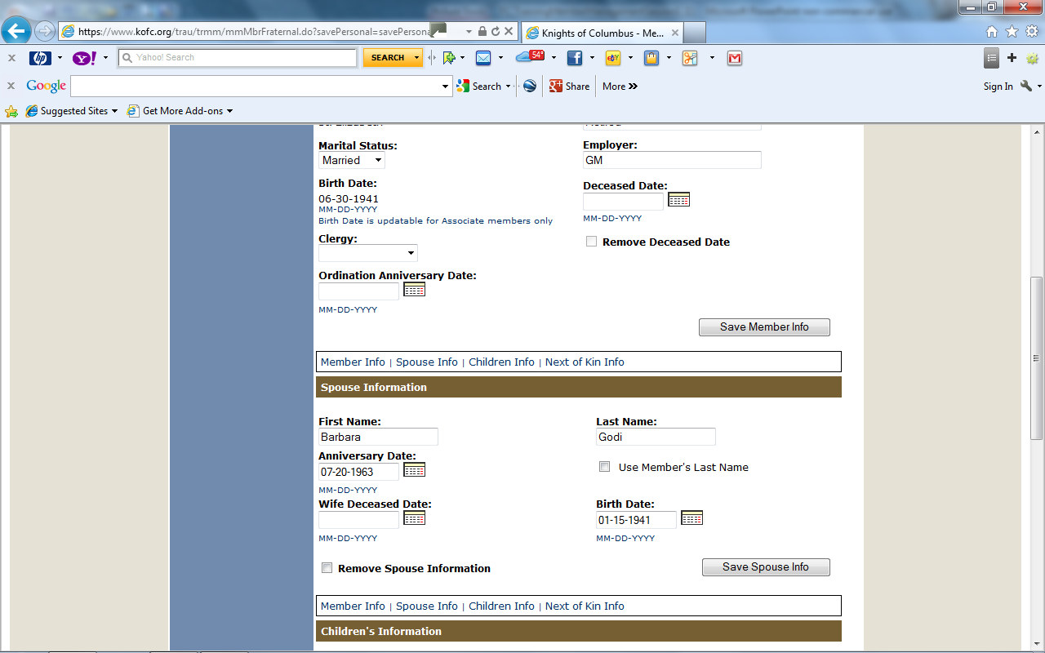
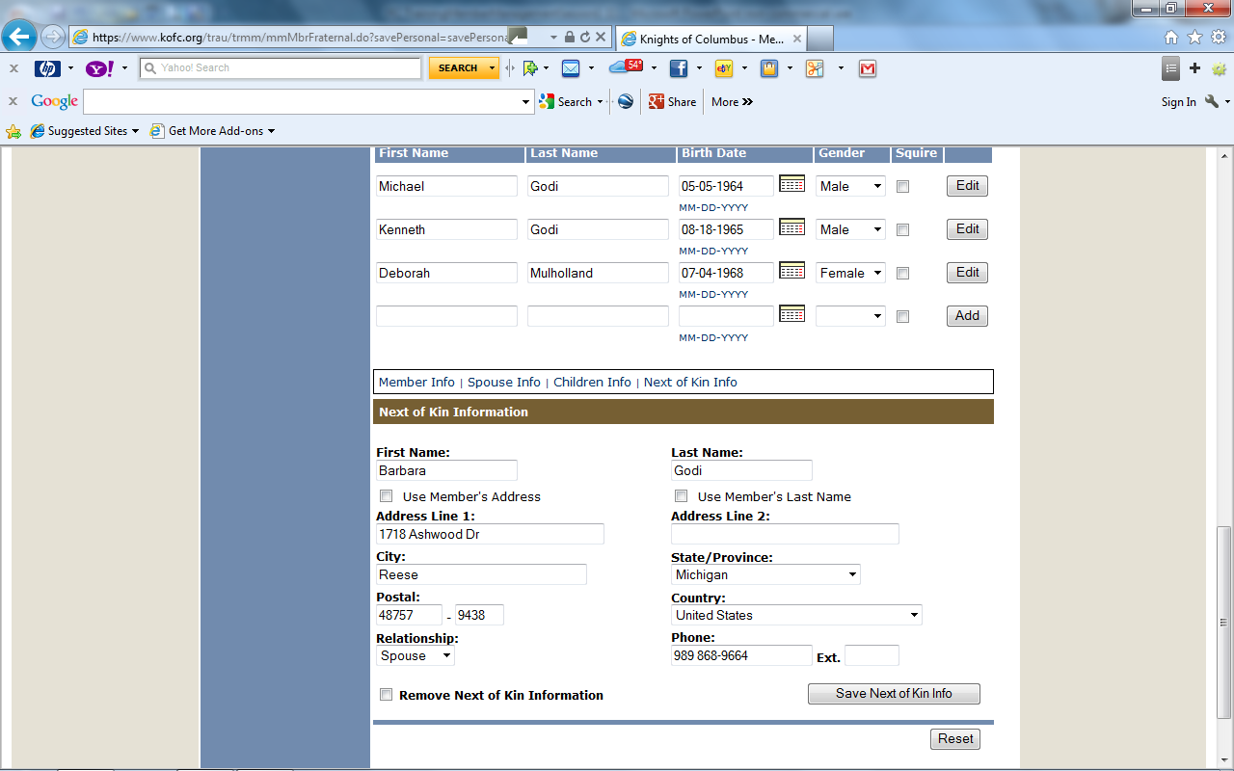
This is the screen you will see after you have finished any one of the sections. This is how this member’s Personal Information Page looks when completed.
You need to click “SAVE” in each section. Clicking save at the bottom will not save the entire record.

Slide 46

Now that we have finished working member information. We will begin working Assembly Administration. So let’s click on the “Assembly Administration “Tab”.

Slide 47
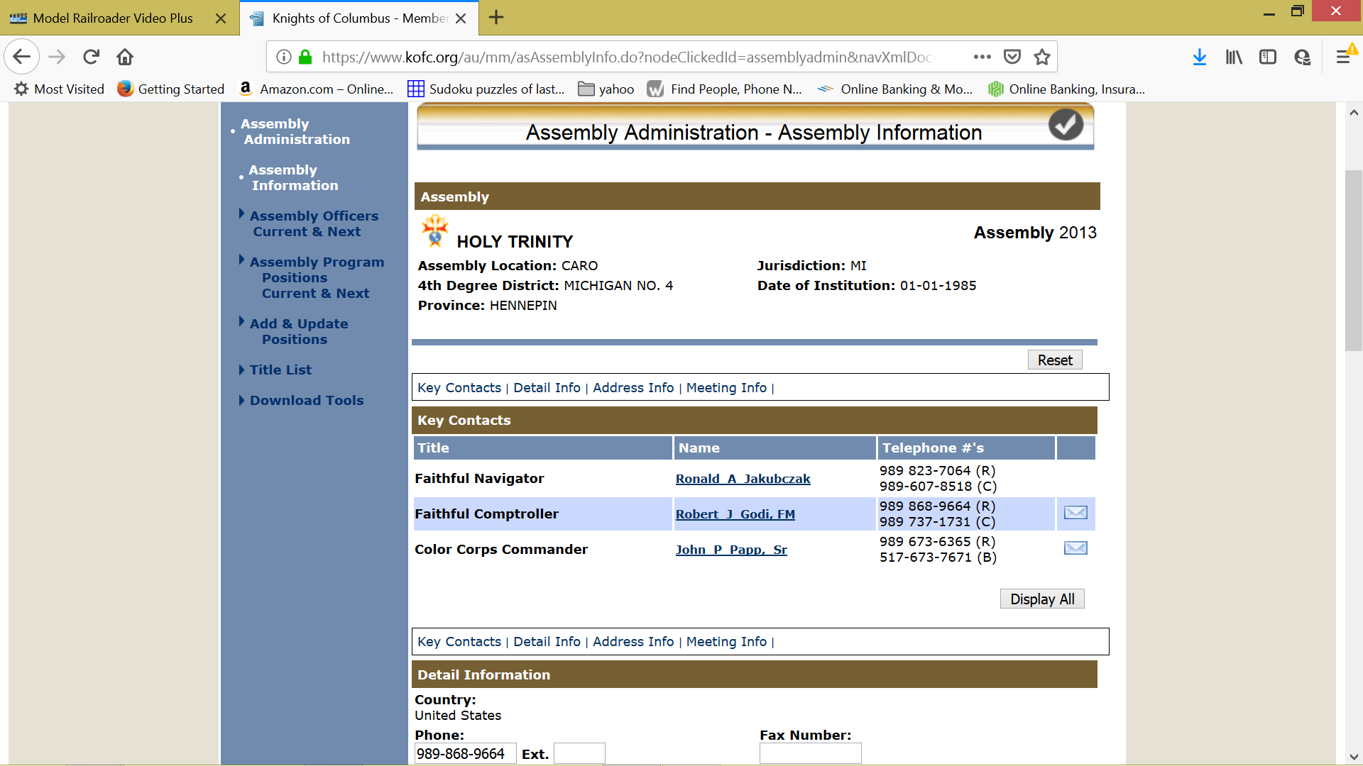
These positions are generated by Supreme for you with the change in Officers on July 1st every year.

Slide 48
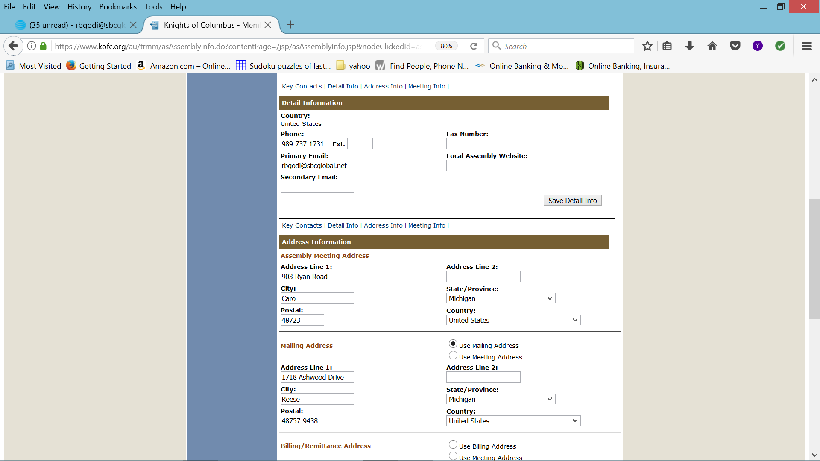
You will need to add assembly phone & ext, Primary Email and Secondary Email, fax number and website address in this area.
You will need to add Assembly Meeting Address, Mailing Address.

Slide 49
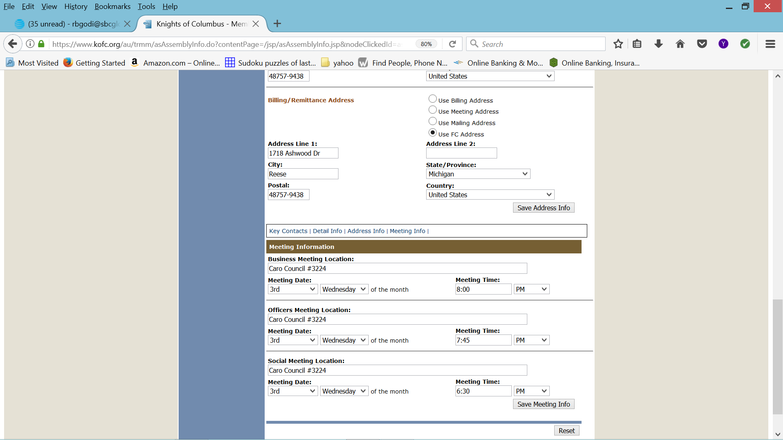
Billing /Remittance address in this area.
You will need to add Assembly Business Meeting Location, Meeting Date, Meeting Time, Officers Meeting Location, Meeting Date, Meeting time, Social Meeting Location, Date and Time in this area.
We will go to “Assembly Officers” “Current & Next”

Slide 50
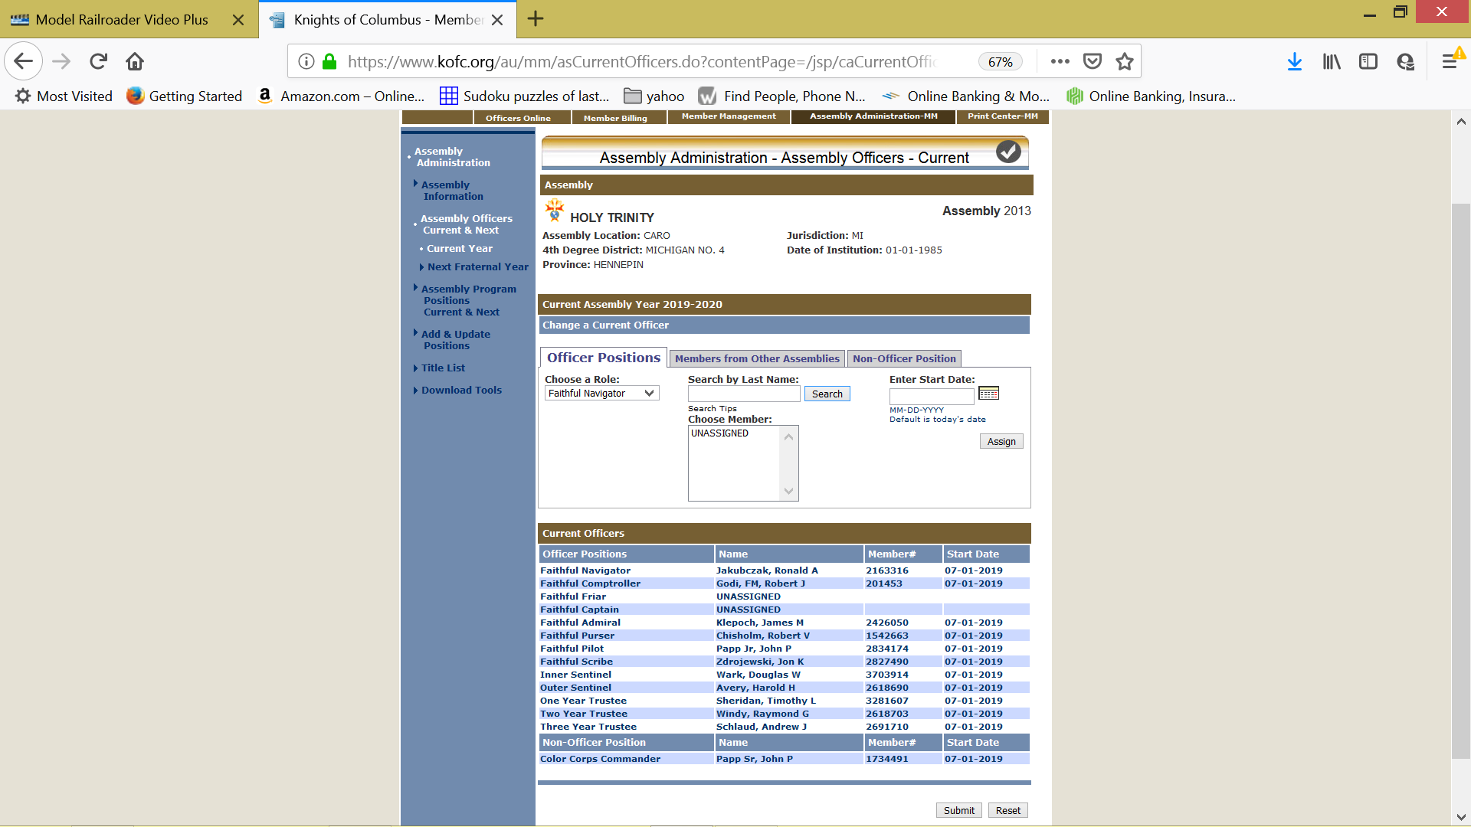
If an Officer where to vacate his Office, and when the new Officer is elected to that role, we can change that Office Position during the current year by using the drop down menu under “choose role:” tab
If you have a officer position open at the time of election, leave it UNASSIGNED and submit your Assembly Officers on time, openings can be filled later.

Slide 51
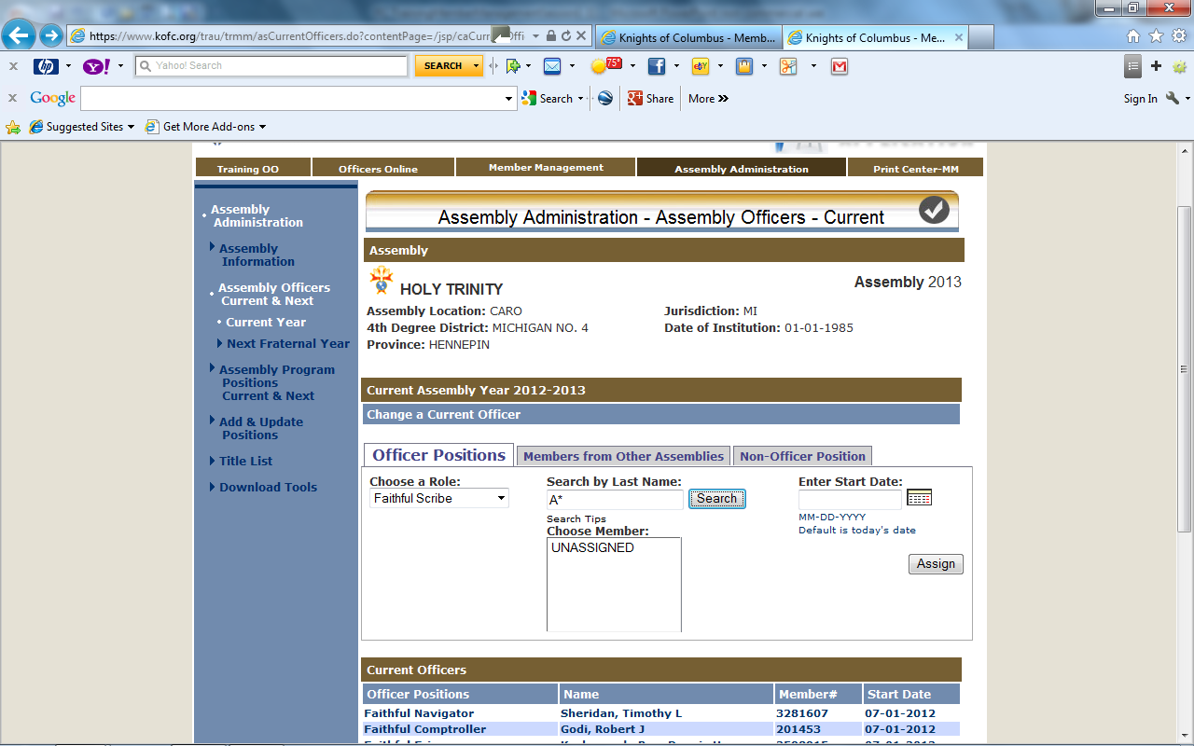
We have selected scribe from the drop down menu. Will search for the scribe name by typing in 1st letter of Last Name (A*). Then enter/return or click on the search button.

Slide 52
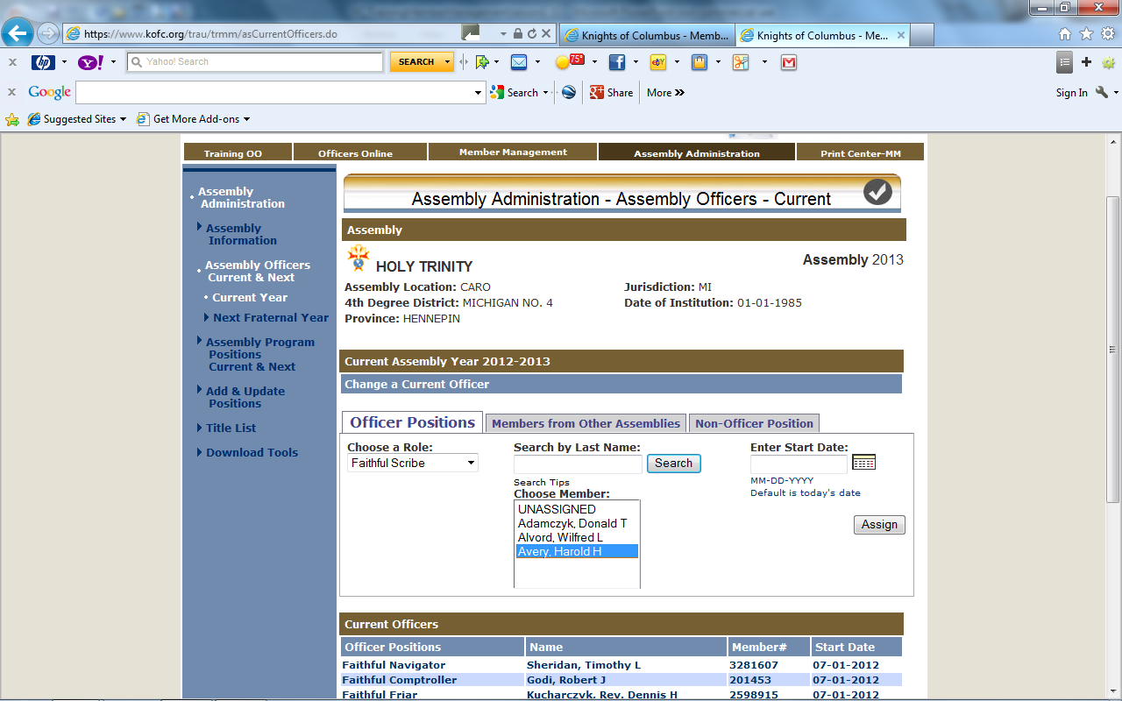
We have highlighted Avery our new scribe. We will now assign him to the scribe position by clicking on the assign button. The screen will refresh with his name as scribe.

Slide 53
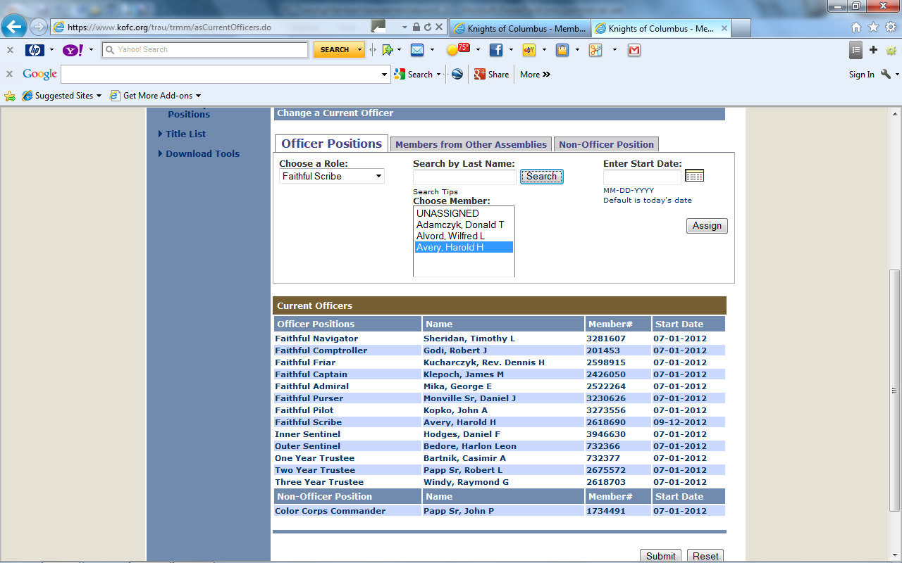
Note start date

Slide 54
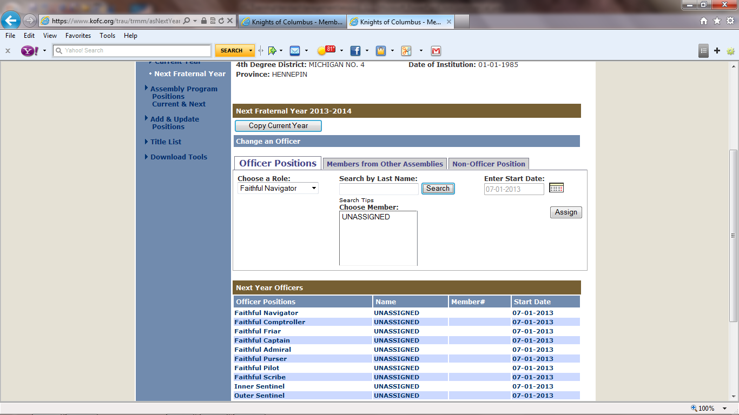
After the election of new officers in May we will work on the Next Year Officers:
It is best at this time to copy current year.
We will show what will happen next if you forget.

Slide 55
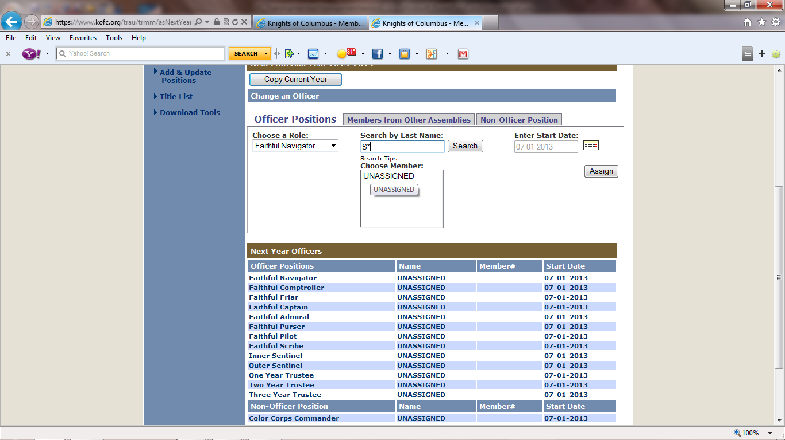
We are going to start with the Faithful Navigator’s Role. By doing a search for the new Faithful Navigator by enter the 1st letter of his last name (S) then click on the search button or enter/return key.

Slide 56
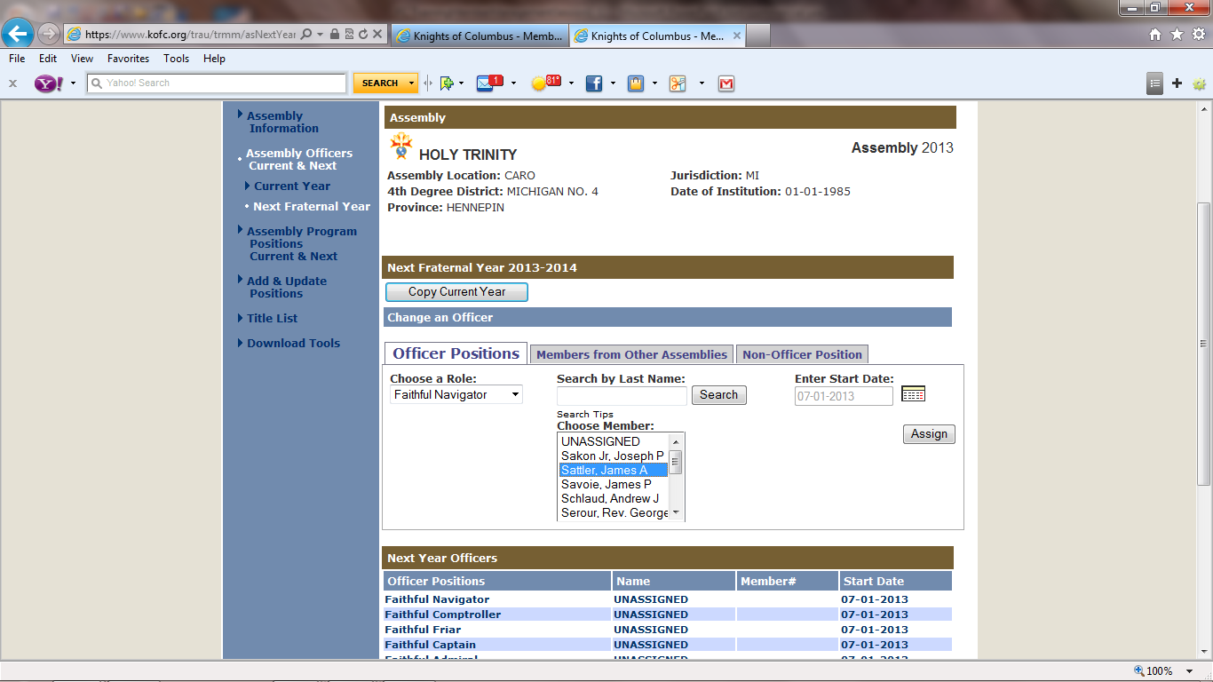
The screen has refreshed with a list of members. We will select Sattler, James A. Then click assign Button. The screen will refresh.

Slide 57
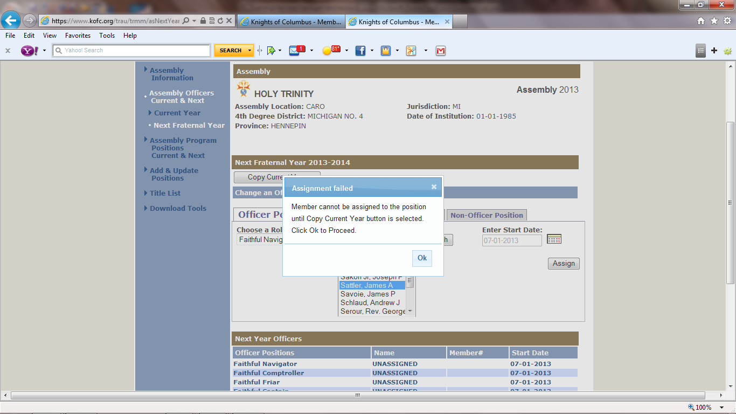
The screen has refreshed with a reminder that we must first copy current year into the next year officers.
Click on OK

Slide 58
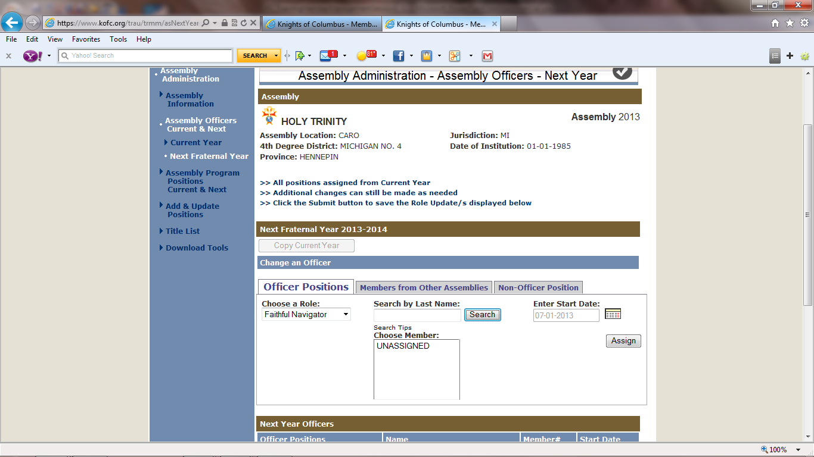
We will assign the name of the new officers to all roles that are not the same as the current year.

Slide 59
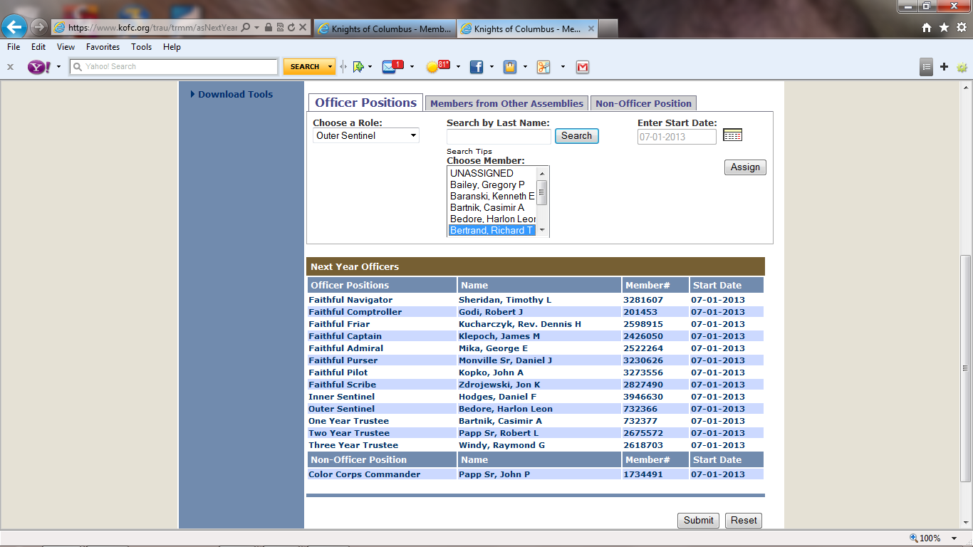
We have now assigned members to all the officer rolls. We will submit by clicking on the submit button .

Slide 60

Click the OK Button

Slide 61

Having submitted this form to Supreme is the same as submitting your form 186 Report of Officer Chosen For Term. You will need to send copies to the Vice Supreme Master, your District Master and one for your assembly records.
If there is an open position submit your report on time. The position can be filled later.

Slide 62

We will click on the Print Center tab. To work on the Reports for officers Chosen Next Fraternal Year

Slide 63
Reports:
To print reports properly on the paper:
Generate the Adobe file (clicking on the report name will do this).
Click on the print icon within the Adobe window.
When the Print window “Dialog Box” opens, the “Page Scaling" reference in this window should be set to ‘Fit to Print.’
Print the Report (click on “OK”).

Slide 64

We will now print report for “Next Fraternal Year Officers” by clicking on the tab.

Slide 65


Slide 66

I prefer to open and then save after reviewing. For me it seems less complicated and cleaner.

Slide 67


Slide 68

The report for Officer Chosen Next Fraternal Year has opened in Adobe. We now can save the report by Clicking on the Save Tab under File Folder

Slide 69

We have click the file tab
Select the Save As Tab

Slide 70
Save the report to a file on your computer. You can send the Officer Report by email as an attachment to the Vice Supreme Master and the District Master.

Slide 71

This is the opening page of the “Print Center – MM”. We have learned how to generate the Officer Report. You should take the time to explore the other available reports. We can look at “Labels” by clicking on the Link.

Slide 72

Take time to learn how each of these scenarios work. They are a great help and cost savings in printing labels for your specific needs.

Slide 73


Slide 74

“Outstanding Balance Report” is a useful tool for the Comptroller. By printing out a report at the start of the Billing Period you can check off the names as the payments are returned.

Slide 75


Slide 76


Slide 77


Slide 78


Slide 79


Slide 80


Slide 81


Slide 82


Slide 83


Slide 84


Slide 85


Slide 86


Slide 87
In order for email to work you need the email address of the assembly members and enter them into the Supreme Data Base for your assembly.

Slide 88
This has been an overview of
Member Management
Session 2 – Assembly Accounting
Session 3 - Member Billing

