Slide 1


WELCOME
FAITHFUL COMPTROLLER
FAITHFUL PURSER
FAITHFUL TRUSTEE
TRAINING
2019
1
Notes:
Welcome

Slide 2

Your Instructor
Robert “Bob” Godi
Former Master
Former District Deputy
2
Notes:
Your Instructor

Slide 3

FAITHFUL COMPTROLLER
Training
3
Notes:
Faithful Comptroller Training 2018

Slide 4

FAITHFUL COMPTROLLER
Elected by membership of assembly.
Can be reelected upon favorable review.
Reports to the Faithful Navigator
Reports all membership transactions to Supreme.
4
Notes:
Faithful Comptroller Duties Overview

Slide 5

FAITHFUL COMPTROLLER
Keeps record of all members of the assembly.
Collects fees, dues and all other funds of the assembly.
Transfers all monies to Faithful Purser.
Prepares all vouchers for obligations of assembly.
Maintains certain records of assembly finances.
5
Notes:
Faithful Comptroller Duties Overview

Slide 6
FAITHFUL COMPTROLLER
Submits supply and material orders.
Monitors timely filing of all assembly forms and reports.
Keeps all member financial records secure.
Assists the audit committee with assembly audit.
Any other duties assigned by Faithful Navigator.
6
Notes:
FAITHFUL COMPTROLLER Duties Overview

Slide 7
What we just saw were the highlights of the duties of the
Faithful Comptroller.
We will now look at each one closer.
Michigan and Ohio Resource Sites
7

Slide 8
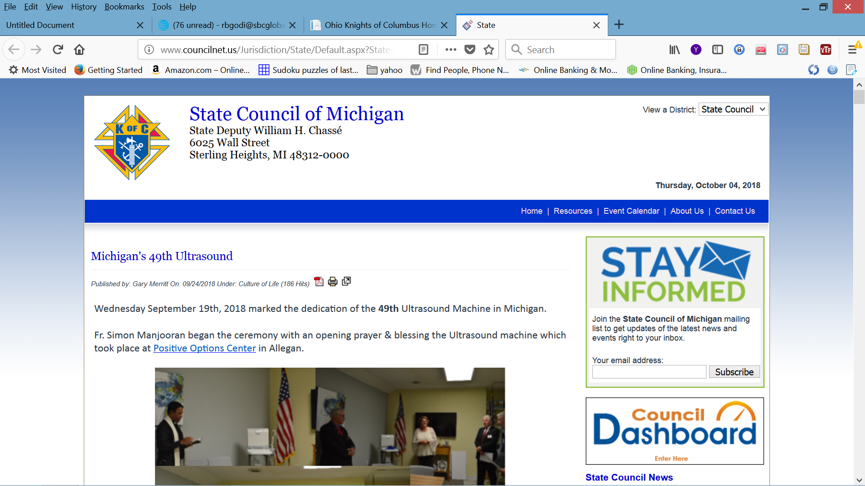
mikofc.org
8
Notes:
Michigan State Council Website
Resources

Slide 9
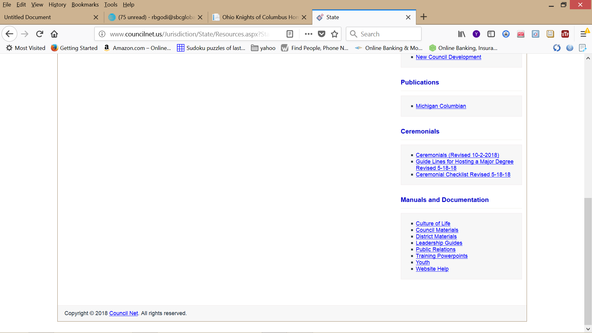
Go to bottom of page and see “Manuals and Documentation” select “Training PowerPoints”
Also look at
“Council Materials”
9
Notes:
Councils Materials
Training PowerPoints

Slide 10
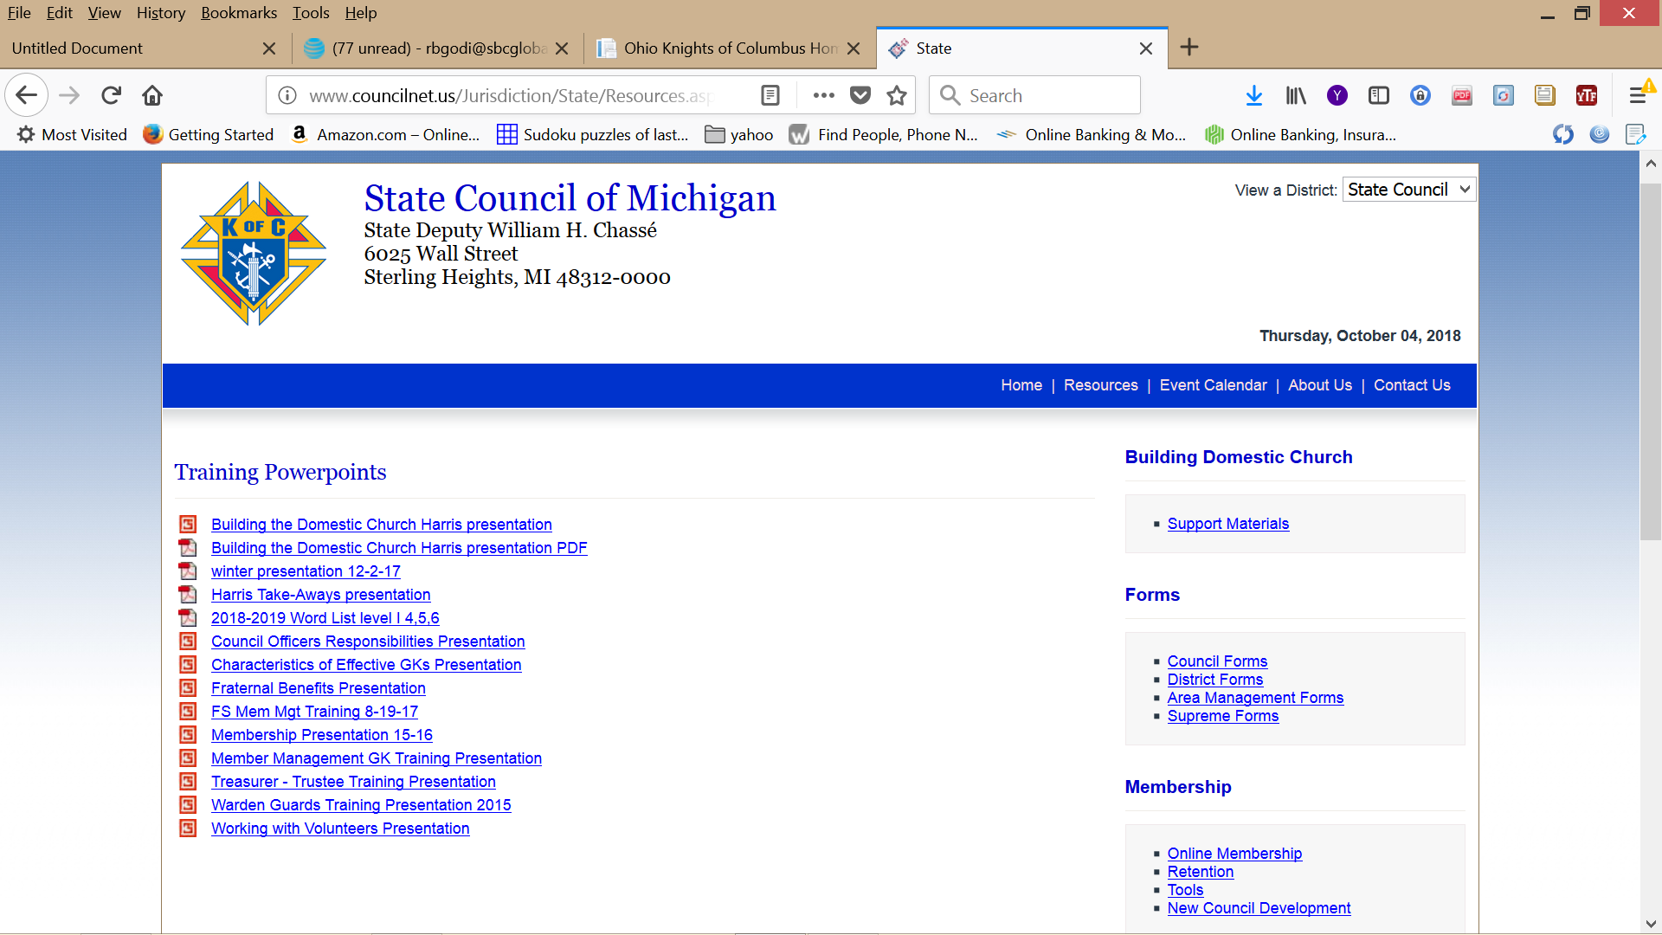
10
Notes:
Training PowerPoints

Slide 11
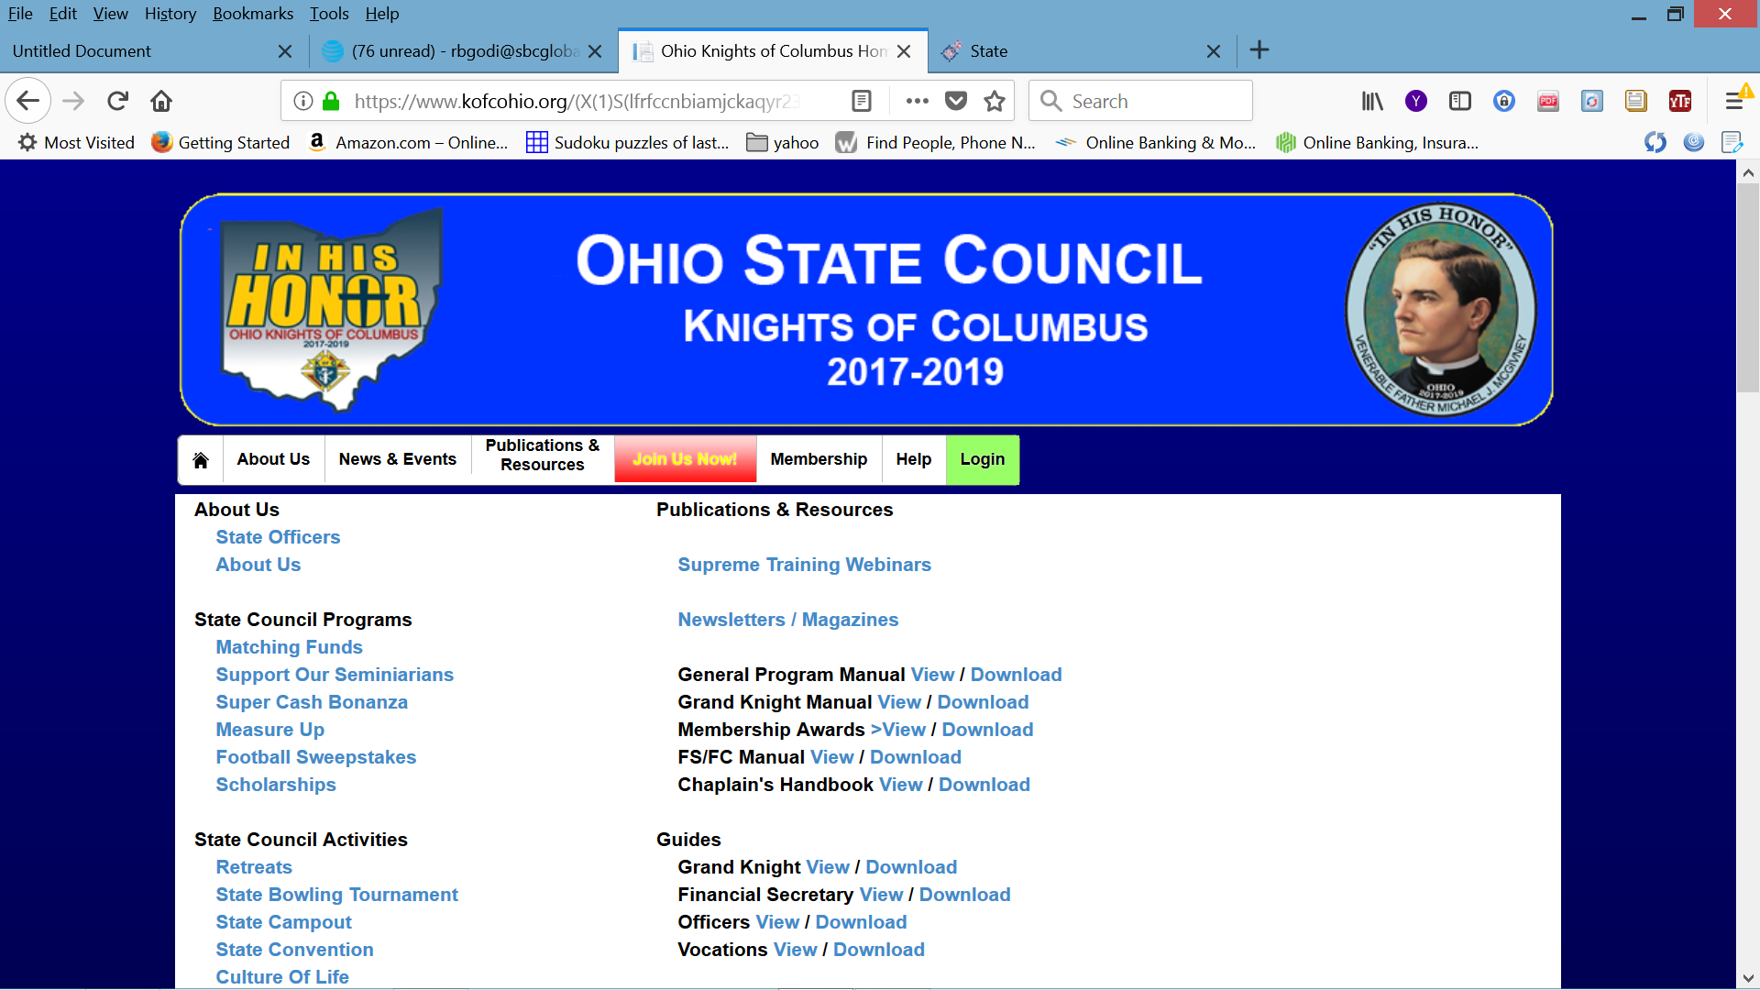
kofcohio.org
11
Notes:
OHIO STATE COUNCIL WEBSITE

Slide 12
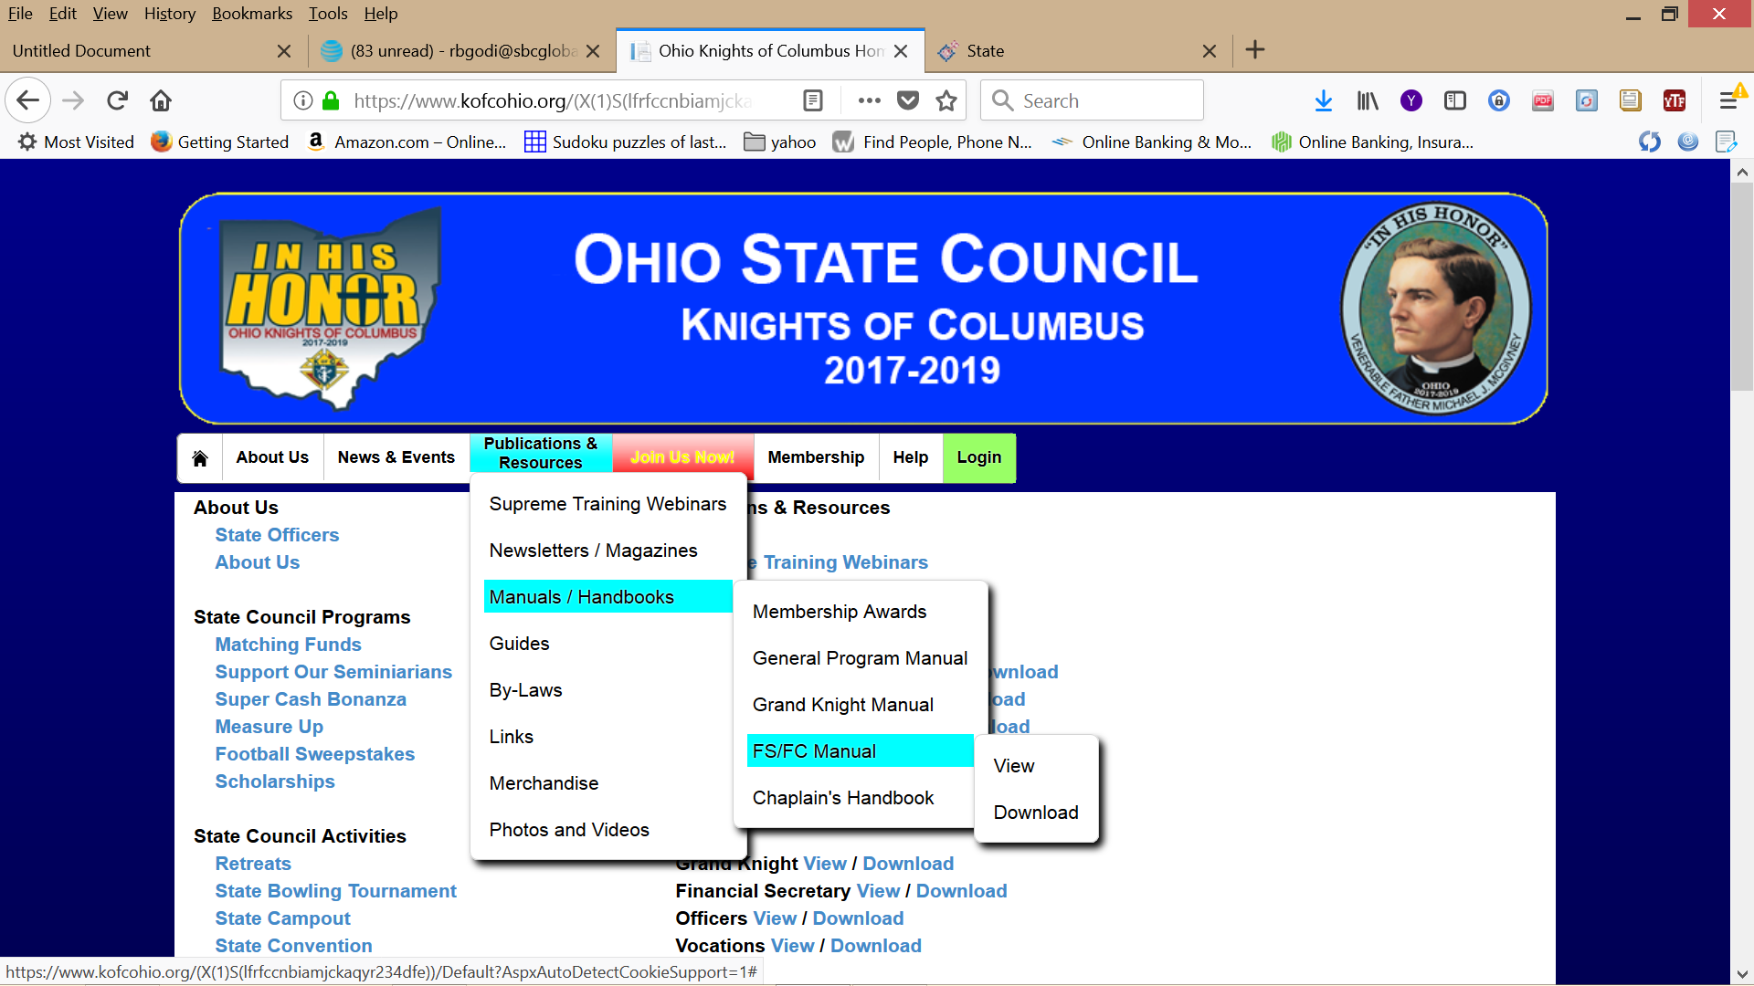
12
Notes:
FS/FC Manual

Slide 13
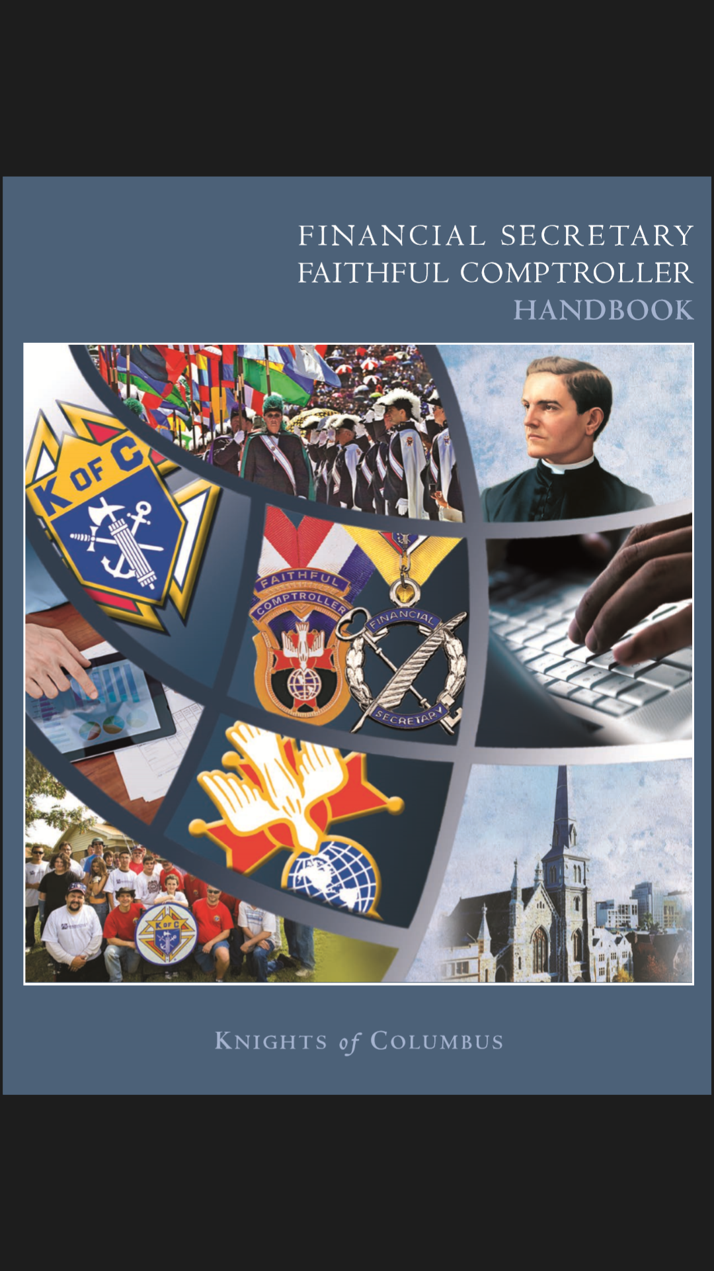
This manual can be download and be viewed, printed or saved to your computer.
13
Notes:
Financial Secretary
Faithful Comptroller
Handbook

Slide 14

DUTIES
COLLECT AND RECEIVE ALL MONEYS
The FAITHFUL COMPTROLLER shall collect and receive all moneys due the assembly and all funds obtained from any source (Section 139 — Laws and Rules of the Order).
14
Notes:
Duties
Collect and Receive all Money

Slide 15

BILLING PROCEDURES
The FAITHFUL COMPTROLLER will mail the Membership Bill — First Notice 15 days prior to the billing period. (January 1 calendar year or July 1 fraternal year)
If payment is not received in 30 days, the FAITHFUL COMPTROLLER will mail the Membership Bill — Second Notice.
15
Notes:
The FAITHFUL COMPTROLLER will mail the Membership Bill — First Notice 15 days prior to the billing period.
If payment is not received in 30 days, the FAITHFUL COMPTROLLER will mail the Membership Bill — Second Notice.

Slide 16
If payment is still not received within 30 days from the date the second notice was sent...
The FAITHFUL COMPTROLLER will provide the names, addresses, telephone numbers and amounts of delinquency for each member in arrears to the retention committee.
The committee should include — but is not limited to — the Faithful Navigator, chairman ex officio; membership director; retention chairman; trustees; and proposer, if available.
16
Notes:
If payment is still not received

Slide 17
• The Faithful Navigator will assign a member of the retention committee to make personal contact with the delinquent member to remind him of his obligation. The committee member will provide a written report of his findings to the Faithful Navigator. If the member is experiencing financial difficulty, the Faithful Navigator will direct the committee members to visit the member and make arrangements to accommodate him with either a payment plan or other financial arrangement acceptable to the assembly. Again, a full report is to be provided to the Faithful Navigator as to why the member is delinquent and why he is considering leaving the Order. Financial difficulty is not a valid reason for suspension.
17
Notes:
Retention committee to make personal contact

Slide 18
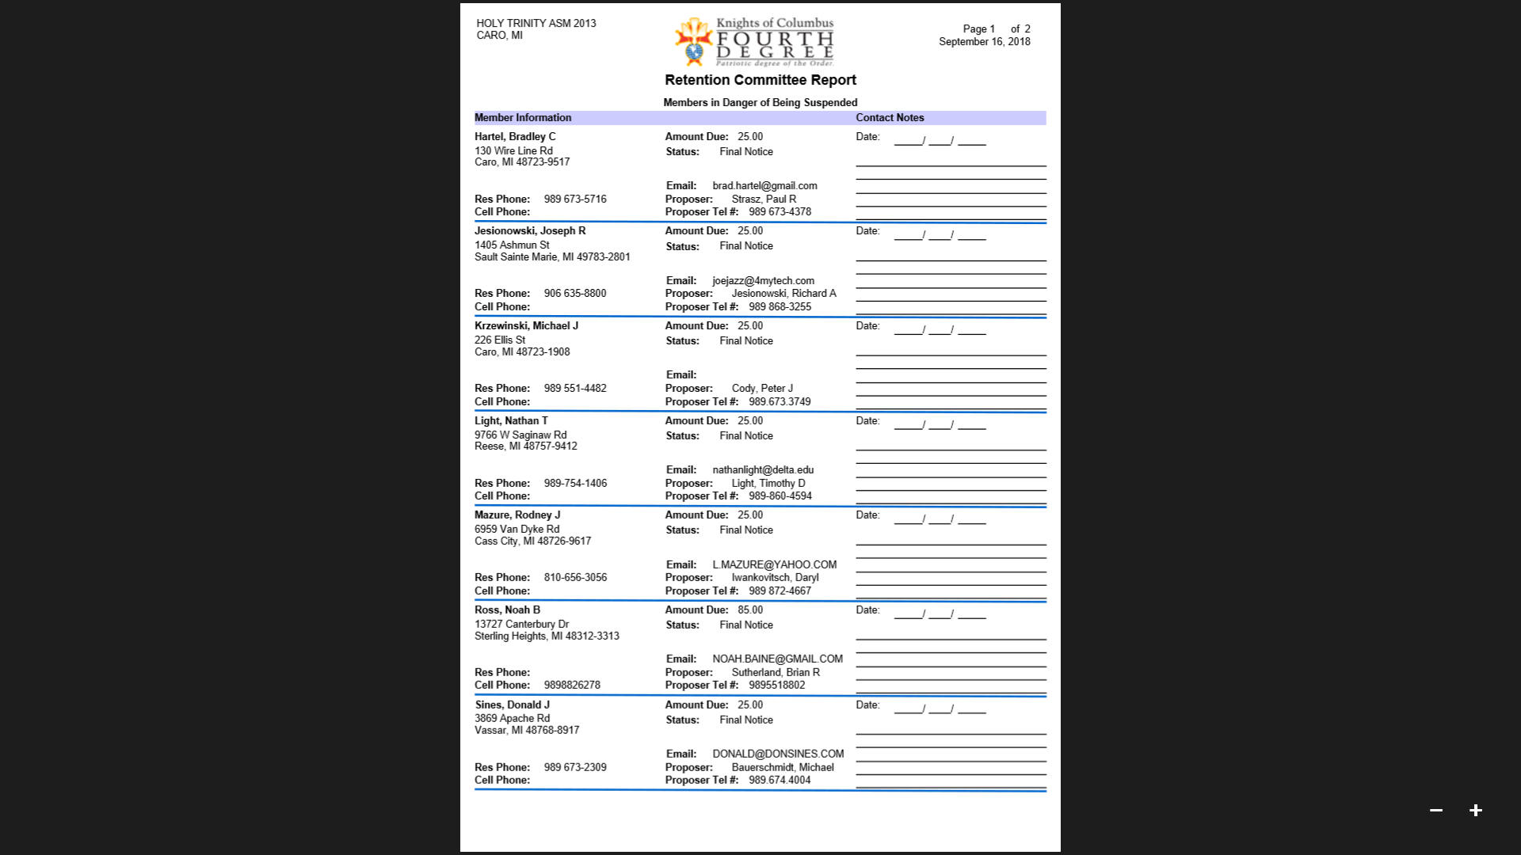
Retention Committee Report
Notice a place for date of contact and results of contact
13
13
13
18
Notes:
Retention Committee Report
Notice a place for date of contact and results of contact

Slide 19
If at the end of the second month of arrearage the member still has not paid his dues, the Final Notice in the Fourth Degree is to be prepared and signed by the FAITHFUL COMPTROLLER.
Notice: any member suspended in the third degree is automatically suspended in the fourth DEGREE.
19
Notes:
the Final Notice

Slide 20
If the delinquent member does not meet his obligation or arrange a satisfactory payment schedule within 60 days following processing of the final Notice, the assembly may file a Form 4 Membership Document, indicating suspension.
20
Notes:
Delinquent member does not meet obligation

Slide 21
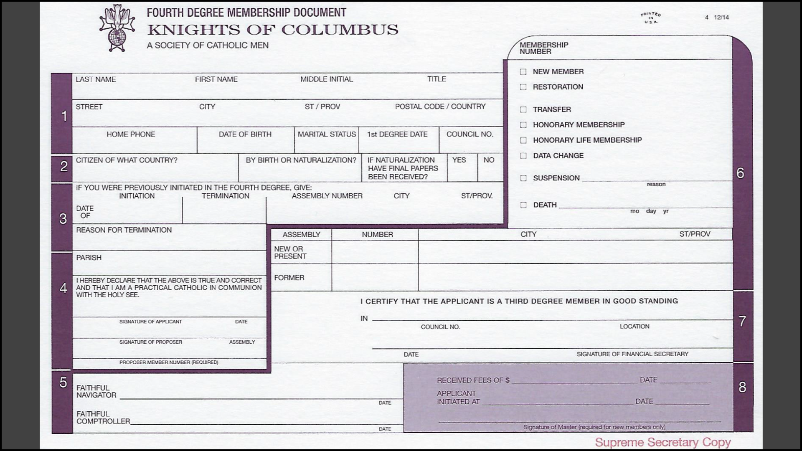
A Form 4 needs to be processed to remove a member from an assembly roster.
21
Notes:
A Form 4 needs to be processed to remove a member from an assembly roster.

Slide 22
KEEP ACCOUNTS
Be the accountant of his assembly, keeping said accounts so that they show the complete and accurate financial standing of the assembly and its members at all times by utilizing such systems and records as are required by the Laws and Rules and furnished by the Supreme assembly at the expense of the subordinate assembly. (Member Management)
22
Notes:
KEEP ACCOUNTS
FS accountant of his assembly

Slide 23
PAY MONIES TO Faithful Purser
Pay over to the Faithful Purser of his assembly all monies received at meetings or between meetings for fines, dues, contributions, initiation fees or from other sources, for which said Faithful Purser shall issue a receipt to such FAITHFUL COMPTROLLER, specifying the funds to which the same shall be credited, which receipt shall be given to the Faithful Navigator by the FAITHFUL COMPTROLLER before the next succeeding meeting. (Member Management)
23
Notes:
PAY MONIES TO Faithful Purser

Slide 24

KEEP ROLL:
Keep a roll of the members, their ages, residences and occupations, with the dates of initiation. (Member Management)
24
Notes:
KEEP ROLL
Keep a roll of the members

Slide 25

NOTIFY SUPREME COUNCIL OF ELECTIONS:
Notify the Supreme COUNCIL of the names and addresses of all assembly officers using Member Management.
(Form 186)
MM
25
Notes:
NOTIFY SUPREME SECRETARY OF ELECTIONS
Member Management

Slide 26
KEEP CERTAIN RECORDS:
Keep a record of the financial and business transactions of his assembly using systems and records approved by the Board of Directors and furnished by the Supreme assembly at the expense of the assembly. the number of proposals received and the names of the candidates, the number elected and their names, the number initiated and their names; the amount of money received and from what sources, the amount paid to the Faithful Purser and for what purpose, the amount of all orders drawn against the Faithful Purser, stating to whom paid and for what purpose. (Member Management)
26
Notes:
KEEP CERTAIN RECORDS

Slide 27
FREQUENTLY ASKED QUESTIONS
1. How long should I retain assembly records?
2. How can I receive a copy of my roster?
3. What does a assembly do when a member states he has
transferred to another assembly and has a dues arrearage?
4. Which transactions must still be reported by submission
of the proper paper form?
FINANCIAL SECRETARY=FAITHFUL COMPTROLLER HANDBOOK
See pages 104 – 110 (Frequently Asked Questions)
27
Notes:
FREQUENTLY ASKED QUESTIONS
1. How long should I retain council/assembly records?
2. How can I receive a copy of my roster?
3. What does a council do when a member states he has
transferred to another council and has a dues arrearage?
4. Which transactions must still be reported by submission
of the proper paper form?
FINANCIAL SECRETARY=FAITHFUL COMPTROLLER HANDBOOK
See pages 104 – 110

Slide 28
DRAW ORDERS:
Draw all orders on the Faithful Purser of his assembly when ordered by the Supreme COUNCIL, vice supreme MASTER, DISTRICT MASTER, his local assembly, board of trustees or Faithful Navigator for the payment of all claims or demands against his assembly, which orders shall be signed by him and countersigned by the Faithful Navigator. (Member Management)
28
Notes:
DRAW ORDERS
Draw all orders on the Faithful Purser of his assembly
Voucher system Member Management

Slide 29
NOTIFY SUPREME COUNCIL OF MEMBERSHIP TRANSACTIONS:
Notify the Supreme COUNCIL promptly of members suspended, expelled, deceased, readmitted, transferred into the assembly, etc., on the Form 4 Membership Document. Data changes can be reported through Member Management. MASTER NOTIFIES SUPREME COUNCIL OF NEW MEMBERS INSTALLED. (After exemplification)
29
Notes:
NOTIFY SUPREME SECRETARY OF MEMBERSHIP TRANSACTIONS
Notify the Supreme Secretary promptly
Deceased can be reported through Member Management
Member's insurance benefits

Slide 30
NOTIFY CANDIDATE’S Faithful Navigator:
When a candidate receives degrees in a assembly of which he is not a member, the FAITHFUL COMPTROLLER thereof shall notify the Faithful Navigator of said candidate’s assembly.
30
Notes:
NOTIFY CANDIDATE’S Faithful Navigator
A candidate receives degrees in a assembly of which he is not a member

Slide 31

MAINTAIN assembly SEAL:
Keep the seal of the assembly and affix the same to all proper papers, etc. (Membership Cards)
YOUR
ASSEMBLY
K OF C
31
Notes:
MAINTAIN assembly SEAL
Keep the seal of the assembly and affix the same to all proper papers,
Membership Cards

Slide 32

OTHER DUTIES:
Perform all other acts required by the Laws of his assembly and the Order and the Rules of the Board of Directors.
32
Notes:
OTHER DUTIES

Slide 33

33
Notes:
It’s question time!!!

Slide 34


Purser – Trustees
Training
2018
34
Notes:
Stop Me as we go if you have Questions

Slide 35
Council Materials –
www.mikofc.org
Resources
Council Materials
Treasurer Training Manual 2013
35
Notes:
Where to find Council Materials.

Slide 36
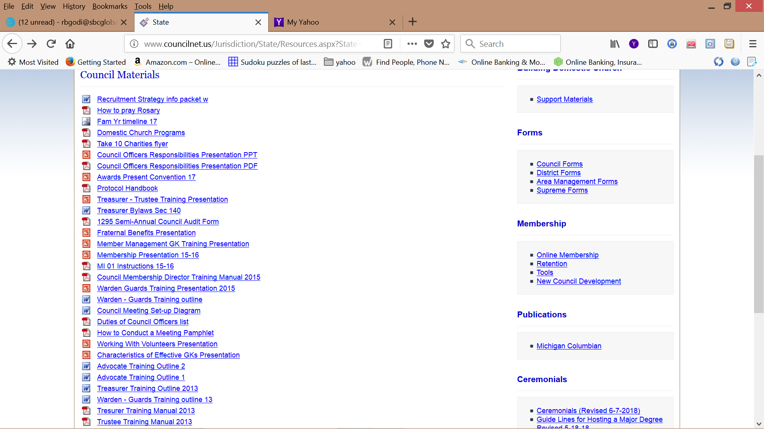
36
Notes:
On Michigan State Council Website

Slide 37
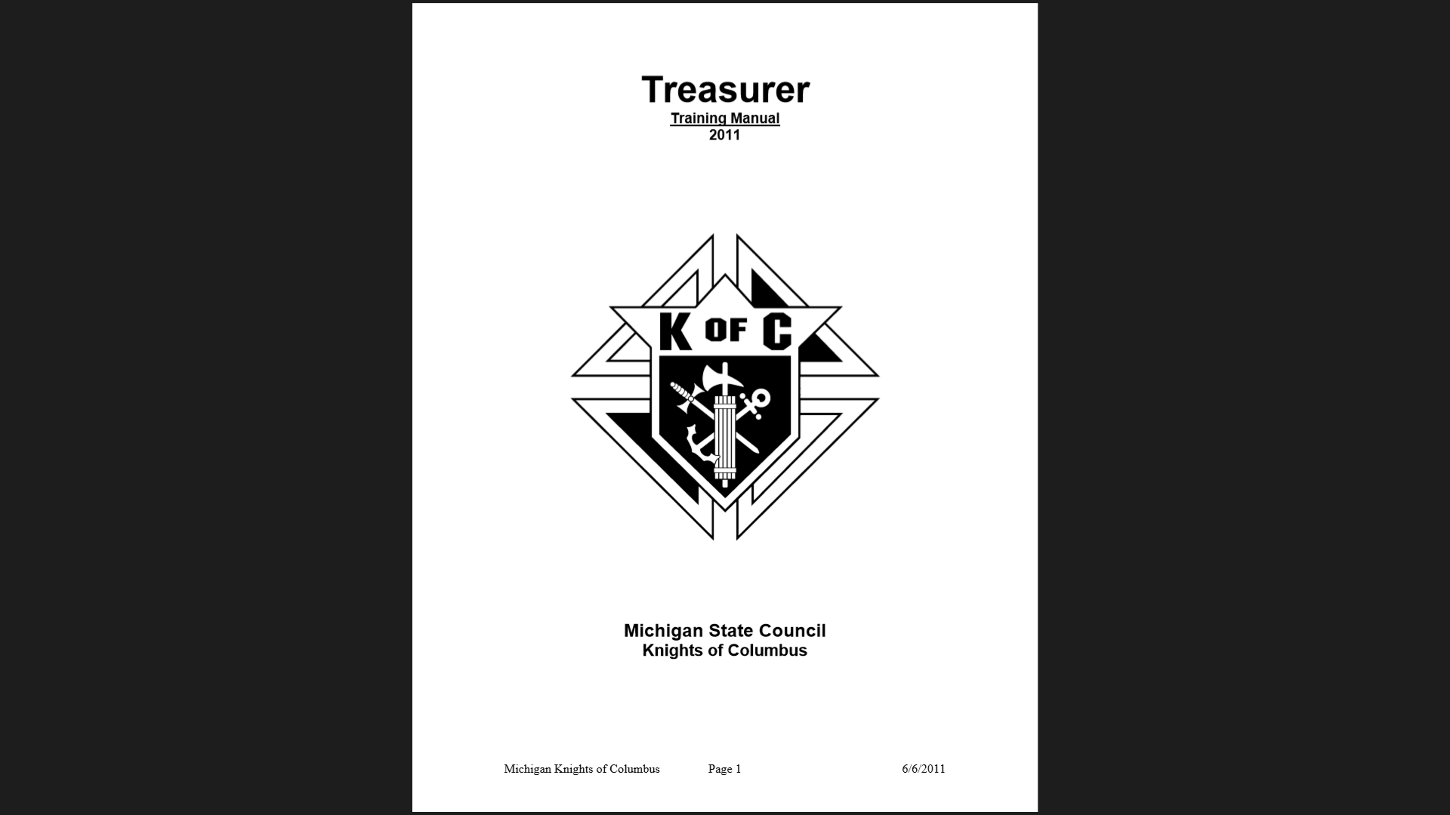
This manual can be download and be viewed, printed or saved to your computer.
Contains information the Faithful Purser can use in the performance of his job.
37
Notes:
Treasurer Training Manual
Contains information the Faithful Purser can use in the performance of his job.

Slide 38

Faithful Purser
Charged with handling assembly funds
Receives money from Faithful Comptroller and deposits it in the proper assembly accounts
Responsible for paying all assembly expenses, including assessments from Supreme
Maintain accurate records of all monies received and expended by the assembly
38
Notes:
Charter Constitution Laws - Treasurer sec.140

Slide 39

Assembly Team of Financial Officers
Faithful Navigator
Faithful Comptroller
Faithful Purser
Faithful Trustees
39
Notes:
Communication and co-operation critical
Purser is key to clarity & integrity of records
Making sure bills are payed in a timely fashion
And sent to the correct location

Slide 40
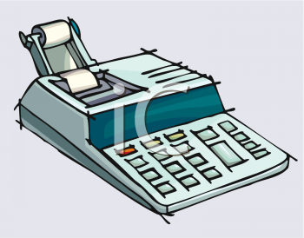
Annual Audit
Faithful Comptroller – Faithful Purser – Faithful Scribe submit relevant records
Board of Trustees conduct the Audit
You should be present but you may not complete the audit
40
Notes:
You may explain your records if the board of trustees have questions

Slide 41

Working with the F.C.
FC receives all incoming funds.
FC records these funds and turns over to Faithful Purser with breakdown.
Faithful Purser prepares receipt and gives original to FC.
Faithful Purser deposits funds into bank in a timely manner.
Faithful Purser presents deposit slip and FC presents original receipt to FN before the next meeting.
41
Notes:
Discussion Questions:
1. What should you do if the FC is not at the meeting and there is money to be turned in from an event?
2. Can I have someone else make a deposit for me if I am unable to do so in a timely manner?
3. If I don’t have the receipt book (Form 281) with me (at a council picnic, for instance), should I take money from the FC?
What about #5 ???

Slide 42
Discussion Questions:
What should I do if the FC is not at the meeting and
there is money to be turned in from an event?
2. Can I have someone else make a deposit for me if I am
unable to do so in a timely manner?
3. If I don’t have the receipt book (Form 281) with me (at a
council picnic, for instance), should I take money from
the FC?
42
Notes:
Discussion Questions:
1. What should I do if the FC is not at the meeting and
there is money to be turned in from an event?
2. Can I have someone else make a deposit for me if I am
unable to do so in a timely manner?
3. If I don’t have the receipt book (Form 281) with me (at a
council picnic, for instance), should I take money from
the FC?

Slide 43
Paying the bills
Faithful Comptroller prepares voucher (Form 157) or using the Member Management.
Faithful Navigator co-signs voucher.
You need a voucher for every check
  Trustees examine the voucher- recommend the approval or rejection by assembly
  Motion by the assembly - “the final authority”
  Budgeted Items - brought up as a “bill”
  Supreme Supplies - No approval is necessary for Supreme charge
43
Notes:
Consider using the check number as the voucher number. This will prove to be convenient and unambiguous for your auditors.

Slide 44
Paying the bills
Faithful Purser prepares check.
Faithful Purser staples bill to voucher and records check number on it.
FN/F Captain co-sign check.
Faithful Purser mails check.
Faithful Purser records disbursement in an appropriate spreadsheet and on check stub.
44
Notes:
Discussion Questions:
1. Even if the FC is absent, we will still need to pay bills. Who should complete the vouchers?
2. Who is authorized to endorse (sign) our assembly’s checks and how do I add myself as a signatory?
3. What do I do if someone submits a voucher for reimbursement of an expense without receipts as proof?
4. What are my responsibilities if I know I will be absent for a meeting?

Slide 45
Discussion Questions:
1. Even if the FC is absent, we will still need to pay bills.
Who should complete the vouchers?
2. Who is authorized to endorse (sign) our assembly’s checks
and how do I add myself as a signatory?
3. What do I do if someone submits a voucher for
reimbursement of an expense without receipts as proof?
4. What are my responsibilities if I know I will be absent for
a meeting?
45
Notes:
Discussion Questions:
1. Even if the FS is absent, we will still need to pay bills.
Who should complete the vouchers?
2. Who is authorized to endorse (sign) our council’s checks
and how do I add myself as a signatory?
3. What do I do if someone submits a voucher for
reimbursement of an expense without receipts as proof?
4. What are my responsibilities if I know I will be absent for
a meeting?

Slide 46
Bank Reconciliation
Faithful Purser receives monthly bank statement.
Adds any interest into checkbook and Journal.
Looks for any unusual charges or credits and deducts or adds to checkbook as necessary.
Checks off all checks and deposits that have cleared.
Using back of statement, Faithful Purser writes in balance of statement in appropriate place.
46
Notes:
Bank Reconciliation

Slide 47
Bank Reconciliation
Faithful Purser lists all open deposits and un-cashed checks in appropriate spots on statement.
Balance derived on back should agree with checkbook – if not, examine amounts and additions and subtractions until correct.
47
Notes:
Bank Reconciliation

Slide 48
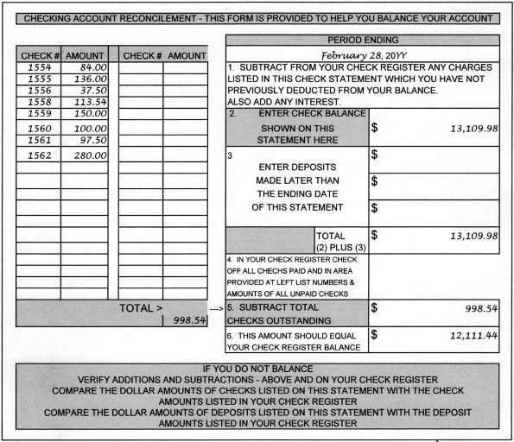
48
Notes:
Highlight
Balance
Outstanding checks
Outstanding deposits - avoid by restricting deposits - 5 days?
This could be done with a spread sheet or a program (Quicken, Microsoft Money, Excei, etc.)

Slide 49
Un-cashed checks
Checks that have not been cashed that are beyond the legal period (60 to 90 days).
Contact payees to see why checks have not been cashed.
Issue a “stop payment” if the amount is significant.
If check is not found, void original and reissue a new check to payee.
49
Notes:
Checks that have not been cashed that are beyond the legal period (60 to 90 days).
When you order new checks - Note should be on checks along with assembly number
 Contact payees to see why checks have not been cashed.
Lost?
 Issue a “stop payment” if the amount is significant.
 If check is not found, reissue a new check to payee.

Slide 50
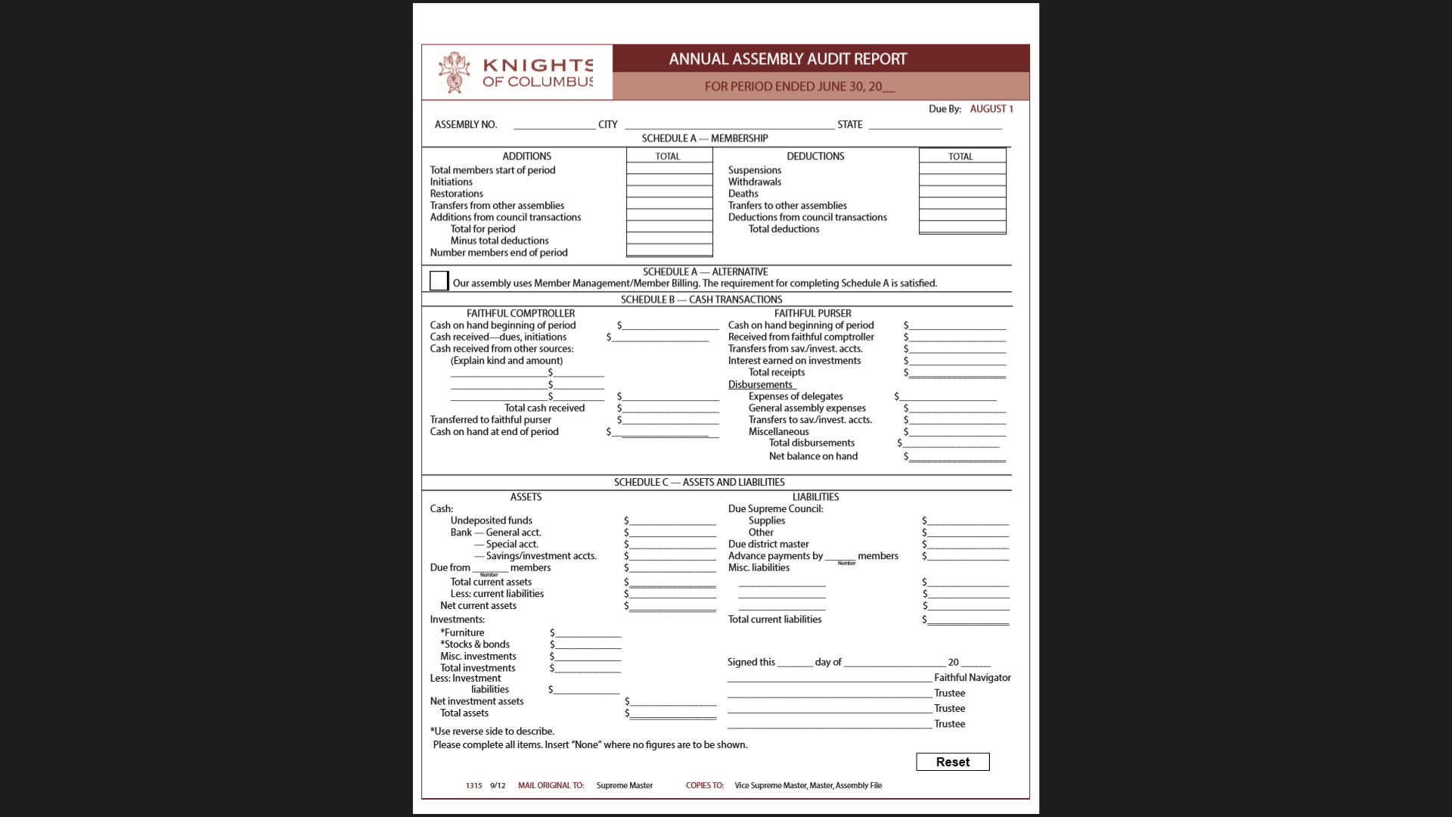
Annual Audit
Due to Supreme by Aug. 1
Schedule A – satisfied by Membership Management
35
50
Notes:
Schedule A – satisfied by Membership Management by checking box.

Slide 51
The Audit
FC presents all of the vouchers with bills attached available for review.
Faithful Purser presents checkbook, check register, vouchers and bank statements to Trustees.
AUDIT FORMS ARE TO BE DONE BY TRUSTEES. NOT THE FP - FC
Last period’s ending balance must be this audit’s beginning balance in:
        Schedule A – Membership
        Schedule B – Cash Transactions.
        Schedule C – Assets and Liabilities
51
Notes:
The Audit

Slide 52

A
B
c
52

Slide 53
The Audit
FN/F Captain oversees audit.
Faithful Purser and Faithful Comptroller should be available to answer questions.
Trustees report audit findings at the next meeting following the audit.
A VSM or District Master may review and/or audit books at any time
53
Notes:
The Audit

Slide 54
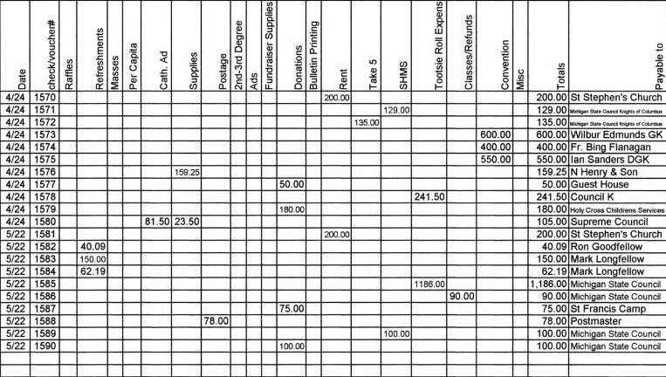
The Ledger
54
Notes:
Paper vs Technology
Someone in your assembly must know Excel
A table like this could be put together in ½ hour
With a second page for receipts

Slide 55

Preparing a Budget
Assembly Team of Financial Officers
Base 3-5 year expenditures / income
Pass as a resolution
Do not include pass-through monies as income (Tootsie roll, take-5, McGivney Chair etc.)
Make budget as detailed as possible.
    Name of payee -Amount to be paid - When
55
Notes:
Preparing a Budget

Slide 56
WHY a Budget??
PPPPPP – Proper Prior Planning Prevents Poor Performance
Meetings are faster
New spending needs new income
56

Slide 57

Reporting at meetings
FC reports income from previous month
Faithful Purser Reports:
Beginning Balance
Expenses
Income (including checkbook interest)
Ending Balance
Written copies of reports for the recorder
57
Notes:
FC Total and breakdown (each item)
#3 should match FC

Slide 58
58
Notes:
It’s question time!!!

Slide 59
Council Materials –
www.mikofc.org
Resources
Council Materials
Trustee Training Manual 2013
59
Notes:
Where to find Council Materials.

Slide 60
60
Notes:
On Michigan State Council Website

Slide 61

This manual can be download and be viewed, printed or saved to your computer.
Contains information the Faithful Trustee can use in the performance of his job.
61
Notes:
Trustee Training Manual

Slide 62
Board of Trustees
Consists of FN and three other elected members
Supervises all financial business of the assembly
Conducts the annual audit
Are elected for terms of three, two and one year.
“They shall perform such other duties as their assembly or the District Master or the officers of the Order may direct.”
Notes:
Primary Duties

Slide 63
Primary Duties
Supervise all financial business of the assembly and approve the payment of all bills
Scrupulously audit assembly financial records
Verify that the assembly sticks to the budget
Approve banks used by the assembly
Set bonding amounts for the FC & FP
Be involved in the selection of the Chaplain
Notes:
The two primary charges:
Ensure that your assembly’s financial status remains in a healthy condition
The vitally important annual audit of the assembly’s financials are conducted

Slide 64

Primary Duties continued
Guide your assembly in matter of tax returns, charitable fund raising, and licensed gaming
Participate in the evaluation of the FC
Serve on the assembly's retention committee
Notes:
Primary Duties

Slide 65
Supervise finances
Always follow protocol or good business practices
Examine the voucher for submitted bills
Motion by the assembly - “the final authority”
Budgeted Items - brought up as a “bill”
Supreme Supplies - No approval is necessary for Supreme or District charges
Assembly by-laws may provide for mutual aid
No money in excess of $500.00 shall be paid or transferred except…..
Notes:
 Submitted Bills – “I recommend that the bills be paid”
 “final authority” unless it violates #5
 Is it already paid?
Is there money left in the budget?
May not use pass-through funds
 Treasurer will read as information
 Resolution required – 2 x $500 does not work

Slide 66
Audit Requirements
Under no circumstances should either the FC or FP prepare the audits
This is to safeguard the assembly’s financial affairs
If the Trustees and FN cannot personally make the audit, they should arrange to have one made by a qualified member at the expense of the assembly.
The Board of Trustees should not control records for more than 1 week.
Notes:
Audit Requirements

Slide 67
Records & items from the FC
Vouchers
Receipts, Purser to FC
Current Assembly Roster (July 1)
Assembly Statements for the audit period
Cash and checks on hand, if any
Bills or invoices requiring payment
Copy of last assembly audit
Member ledgers (or Outstanding Balance Report in Member Billing)
Notes:
Records & items from the FC

Slide 68
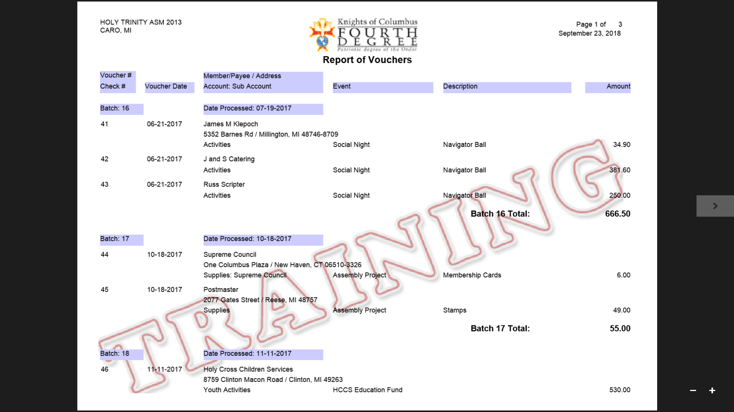
July 1 – June 30
Using Member Management
Notes:
Report of Vouchers – Member Management

Slide 69
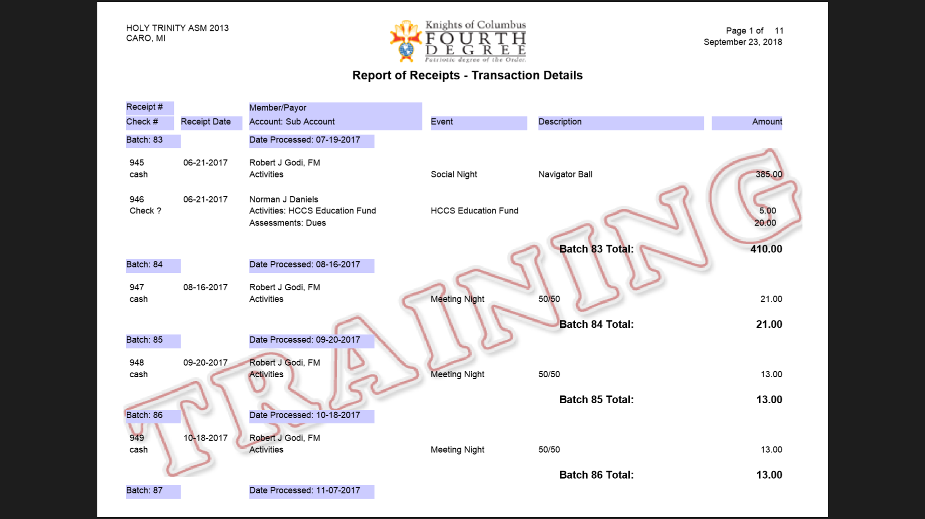
July 1 – June 30
Using Member Management
Notes:
Report of Receipts – Member Management

Slide 70
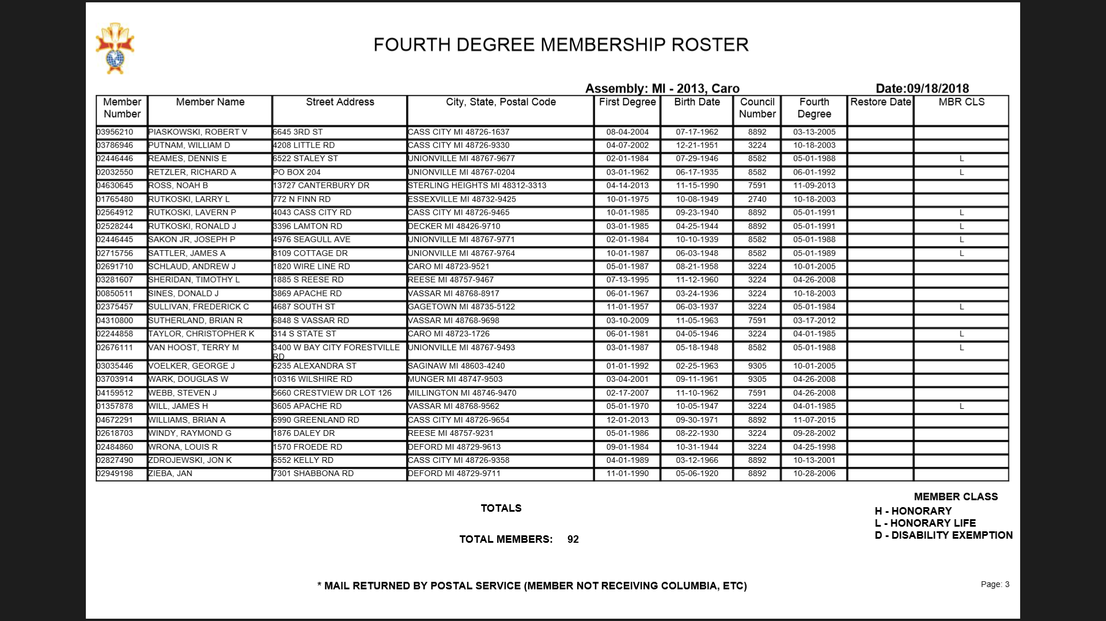
LAST PAGE
Notes:
Last page
FOURTH DEGREE MEMBERSHIP ROSTER

Slide 71
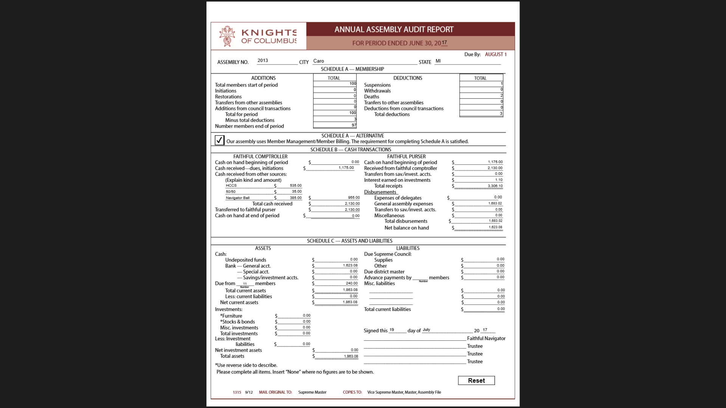
These figures must appear at the top of the next Audit
Copy of last assembly audit
Notes:
Copy of last assembly audit
These figures must appear at the top of the next Audit

Slide 72



From the PURSER
Faithful Purser’s Cash Book
Check book, bank statements, cancelled checks and vouchers for the audit period.
All bank books, all accounts.
All documents reflecting cash or liquid assets such as stocks, bonds, notes, etc.
From the Scribe
Minute Book
Notes:
From the Purser
From the Scribe

Slide 73

Completing the
Audit Report
Each member of the board of trustees should have a copy and read pgs.5-10 of the Trustee training Manual.
Audit report is due Aug.1.
At the next regular meeting following the audit, the Trustees should report to the membership.
Notes:
Completing the Audit Report

Slide 74
Trustee Training Manual pages 5 -10
COMPLETING THE AUDIT REPORT
SCHEDULE A — MEMBERSHIP
SCHEDULE B — CASH TRANSACTIONS TREASURER
AUDITING DUES PAYMENTS
SCHEDULE C — ASSETS AND LIABILITIES
ASSETS
LIABILITIES
INVESTMENTS
DISTRIBUTING COMPLETED AUDIT
Notes:
Trustee Training Manual pages 5 -10

Slide 75
A
B
c
Notes:
Annual Assembly Audit Report

Slide 76
FREQUENTLY ASKED QUESTION
1. What would you do if you discovered that a check had been
written for which there was no voucher?
2. What would you do if, while scrutinizing a voucher during the
meeting, you discovered that proper receipts for a
reimbursement were missing?
3. When can a Trustee look at the Treasurer’s checkbook or ledger?

Slide 77

Assembly Budget
Encourage the establishment of a reasonable assembly budget.
Budget should be prepared by the FN, FC, Faithful Purser and Trustees.
Budget should be adopted by resolution.
Maintain an accurate balance of remaining funds.
Remind assembly of current status of the budget when new spending is discussed
Notes:
Know what you have to spent = what you have to earn
The Financial team
Resolution
1st meeting in writing no discussion
Publish
2nd meeting discuss & vote
Check with Purser & FC before meeting
New Spending = New fund raising

Slide 78

Tax Returns
The board of trustees should have a copy and read pgs.5-10 of the Trustee Training Manual.
Each assembly:
Is federal tax-exempt under Sec. 501(c)(8)
Must have an (EIN) Employer Identification Number
Must file a return with the IRS
With annual gross receipts of :
  $50,000 or less electronically file a Form 990-N
  $50,001 to $199,999 use Form 990- EZ
Notes:
Reading is good – cover some highlights
Federal not state sales tax
Include es pass-through monies as income
990

Slide 79
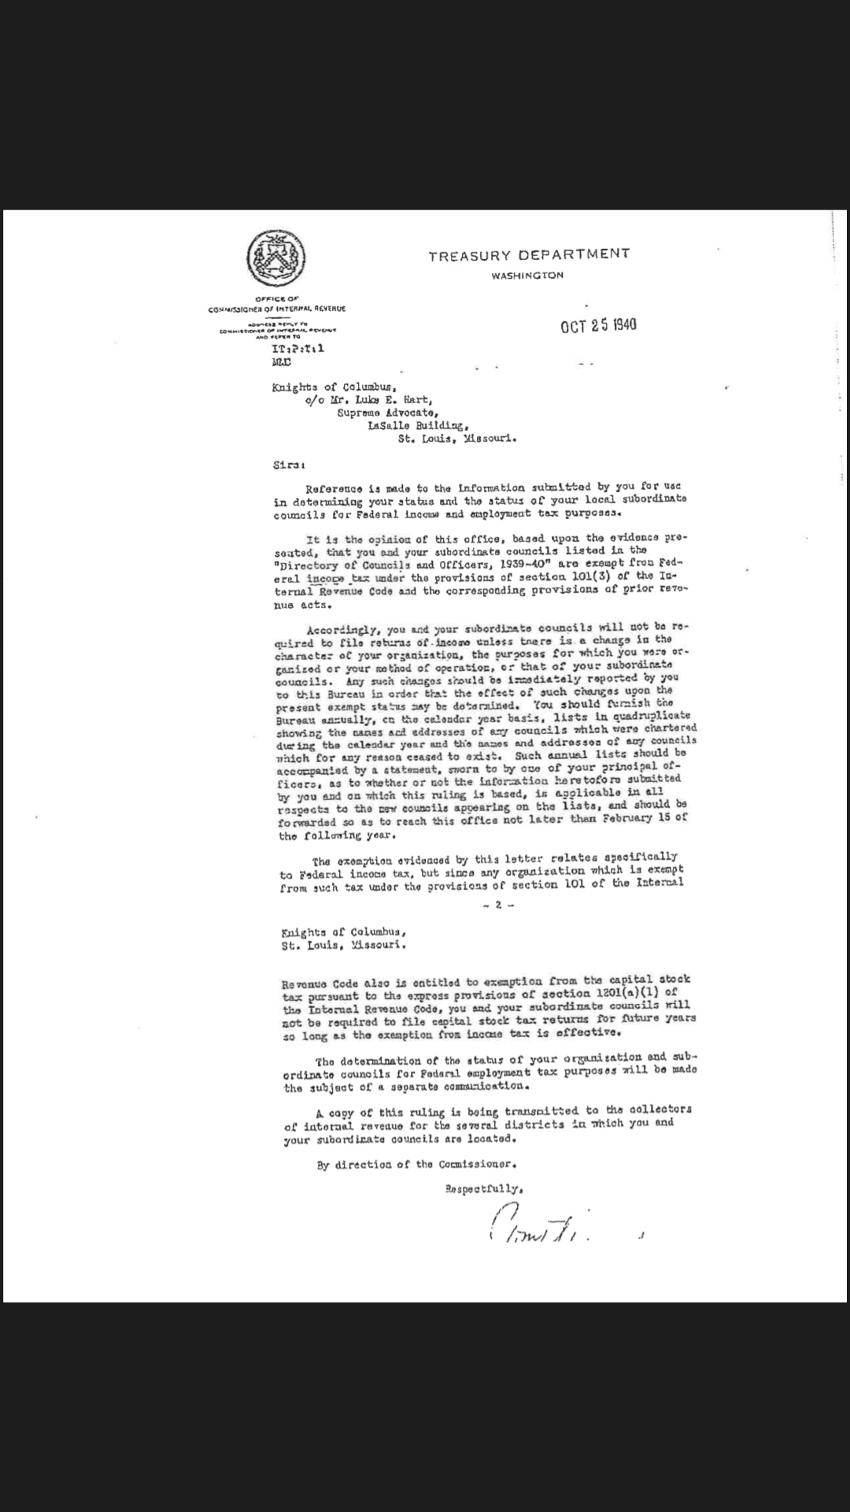
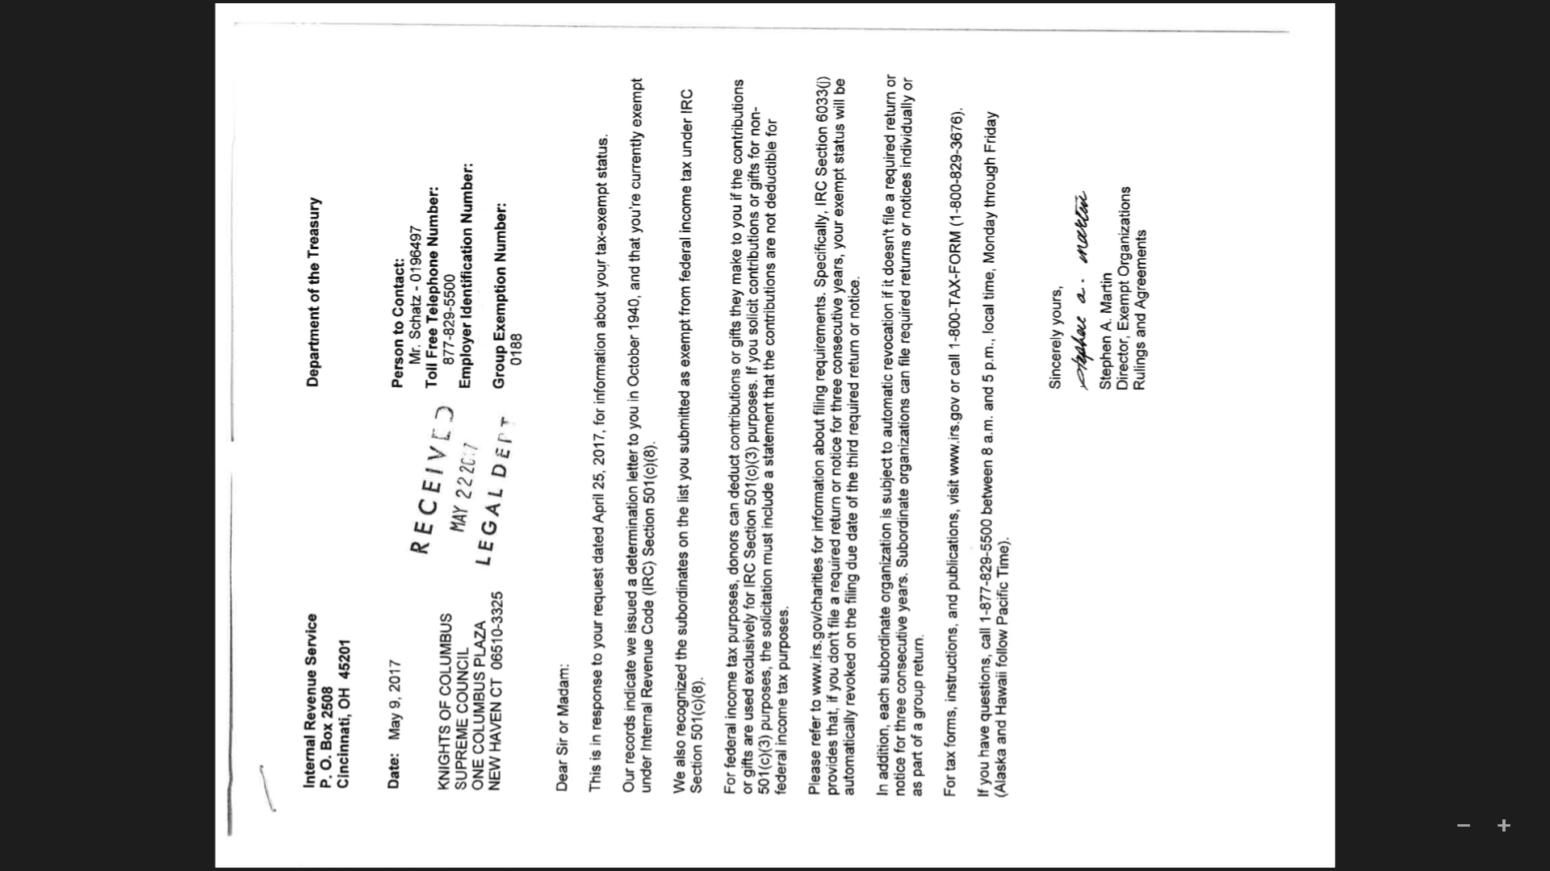
The original 501(C)(8) letter of 1940 on left and reaffirming letter in 2017 on right
Notes:
The original 501(C)(8) letter of 1940 on left and reaffirming letter in 2017 on right

Slide 80
501(C)(8) Letters
Where to find if needed ----
www.kofc.org
Sign In
Officers Desk Reference
Tax Issues
5. Section 501(c)(8) Knights of Columbus Group Exemption
Click HERE for the letter issued by the IRS to the Supreme Council in 1940, recognizing the federal income tax exemption for the Supreme Council and its subordinate units (the “group exemption”). Click HERE for the most recent letter from the IRS (2017) confirming this exemption.

Slide 81

DO NOT FAIL TO FILE A 990 TAX RETURN!!!
If you miss for 3 years in a row you will loose your Tax Exempt Status
It is a big pain in the a%$ to get it back..

Slide 82

Tax Records
Each assembly should maintain a tax file
See pages 12-13 of the Trustee training Manual for a detailed list
Copies in 2 or more locations
Federal law imposes a penalty of $20 per day, up to a maximum of $10,000, for incomplete or late filing.
Notes:
2 or more locations assembly file, FC, FPurser, Trustees

Slide 83
MAINTAINING TAX FILES pages 12-13
Each assembly should, at a minimum, maintain a tax file that includes copies of the following:
The organization's by-laws and all amendments
The organization's minutes for the last four years
IRS group exemption letters dated October 25, 1940 and October 15, 1998 (See Officers On Line, Support Materials, for Form 990 Information posted on the officers pages of the Supreme website, or contact the Supreme Advocate)
Forms 990, Forms 990-EZ, or Forms 990-N filed for the last 10 years
Notes:
MAINTAINING TAX FILES pages 12-13

Slide 84
MAINTAINING TAX FILES continued
The following forms filed by the organization in the last 10 years: Summary Form 1096 and Information Return for Income Payments (Form 1099), if any; Summary Form W-3 and Income Tax Withheld on Wages (Forms W-2), if any
The organization's application (Form SS-4) for its Employer Identification Number;
Tax returns for the last five years filed under the Federal Insurance Contribution Act and the Federal Unemployment Tax Act, if any
Any prior revenue agent examination reports
Form 990 and Form 990-EZ worksheets for those years, if any, in which gross receipts were less than the $50,000 threshold amount
Notes:
MAINTAINING TAX FILES continued

Slide 85
Retention committee
The Assembly Retention Committee consists of the Faithful Captain as chairman and the Trustees. They apply the principle of Fraternity to work with our brothers who find themselves out of communication with the rest of the membership. The task includes re-recruitment and all actions on non-payment of dues.
See pages 23-27 of the Trustee training Manual for concise directions & procedures

Slide 86
Retention committee continued
Is he a Life or Honorary Life member?
Is he disabled (FS to fill out form 1831- expires Dec.31 each year) FC can not file disability request.
Is he no longer a practical Catholic or is he a convicted felon (prior to initiation or since)?
Recommend a waiver of dues, when appropriate.
Confers with the Faithful Navigator and Faithful Comptroller about the situation of each member prior to Final Notice and to Suspend being sent.
Notes:
Yep! You’re it
read
Life or Honorary Life – check look at dates etc. Supreme should but…. (will generate automatically)
waivers expire each year on 12/31, and must be renewed during the 90-day period prior to expiration. Supreme Council will send a request for confirmation of
continued disability during October. Failure to complete and file the annual renewal form will terminate the council’s relief from payment.
Is he no longer a practical Catholic or is convicted felon (prior to initiation or since)? documentation
May recommend a waiver of dues, when appropriate. – Charity is the 1st duty – membership need not know

Slide 87
Retention committee
Take no shortcuts, use the Retention Worksheet
Your goal is to re-recruit this brother
Suspension means we have failed a brother knight
Notes:
Retention committee

Slide 88
Retention Committee Report
Notice on the right a place for date of contact and results of contact
NO SHORT CUTS
Notes:
RETENTION COMMITTEE REPORT

Slide 89
Miscellaneous – The Last Hurrah
The board of trustees should have a copy of the Trustee Training Manual.
An excellent resource (particularly pgs. 1-27)
MiKofC.org / resources officers training manuals / Trustee Training Manual (Posted 2015a)

Slide 90

The End of this Session
With wishes for the Beginning
of a Great Fraternal Year
Flame without Focus is a Wildfire
Notes:
Remember there are no small jobs only small men
Do you have any finial questions?
Thank You

Slide 91
THE ONLY DUMB QUESTION IS THE ONE YOU LEAVE WITH!!
Notes:
Questions

Slide 92
Thank You For Your Attention
Robert “Bob” Godi, FDM, FDD
R.godi@mikofc.org
989 737-1731
Best Wishes
Notes:
Thank You For Your Attention
Robert “Bob” Godi, FDM
R.godi@mikofc.org
989 737-1731

Slide 93
The FAITHFUL PURSERS AND FAITHFUL TRUSTEES may leave at this time. The balance of the training time will be devoted to MEMBER MANAGEMENT
for the FAITHFUL COMPTROLLERS.
THANK YOU
Notes:
PURSERS AND TRUSTEES MAY LEAVE

