Slide 1

Faithful Navigator Training
2019
Former Master George Walrath

Slide 2
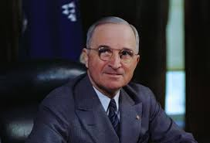
Harry S. Truman
the 38th President of the United States once said:
“The Buck Stops Here!”
As the CEO of your Assembly, President Truman’s Statement applies to you.
You are in Control of your Assemblies Programs and Finances and the success of your Assembly depends on How YOU do your job.
Today we will provide you some tools to help make you Successful.
BUT FIRST

Slide 3
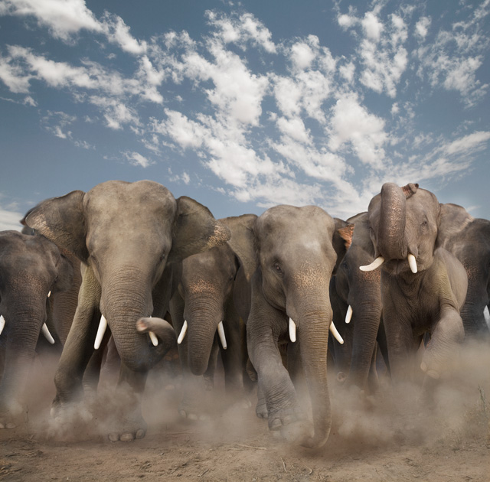
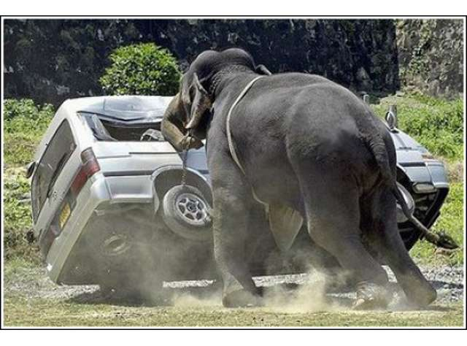
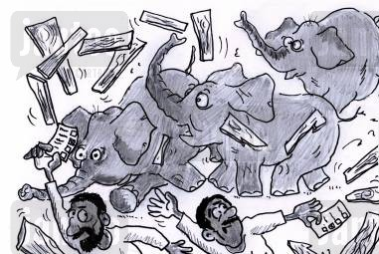
We interrupt our regularly scheduled Training as the Elephant has Arrived

Slide 4
!!A WORD OF CAUTION!!
The following slides contains Directives from our Supreme Master
They are not for discussion or debate
Neither I, your current Master, or our Vice Supreme Master issued these Directives, however we all (including you) are tasked with enforcing them.

Slide 5
From our Supreme Master:
The “Classic Regalia was retired effective July 1, 2019.
The PG113 pin is the only pin allowed to be worn on the new uniform.
We obey our Priests. Any member who is refused entry into Church because he is in the new uniform should obey the Priest. The District Master should be contacted. The District Master will make the determination if the Diocesan Bishop should be contacted to discuss this incident and the refusal of the Sacraments over an article of clothing.

Slide 6
From our Supreme Master:
The “Classic Regalia” cannot be worn at a Casket Watch. The deceased may wear his “Classic Regalia” if the family so wishes.
Social Baldric is worn over the tie.
Social baldric is never worn with the new uniform.
The colored beret patch can be procured by sending an email to either; suprememaster@kofc.org or patches@kofcuniform.com stating your name, membership #, your address for the patch to be mailed to, position held, and the color of the patch needed.

Slide 7
From our Supreme Master:
The beret is placed underneath the belt on the right side between the first belt loop and your pants pocket.
The 4th Degree Team members should all wear the same color business suit when the robes can no longer be used. Supreme is considering sometime in the future that all team members will be required to wear the new uniform, but not mandatory at this time.

Slide 8
From our Supreme Master:

Slide 9
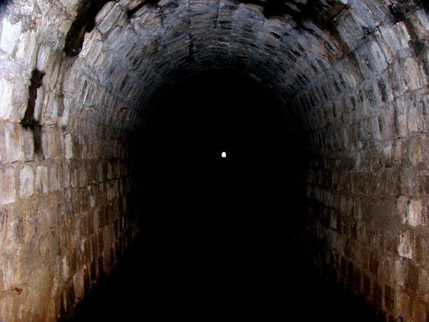
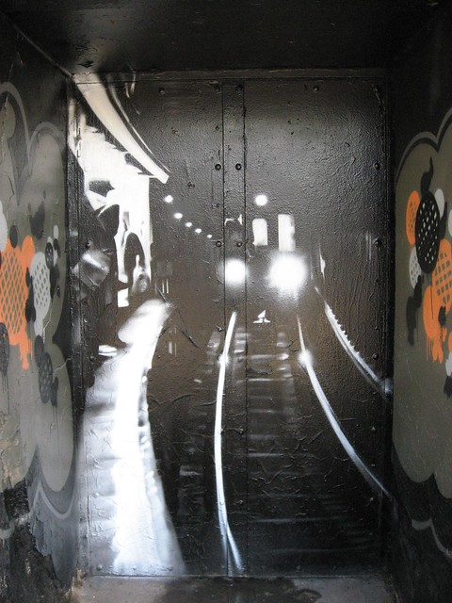

A Light at the end of the Tunnel?
OR

Slide 11
AND NOW
Back to our Regularly Scheduled Training

Slide 12

As Navigator Just what is your Job?
Laws and Rules of the Fourth Degree:
ARTICLE VIII ASSEMBLY OFFICERS AND DUTIES
Section 24. Duties of Assembly Officers.
Officers of the assembly should be present at all assembly meetings.
The Faithful Navigator shall:
Preside over all meetings of his assembly and shall enforce the rules and regulations of the assembly and the laws of the Order, and shall be Chairman of the Board of Trustees.
Appoint committees in addition to the permanent committees provided by the laws of his assembly as he may deem proper or as may be directed by the assembly, and he shall be a member ex-officio of all committees.
Countersign orders drawn and signed by the Faithful Comptroller for the payment of money when the same have been ordered by the assembly or approved by the Board of Trustees.
Countersign checks drawn and signed by the Faithful Purser.
Perform such other duties as the Supreme Assembly may impose.
Establish a Honor Guard pursuant to Article XII

Slide 13
Translate PLEASE!
As the Faithful Navigator your responsibilities include:
Follow and enforce the Laws and Rules of our Order and the Fourth Degree
Attend and lead all the meetings of your Assembly during your term following the Format as shown on Form 2066 “Responsibilities of the Faith Navigator”
Attend all District Meetings and Functions (at Official Functions Assembly authorized to cover your expenses)
All District Assembly Meetings
All District Exemplifications (Typically 2 per year)
The Hennepin Province Annual Meeting
All special meetings as called by the Master for the District

Slide 14
AND
Submit all reports to the Master for the District at least 20 days prior to the Supreme Due Date:
Form 186 Report of Assembly Officers Selected due to Supreme July 1st due to the Master by June 1st each year
Form 1315 Annual Assembly Audit due to Supreme by August 1st , due to the Master by July 10th each year
Form 1728A Annual Survey of Fraternal Activity Report due to Supreme by January 31st, due to the Master by January 1st
TBP-1 To be a Patriot Award Entry Form due to the Master by April 30th
Form 2863A RSVP/Plaque Application due to Supreme by June 30th, due to the Master by June 1st.
Form 2321 Civic Award Application Due to Supreme by June 30th due to the Master by June 1st

Slide 15
And And?
By countersigning all orders drawn for payment by the Assembly approve all expenditures of Assembly funds.
Sign ALL checks drawn on the Assembly Account(s) as a second signer. (All Checks MUST have two signatures.)
Establish a “Patriotic” themed Assembly General Program with the Faithful Captain
Publish at least quarterly an Assembly Newsletter to the membership copying the Master.
Complete and submit the Civic Award Annually
Arrange the Annual Assembly Officer Installations
Meet with supported Councils Grand Knights to determine how the Assembly and Assembly Color Corps may assist the Council

Slide 16
And More?
Attend Special Council Events as the Representative of the Master for the District, (Must inform MFD prior to event)
Appoint standing Committees to include:
  Membership (Faithful Admiral to chair)
  Retention (Faithful Comptroller typically chairs)
  Programs (Faithful Captain to chair)
Appoint an Assembly Friar (Requires permission from the Bishop)
Appoint a Council Liaison for each Council (Have each Liaison report at each Assembly Meeting)
Appoint a Honor Guard Commander and establish an Assembly Honor Guard. Schedule Certification of said Honor Guard with Master for the District.

Slide 17
And Still More!
Obtain and publish nominations for the officers of the Assembly in March and April for the following Fraternal Year.
Conduct an Election of Officers in May for the next Fraternal Year
Select a “Sir Knight of the Year” and submit your recommendation to the Master prior to June 1st
Attend all Major Degrees in Assembly Area
Other Activities as Assigned by the Master for the District
Leave your Assembly better than when you became the Navigator!

Slide 18
WOW,
That is a LOT I NEED HELP!!!
HELP
The Officers of the Assembly elected and appointed are there to help.
They are your Team,
You cannot do it all by yourself
You Must use your Officers if you are to be a success

Slide 19
What do the other Officers do?
ARTICLE VIII ASSEMBLY OFFICERS AND DUTIES
Section 24. Duties of Assembly Officers
Officers of the assembly should be present at all assembly meetings.
The Faithful Captain shall:
In the absence of the Faithful Navigator, perform the duties and exercise the powers of the Faithful Navigator.
It is also the responsibility of the Faithful Captain in order to assure a good attendance at meetings and other functions of the assembly
To take direct charge of all activities social and otherwise under that portion of the order of business known as the Good of the Order.

Slide 20

Say What?
The Captain is:
Your Back up, he is the Number 2 in Command – Your Shadow
The Program Director for the Assembly (the Keeper of the Assembly Calendar)
The Assembly Social Director
A member of your Membership, Recruiting and Retention Committees
Attends all District Meetings and Exemplifications
Attends Annual Father Hennepin Province Meeting

Slide 21

The Faithful Pilot:
Performs the Duties of the Warden in the Third Degree Council
Is responsible for the arrangement of the assembly chamber.
Has charge of all properties of the assembly except moneys and accounts and record books of the officers but including ceremonials.
Directs and is responsible for the activities of the Inner and Outer Sentinels.
Acquires and maintains a thorough knowledge of the policies, procedures, and protocols governing the National Flag in order to instruct the members of the Assembly, to ensure its proper care and display, and to serve as an authority on the flag for assigned councils

Slide 22
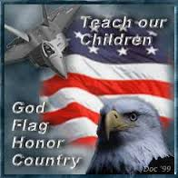
In Other Words:
The Pilot is:
The keeper of the physical property of the Assembly
The Assistant Program Director
The one who insures the Assembly Chambers are set up on time and correctly
The overseer of the Sentinels
The Flag Protocol Officer for the Assembly

Slide 23
The Faithful Comptroller is the CFO of the Assembly
The Faithful Comptroller shall:
Maintain the Assembly Membership and Financial Records.
Keep a roll of the members, their age, occupation and residence with the date of their initiation in the Fourth Degree.
Collect and receive all moneys due the assembly and all funds obtained from any source and transfer the same to the Faithful Purser and obtain a receipt from the Purser.
Keep account of the charges and receipts of each member in accordance with the standard accounting system provided by the Supreme Council.
Make available to the Faithful Navigator and Board of Trustees at least once a year, all membership records and financial accounts for the purpose of preparing the official audit.

Slide 24
AND …
Draw all orders on the Faithful Purser when so ordered by the assembly, the Board of Trustees or the Faithful Navigator for payment of all claims of demands against his assembly which orders shall be signed by him and countersigned by the Faithful Navigator.
Issue to each member, not indebted to the assembly or at the direction of the Faithful Navigator, a Fourth Degree Membership Card duly signed and attested but such card shall be issued only if the member produces a Third Degree Membership Card showing his good standing in his Council.
Notify the District Master of the names of all candidates from his assembly awaiting initiation and give written notice to the Financial Secretary of the council to which such member belongs that the member has been accepted as a Fourth Degree member of the assembly.

Slide 25
Still More…
Notify promptly the Supreme Secretary, Master and Financial Secretary of the council concerned of the death, transfer, withdrawal, suspension, expulsion, reinstatement, readmission or transfer of members on the forms provided by the Supreme Assembly.
Be the custodian of the seal of the assembly and affix same to all proper papers.
Perform all other acts required by the laws of the Fourth Degree, the Order and the rules of the Board of Directors.
Performs all other duties assigned by the Master for the District
Performs all other duties as assigned by the Faithful Navigator

Slide 26
IN ADDITION
The Faithful Comptroller:
Is a member of the Membership and Retention Committee
Maintains the Assembly records on the Supreme Member Management Web Site
Attends District Meetings and Exemplifications
Attends Annual Father Hennepin Province Meeting

Slide 27
The Faithful Purser shall:
Be the custodian of all funds of the assembly obtained from any source by or through any person or persons, acting for or in the name of the assembly or under its direction or authority.
At each meeting of the assembly, receive from the Faithful Comptroller all moneys whatever received by said Comptroller at such meeting, or between meetings, and shall give a written receipt to such Comptroller thereof, specifying the fund to which the same shall be credited. The moneys so received by such Purser shall be forthwith deposited by said Purser to the credit of the assembly in an approved bank or other secure institution of deposit, subject to approval of the Board of Trustees or majority vote of the assembly. He shall obtain vouchers or certificates of deposit thereof, and report the same at the next regular meeting of the assembly.
Pay all orders drawn on him which are signed by the Faithful Comptroller and counter-signed by the Faithful Navigator. All such orders shall have the approval of the Board of Trustees, except demands of the Supreme Council, initiation fees due the District Master, the regular and usual stated payments of the assembly and payments authorized by the assembly as provided in Section 24(k).

Slide 28
More for the Purser to do:
Keep separate accounts of the moneys placed in his hands by his assembly or the officers thereof and be ready at all times to plainly show the amount of moneys in the funds of the assembly, the dates of receiving and disbursing same; such accounts to be kept in books furnished by the Supreme Secretary to said Purser at the expense of the assembly.
Make available the Board of Trustees his books and records for the purpose of preparing the annual audit.

Slide 29
In Other Words: The Faithful Purser:
Is the Assembly Banker, the keeper of the Assembly’s funds.
He deposits all funds received from the Comptroller, and dispenses those funds with Assembly approval, as cosigned by the Faithful Navigator
He keeps an accurate record in books supplied by Supreme at the Assembly’s expense of all transactions
He provides such records to the Assembly Trustees for the annual Audit
He makes a monthly report as to the Assembly’s funds at the Monthly Assembly Meeting

Slide 30
The Faithful Scribe shall:
Keep a true record of the doings of his assembly upon books approved by the Board of Directors and furnished by the Supreme Secretary at the expense of the assembly.
Conduct all correspondence of the assembly and perform such other duties as the assembly or the Order may direct.
In other words - The Faithful Scribe:
Takes notes at all Assembly Functions, and makes and keeps a permanent hard copy record of the proceedings of the Assembly in the Official Fourth Degree Minute Book from Supreme form # 437E.
Writes correspondence for the Assembly, to include Invites, Thank-you letters/cards, condolences, and alike.
Typically is the Newsletter editor
Is the keeper of Supreme forms and certificates

Slide 31

The Faithful Sentinels shall:
The Faithful Inner and Outer Sentinels are specifically entrusted with the responsibility of seeing that all in attendance at an assembly function are in possession of both a Third and Fourth Degree Membership Card and so report to the Faithful Pilot.
They shall perform such other duties as may be imposed upon them by the Faithful Pilot.
Secure the entrances to the chamber during the transaction of the business of the Assembly

Slide 32
The Faithful Admiral shall:
Preside at all meetings of his assembly in the absence of the Faithful Navigator and Faithful Captain.
In the absence of the Faithful Friar, perform his duties at assembly meetings.
Perform any other duties assigned to him by the Faithful Navigator.
The Faithful Admiral is also
Is the immediate Past Faithful Navigator (MUST have served as a Faithful Navigator)
Is the senior advisor to the Faithful Navigator
Is the Membership Director for the Assembly

Slide 33
The Board of Trustees
The Board of Trustees shall consist of the Faithful Navigator and three members to be elected by the assembly.
The Faithful Navigator shall be its Chairman.
At the first election of a new assembly three Trustees shall be elected; one to hold office for
one year or until the second next regular election, one for two years or until the second next regular election; and the other for three years or until the third next regular election; as determined by lot among themselves. Thereafter, at each succeeding election one Trustee shall be chosen for a term of three years.
The Trustees shall have supervision of all the financial business of the assembly and their approval shall be necessary for the payment of all moneys, except demands of the Supreme Council, initiation fees due the District Master, regular and usual payments of the assembly, and payments authorized by the assembly after resolution and vote in accordance with Section 24(k).

Slide 34
More for the Board to do…
They shall audit the accounts of the Comptroller and Purser annually as of June 30 and report thereon to their assembly, the Supreme Secretary, Supreme Master, Vice Supreme Master, and Master upon blanks approved by the Board of Directors and furnished by the Supreme Assembly.
They shall see that the Faithful Comptroller and Faithful Purser give proper bonds running to the Knights of Columbus in trust for their particular assembly and in amounts fixed by said Trustees, and they shall be the custodians of such bonds. But in case the Supreme Board of Directors shall bond such officers, the Trustees shall be charged only with fixing the amount of such bonds in excess of the amount provided for by said Board of Directors and in such case they shall have evidence that said officers shall have been bonded in such excess amount.
They shall perform such other duties as their assembly or the District Master or Vice Supreme Master or the officers of the Order may direct.

Slide 35

In other words The Board of Trustees:
Consists of a Three year Trustee, who serves 3 (6) years, a Two year Trustee, who serves 2 (4) years a One year Trustee who serves 1 (2) years and the serving Faithful Navigator.
The Board of Trustees is typically made up of Past Faithful Navigators
The Board of Trustees reviews all financial transactions of the Assembly, reviews all expenditures with the exception of Budgeted Items, requirements of the Supreme Council, initiation fees due the District Master, and funds taken by the Faithful Navigator under $500.01 for charitable acts to Brother Sir Knights and makes recommendations to the Faithful Navigator and the Assembly
They perform and sign the Annual Assembly Audit

Slide 36


The Appointed Positions:
The Council Liaison
The Faithful Friar
The Honor Guard Commander

Slide 37
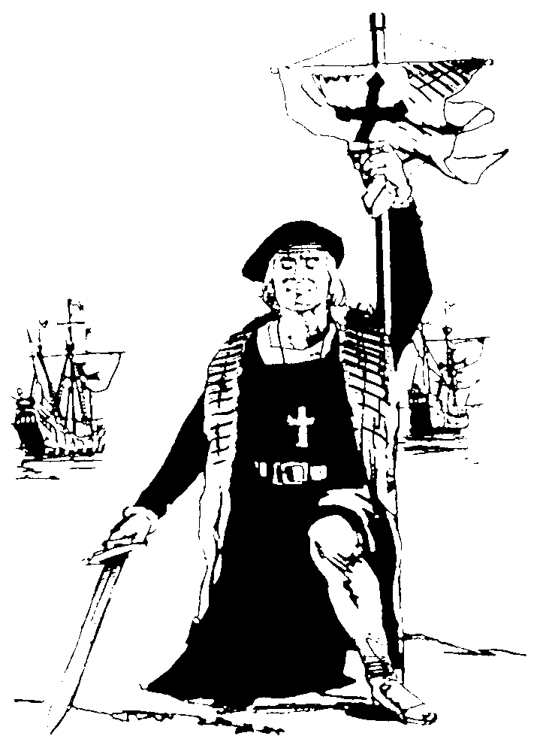

The Council Liaison
Attend all Council Meetings and make a report on the activities of Fourth Degree
Attend all Assembly Meetings and Make a report on the activities of your Third Degree Council
Organize and conduct Fourth Degree recruitment activities at your assigned Council
Provide a copy of the Council Roster (obtained from the Financial Secretary) to the Assembly Comptroller and Membership Director.

Slide 38
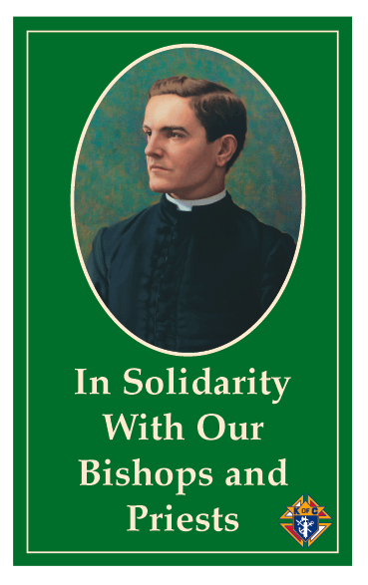
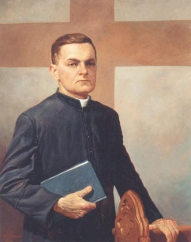
The Faithful Friar
Your Faithful Friar is your confidant, and confessor
Writes a monthly article for your newsletter
Makes determination of a Brother’s standing in the Church
Attends Business and Officer meetings as his schedule will allow
Provides Spiritual Guidance for the Assembly

Slide 39
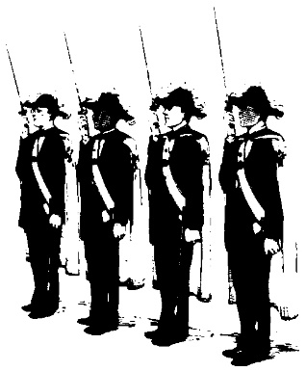
The Honor Guard Commander
Recruits and Trains the Assembly Honor Guard
Commands the Assembly Honor Guard
Maintains a Roster of the members of the Assembly CC
Maintains a record of Assignments and who attended
Maintains the Honor Guard Calendar
On the behalf of the FN accepts Honor Guard assignments
Meets with local Parish Pastors on a routine basis to review CC procedures and to determine what the Pastor wishes are.
Meets with the Celebrant before EVERY Honor Guard event in a Church or where the ceremonies will be presided over by a member of the Clergy
Meets with local Funeral homes to insure they are contacted when a Brother Knight or Lady dies.

Slide 40
That is YOUR Leadership Team
OK so now we have a team in place, what do we do?
Set Goals
a. Program
b. Membership
c. Financial
2. Develop a plan to Accomplish those Goals
3. Leave the Assembly in better shape

Slide 41
Set Your Assembly Goals
In June/July Officers meet to establish Assembly Goals and Calendar for the Fraternal Year
Faith Navigator Sets the Meeting Times, Dates, and Location(s)- Plans the Installation of Officers and sets a date for the Audit (Due August 1st)
Faithful Captain provides suggested Patriotic Activities
Honor Guard Commander schedules Practices
Membership Goal is set by Supreme as 10% of the July 1st Assembly Membership

Slide 42
DO NOT FORGET YOUR LADIES
Our Ladies are a part of the Fourth Degree and as such are a part of your Assembly. As you are a part of the District Assembly, so is your Lady.
The Ladies of your Assembly should feel as though they are a significant part of your Assembly and your Assembly Programs, this goes especially for the widows of fallen Sir Knights. Every Assembly should have a Ladies program as does the District and as the Faithful Navigator you need to encourage the active participation of the Ladies of your Assembly.
Our Ladies add a softer, kinder, and gentler aspect to all we are and do as Sir Knights. They are also extremely strong assets in recruiting. We all know that if a Third Degree Brother’s wife wants him to complete his journey, it shall happen. Remember to use this great asset and include your Ladies in your recruiting program.
If your Assembly does not have a Ladies Program, let this be a part of you legacy, as you will leave a stronger Assembly if you establish a viable Ladies program.

Slide 43
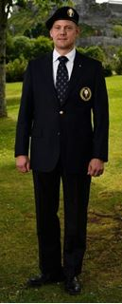
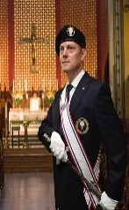
The Honor Guard
The Fourth Degree is the “visible arm” of our Order and it is our Honor Guard that give us that visibility. As the Faithful Navigator it is your duty to insure your Assembly’s Honor Guard is dressed properly, and is well trained.
Your diligence in selecting your Honor Guard Commander will weigh heavily on the success of the Honor Guard.
Always inspect your Honor Guard prior to any function to insure everything is in ship shape and it shows that you care how they look.
Uniformity is a key to success, follow the procedures in the Fourth Degree Drill Manual, and as shown in the Color Corps Training guide “Boot Camp with a Sword” as follows.
Remembering the old time commercial for razor blades:
Look Sharp – Feel Sharp – Be Sharp
As the Ultimate leader of your Assembly you must have a good knowledge of the Color Corps Drill Manual and be able to demonstrate your Knowledge as a member of the Honor Guard. It is strongly recommended that you with your Honor Guard Commander.
Remember that during a Honor Guard event you are only second in Command as the Honor Guard Commander is in Charge and you are to follow his lead. (Therefore as you choose your Honor Guard Commander choose wisely.)

Slide 44
Membership Recruitment
Membership is the lifeblood of our Order
If we are not Growing we are DIEING
We need to Recruit younger Brothers to be Sir Knights and Honor Guard Members
The following Slides contain some tips on Membership Recruitment:

Slide 45
Recruiting Tips
Recruiting is a 24 hour, 7 day, 12 Month, 365 Day Continuous process.
Collect $70.00 when you get the Form 4, explaining that additional funds will be required depending on the program set by the Master for the District
Have Admiral report at each meeting:
  Number of Candidates
  Current Program/Drive

Slide 46
The Form 4
The Form 4 MUST be filled out Completely and Correctly to be processed by Supreme
Must have the
Membership Number
Be signed by
Council Financial Secretary
Faithful Navigator
Faithful Comptroller

Slide 47
Recruiting Tools

Slide 48

The 24hour Sir Knight

Slide 49
The Candidate Letter

Slide 50


The Forms (Ugh!)
A wise man once said the job is not done until the paperwork is done; this is never more true than in the role of the Faithful Navigator, as you are responsible to insure all your Assembly’s paperwork is done, done properly and ON TIME.
Your performance as a Faithful Navigator as determined by those higher in rank in our Order is basically determined by two factors, membership growth, and the timeliness and accuracy of your paperwork.
More and more the traditional forms are being replaced by the Member Management program and other online tools supplied by Supreme. Most forms may now be completed on line or in the case of the Form 186 through the Member Management program. However, the Assembly Audit form and To Be a Patriot Form still may only be completed by hand and submitted through the US Postal Service mail.
All forms submitted to the State Council or Supreme must be also sent to the Master for the District and the Vice Supreme Master.

Slide 51

More Information on Forms
The Forms the Assembly must submit this Fraternal year are:
2019
July 15 Assembly Annual Audit Report due to Master
August 1 Assembly Annual Audit Report due to Supreme
September 1 1. Registration forms for Provincial
2. Provincial in Memorial Form
November 30 Send out Dues Notices and individual Fraternal Survey
2020
January 15 Fraternal Survey Due to Master
January 31 Fraternal Survey Due at Supreme
May 1 To be a Patriot Award Packets due to Master
June 1 1. Form 186 Report of Assembly Officers Due to Master
2. Key Officers Report Due to Master
3. Civic Award due to Master
4. Sir Knight of the Year Due to Master
5. Newsletter of the Year Due to Master
If you have any questions as to the Forms please call the Master for the District.

Slide 52
Chain of Command
Board of Directors of the Knights of Columbus
Supreme Knight
Supreme Master
Vice Supreme Master
Master for the District
Faithful Navigator
Sir Knights
Always Follow the Chain of Command
NEVER Call the Supreme Fourth Degree Office unless you have first called the Master for the District, and Vice Supreme Master!!!!

Slide 53
Final Thoughts
Everything you have seen today is on the Provincial Website as Navigator Training 2019
www.hennepinprovincial.org
As the Faithful Navigator you will leave your mark upon your Assembly, it is up to you what that mark will be.
Work Hard and Have Fun

Slide 54

??Any Questions??

